Slide 1


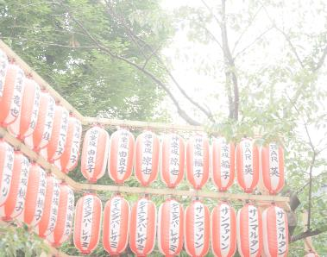

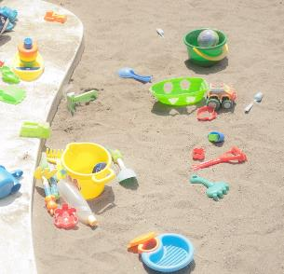
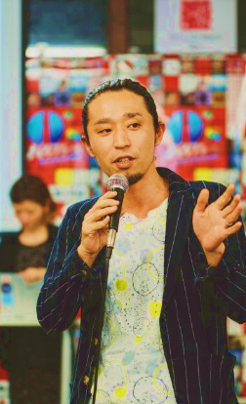
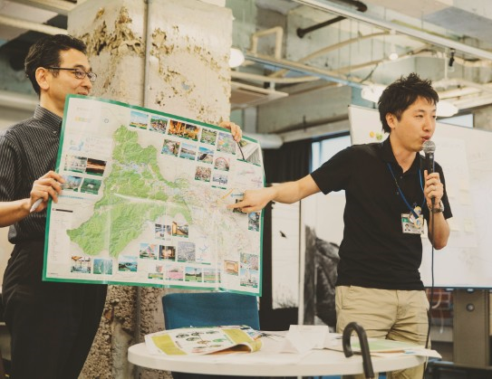
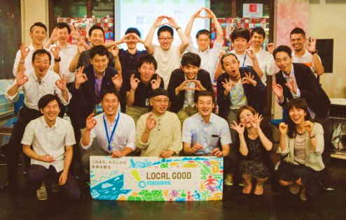

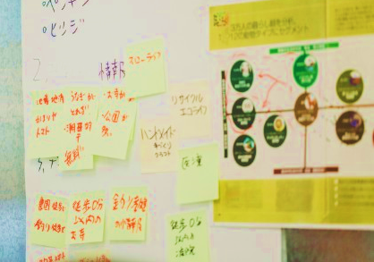
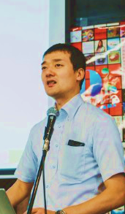
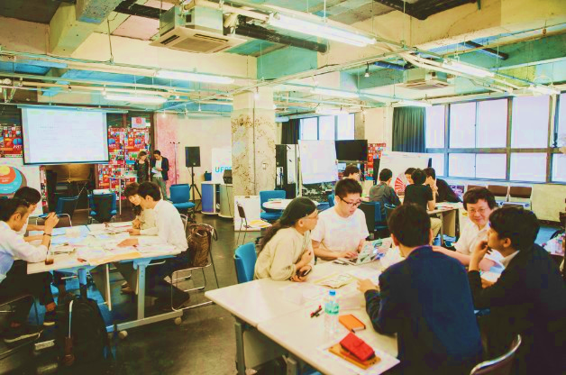
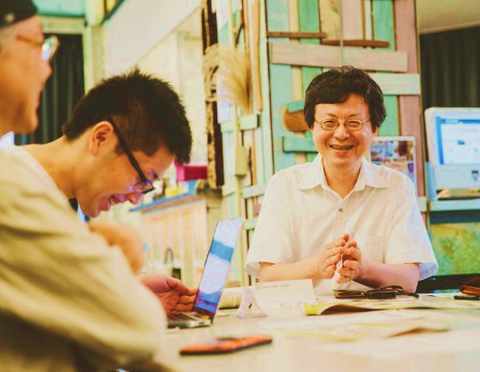
a joint project between the Ministry of Internal Affairs
and Communications (MIC) and Recruit Communications
Creating indicators for you to choose a town that rightly matches your life style
̶Project to Improve Charms of Communities̶

Slide 2
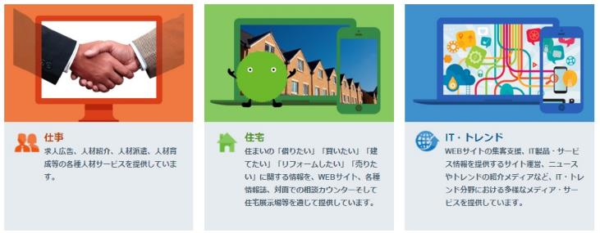
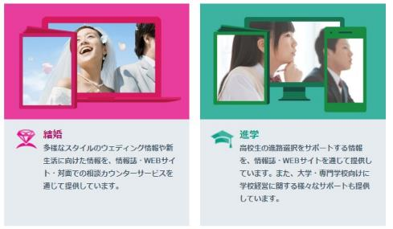
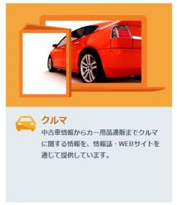
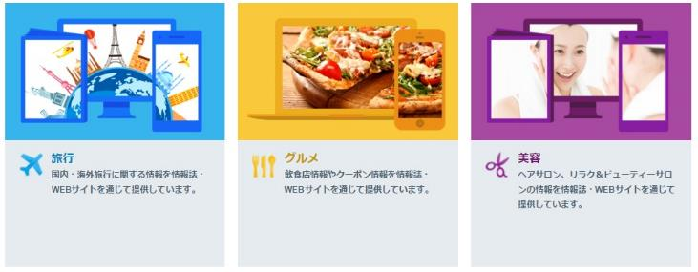
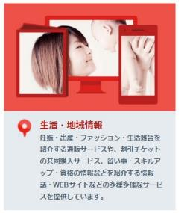
Introduction about Recruit Communications
We are engaged in various kinds of solution services, including customer-attraction solutions, Web marketing, media production/
distribution/advertisement, and customer services for clients of Recruit Group companies. The characteristics of our company is that we are able to perform cross-sectional solutions for a wide range of issues, from job-related matters to residential problems.

Slide 3
Introduction about Recruit Communications
Recruit Communications
↓
What is “communication”?
↓
If this means a conduct to convey some words
or ideas to someone, what do we convey?
↓
To convey “charms → experience”
↓
We need to convey not a “material”,
but a “thing” that was gained by the “material”.
We convey not a “flower”, but the “joy” that is brought about by the floor, and not a “residence” but the “joy of life” realized in there.
↓
Recruit Communications is a company to create relationships between “human beings” and “things”, as well as those among “human beings”.

Slide 4
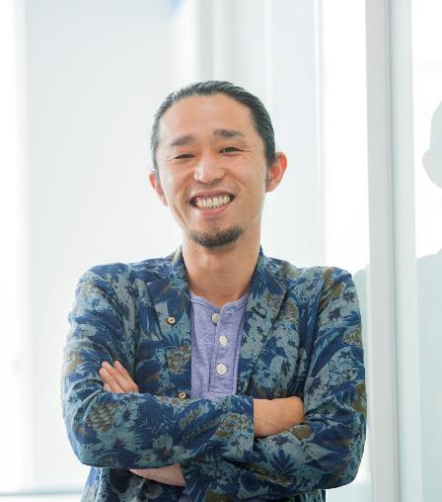
Profile
竹内さんの写真入る
◆2012
Chosen as the MVP of entire Recruit Communications
◆2014
Received the Recruit Group All-company Award
◆2014
Chosen as the MVP of entire Recruit Communications
◆2014
Received the Grand Prix in the Recruit New Business Contest
Developed “Program to Create Regional Community Relations” (a program to transform unknown towns to towns in which you want to live).
Working as a lecturer for advertisement-meeting seminars in the field of promoting communities.
Project owner of the “Project to Improve Charms of Communities” (a public-private joint project between the Ministry of Internal Affairs and Communications (MIC) and Recruit Communications)
Mr. Seiichi TAKEUCHI
Communication Producer, Cross-sectional Business Solution Group, 2nd Solution Bureau
and concurrently,
General Manager, Bridal Creation Department

Slide 5
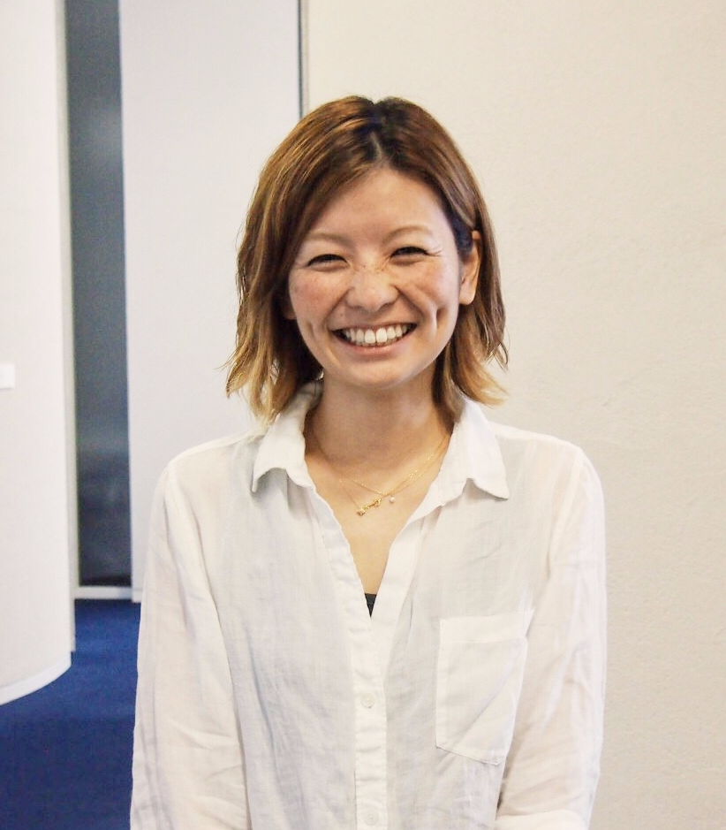
Profile
竹内さんの写真入る
◆2012
Awarded the Gold Prize at Travel-field Creative Contest organized by Recruit Communications
◆2013
Chosen as the MVP in the field of residence, Recruit Communications
◆2014
Chosen as the MVP in the field of residence, Recruit Communications
Taking charge of promoting sales of newly constructed condominiums of major developers, urbanization projects of municipalities, and utilization of vacant houses within the scope of SUUMO.
Conducting interviews with more than 100 people every year.
Project Leader of the “Project to Improve Charms of Communities” (a public-private joint project between MIC and Recruit Communications)
Ms. Junko ENOMOTO
Communication Producer, Cross-sectional Business Solution Group, 2nd Solution Bureau
and concurrently,
Planner, Residence Creation Department

Slide 6
Introduction
We know this is sudden, but we have a question to you.
When you move to a new town, how do you find it?
Based on the traffic access, price,
floor-plan of the condominium, ---?
It is possible that you are making a decision based on indicators that have not much to do with the image of your desired life.

Slide 7
Introduction
We know this is sudden, but we have a question to you.
When you move to a new town, how do you find it?
Based on the traffic access, price,
floor-plan of the condominium, ---?
It is possible that you are making a decision based on indicators that have not much to do with the image of your desired life.
We wish you could find a residence that
suits your own life style!

Slide 8
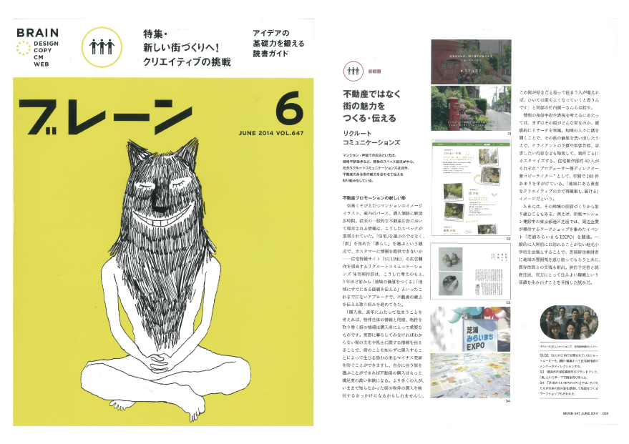
Importance of life style
The most important thing is the manner by
which the charms of the life in the community are conveyed.
About 60% of buyers of newly constructed condominiums are going to live
in a community in which they have never lived before.

Slide 9
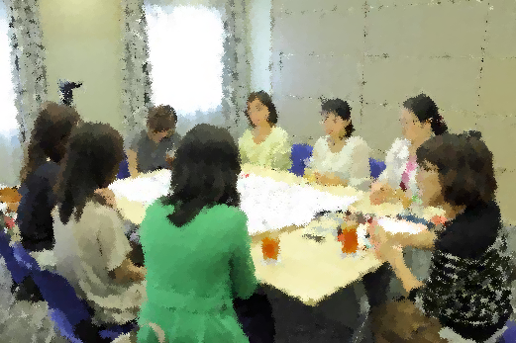
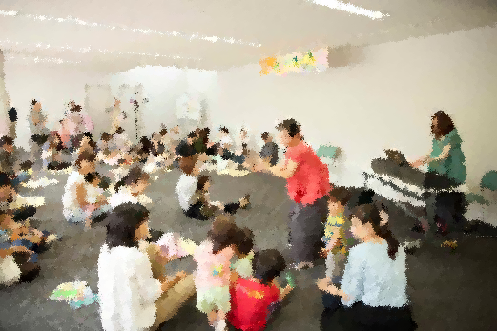
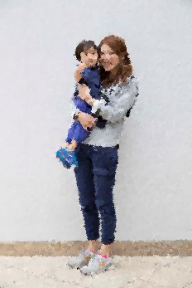
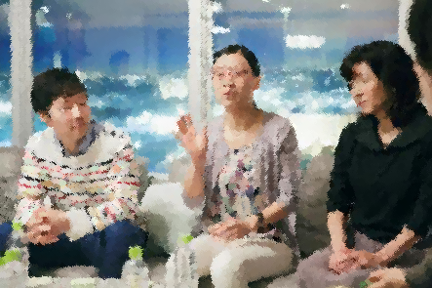
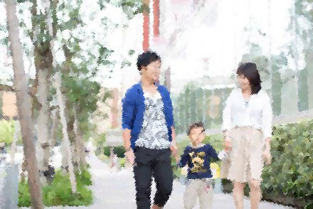
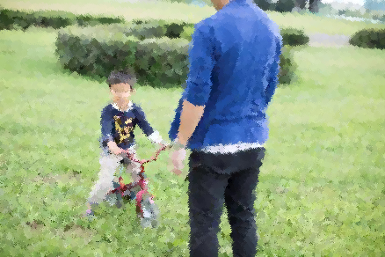
What we learned from interviews with residents.
We have come to see the characteristic of
life style unique to each community.
For instance, in this or in that community, circle activities by fathers and mothers are quite active; local festivals are held somewhere every Sunday; many children are exchanging greetings on the way; three baby buggies can pass through sidewalks side-by-side at a time because they are wide enough; no one blames even if someone kicks a ball hard; there are parks where you can play freely to your heart’s content; and so forth.
Notes:
街ごとにライフスタイルの特色がある

Slide 10
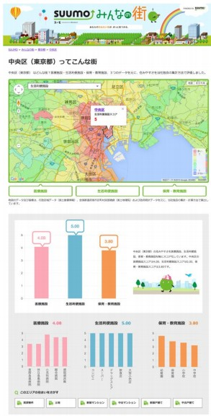
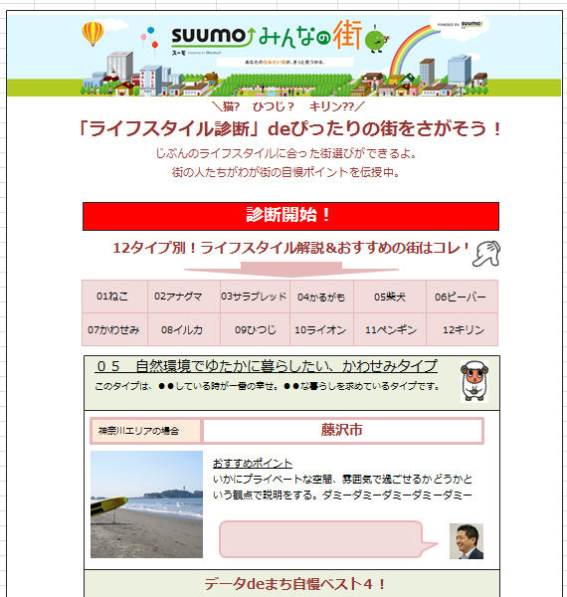

What we wish to realize.
We wish to realize a good method to find the most suitable town for you to live in that correspond to your desired life style, by use of various data.
For you who chose your desired life style, we introduce towns which are convenient for you to live in.
You will certainly develop an interest in the towns that have been unknown to you.
Notes:
つくります。
自分に近いライフスタイルを選択すると暮らしやすい街が紹介されるページです。

Slide 11
Issues when connecting life style with data
1. Translation of life style
How can we translate organic information (i.e. life style) by using inorganic data?
Data acquisition
How can we acquire inorganic data in order to express organic information (life style)?

Slide 12
Project to
improve
charms of communities,
by use of data
Notes:
２つの課題を解決するために発足→「都市の魅力向上プロジェクト」

Slide 13
Players of public-private collaborative work
Promoter: MIC
Desirous of promoting utilization of open data
Justifying
power
Good for everyone
Public-private collaborative open innovation
Public data
in possession
Driving force
Planning/editing power
Creative power
Data-carrying place
Planning: Recruit Communications
We want to increase the number of incoming people, by developing services that correspond to the needs of customers choosing their places to live.
Cooperation: Municipalities
Although access to the center of big cities may not be good, we want to increase the number of people to live, by appealing the charms of the life in our municipalities.

Slide 14
Common objectives for all players
Present
To live in a town that is already known to you because you have connections there or because the place is popular among people.
Ideal
To live in a town in which you want to live because the town matches your life style and you will become happier there.

Slide 15
Common objectives for all players
Present
To live in a town that is already known to you because you have connections there or because the place is popular among people.
To this end, we create indicators for you to choose a town that rightly matches your life style.
Ideal
To live in a town in which you want to live because the town matches your life style and you will become happier there.

Slide 16
Common objectives for all players
Present
To live in a town that is already known to you because you have connections there or because the place is popular among people.
We gather ideas from MIC, municipalities and Recruit.
Ideal
To live in a town in which you want to live because the town matches your life style and you will become happier there.

Slide 17
Issues when connecting life style with data
1. Translation of life style
How can we translate organic information (i.e. life style) by using inorganic data?
Data acquisition
How can we acquire inorganic data in order to express organic information (life style)?

Slide 18
Issues when connecting life style with data
1. Translation of life style
How can we translate organic information (i.e. life style) by using inorganic data?
What is life style?

Slide 19
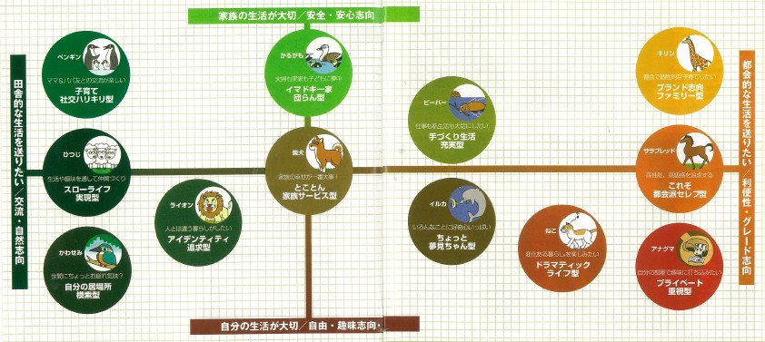
Solution to the issue of “Translation of life style”
Definition of life style
Definition as to “what type of people will become happy when living in what kind of town”, referring to 12 types of life styles created based on answers to questionnaires.

Slide 20
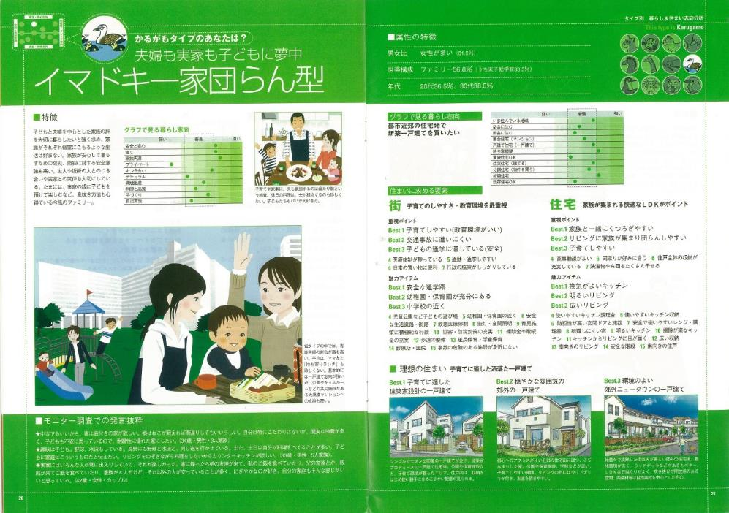
Solution to the issue of “Translation of life style
Important points differ from type to type
In the case of “spot-billed duck type = nowadays happy family get-together type”, for example,
You will come to know the charms of town from the viewpoint of “What kind of information will induce you to move to this town”.
What you want for the town
Safety, security, whether educational facilities are in the vicinity?, etc.
Importance is placed on the child care environment.
You also consider it important to socialize with your friends and neighbors.
Streets are paved, the width of roads is wide enough, sidewalks and roadways are separated.
Many elementary and junior high schools are in the community.
Many festivals are held and people in the community are intimate with each other.

Slide 21
Solution to the issue of “Translation of life style”
To translate the charms of life
by use of data
By defining your typical type of life style, you will find useful data.
Definition of
the Charms of Town
(Example)
Translation
by use of Data
(Example)
Average number of living years
Long-term dwelling
Active mutual association among residents
Number of town-hall events/festivals
Love for the community
Number of NPOs
Intimate atmosphere of downtown
Number of stores
Spirit of mutual aid
Rate of participation in fire brigades

Slide 22
Solution to the issue of “Translation of life style”
MIC
Desirous of promoting utilization of open data
Justifying
power
When data are provided by municipalities, we are ready to utilize them.
Good for everyone
Public-private collaborative open innovation
Public data
in possession
Driving force
Planning/editing power
Creative power
Data-carrying place
Municipalities
Although access to the center of big cities may not be good, we want to increase the number of people to live, by appealing the charms of the life in our municipalities.
Recruit Communications
We want to increase the number of incoming people, by developing services that correspond to the needs of customers choosing their places to live.

Slide 23
Issues when connecting life style with data
1. Translation of life style
How can we translate organic information (i.e. life style) by using inorganic data?
Data acquisition
How can we acquire inorganic data in order to express organic information (life style)?

Slide 24
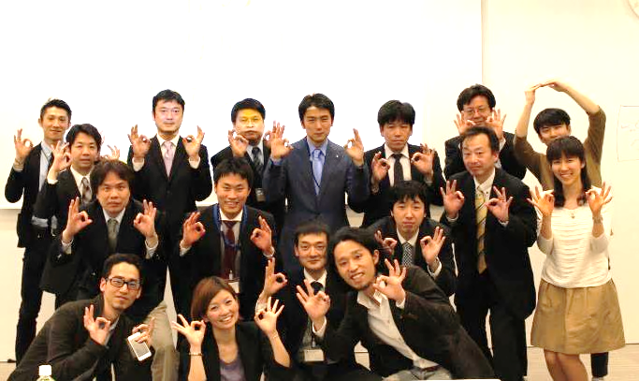
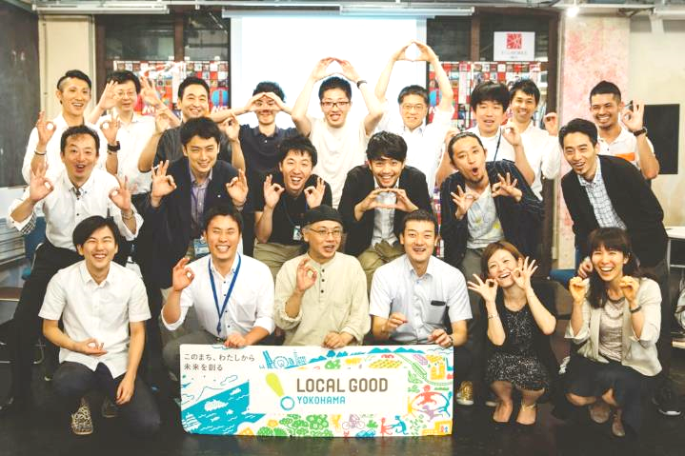
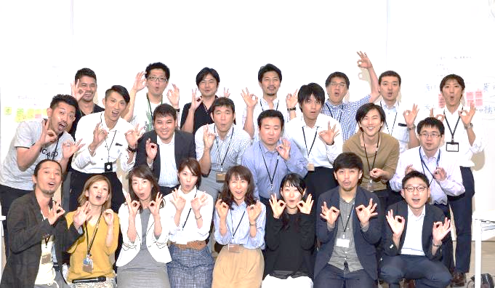
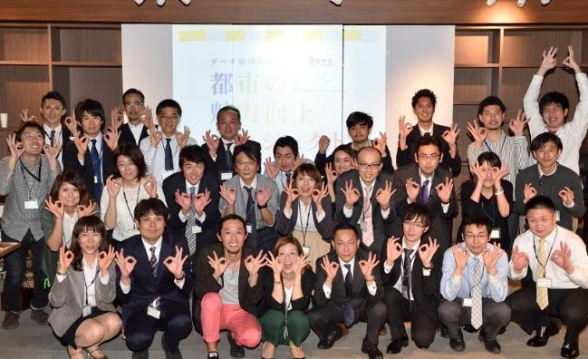
Solution to the issue of “Data acquisition”
Public-private cooperative workshops
A cumulative total of 97 from MIC, communities,
VLED and private companies took part in our workshops

Slide 25
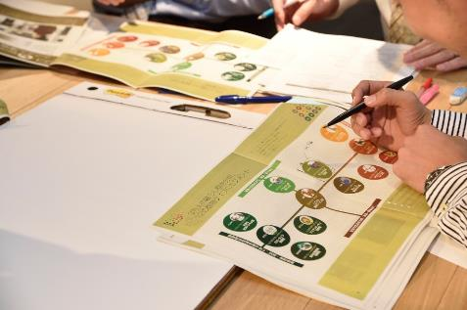
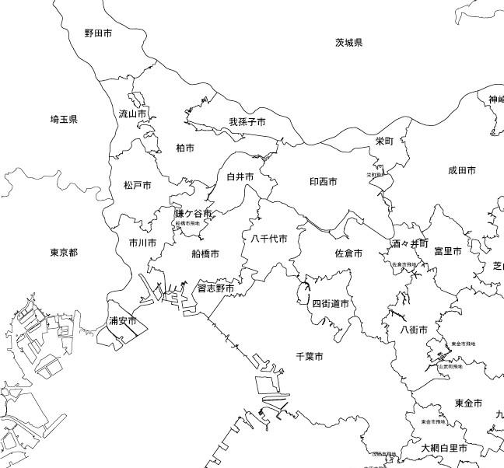
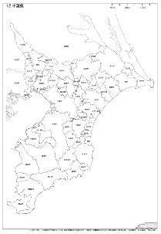
Solution to the issue of “Data acquisition”
１
To define “Customers”
What type of people with a specific type of life style will become happy when living in what type of town?
We define the type of life style suitable to individual customers.
キリン
イルカ
ねこ
かる
がも
ペン
ギン
柴犬
サラブレッド
例）情報感度が高いので…
IT教育学校数
のデータが響く
ひつじ
※あくまでもイメージであり、仮置きしているだけです。

Slide 26
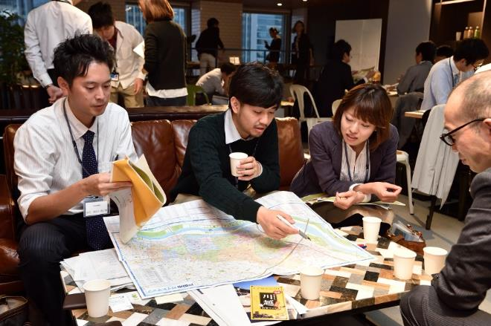

Solution to the issue of “Data acquisition”
To identify the charms of life in individual towns.
What type of people with a specific type of life style will become happy when living in what type of town?
We define the type of life style suitable to individual customers.
２
Definition of
the Charms of Town
(Example)
Long-term dwelling
Active mutual association among residents
Love for the community
Intimate atmosphere of downtown
Spirit of mutual aid

Slide 27
Solution to the issue of “Data acquisition”
To define the data
that will prove the charms.
What do we translate with data?
To Define indicators by examining various ideas,
mainly focusing on data in the possession of municipalities
３
Definition of
the Charms of Town
(Example)
Translation
by use of Data
(Example)
Average number of living years
Long-term dwelling
Active mutual association among residents
Number of town-hall events/festivals
Love for the community
Number of NPOs
Intimate atmosphere of downtown
Number of stores
Spirit of mutual aid
Rate of participation in fire brigades

Slide 28
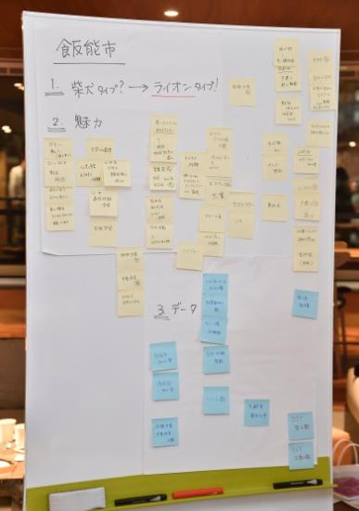
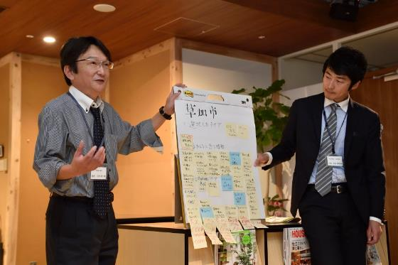
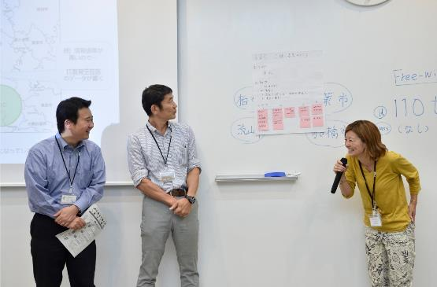
Solution to the issue of “Data acquisition”
４
Each municipality team makes a presentation about the charms of its community.
Presentation of the flow of ① ~ ③
To present charms and data that will induce
the inflow of people into own communities.

Slide 29
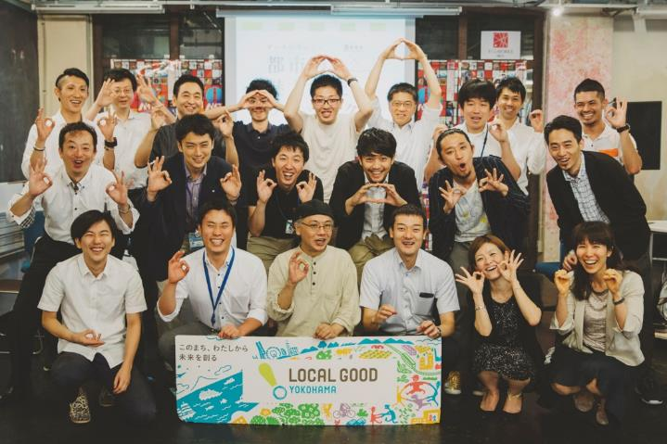
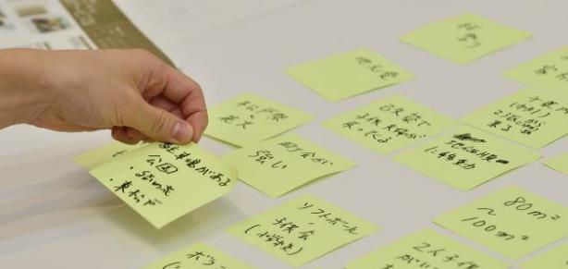

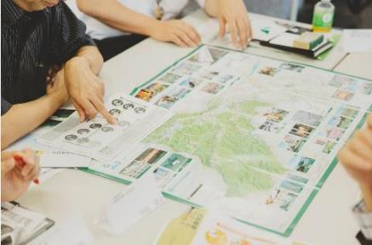
Solution to the issue of “Data acquisition”
Through workshops arranged for people from MIC, municipalities, VLED and Recruit without regard to their roles and titles in respective organizations,
they have become true persons in charge,
by putting different ideas on the table.

Slide 30
Voices of participants from municipalities
Before participation
We wonder for what purpose data will serve.
We don’t like that data are used in a peculiar way.
They surely seem to be useful.
We have a mountain of hidden treasure!
Through brainstorming, people from municipalities in the possession of data have discovered the significance of data.
After participation

Slide 31
Activities towards the future
Present
To live in a town that is already known to you because you have connections there or because the place is popular among people.
Ideal
To live in a town in which you want to live because the town matches your life style and you will become happier there.

Slide 32
Activities towards the future
Present
To live in a town that is already known to you because you have connections there or because the place is popular among people.
Elaboration of indicators
Subject Areas
Goal
STEP 1
(FY 2015)
Kanagawa, Saitama, Chiba
WS of 15 municipalities
Individual data
for indicators
Release of articles based on data
STEP 2
(FY 2016)
Metropolitan area, Kansai area:
Increased coverage
Individual data
for indicators
Release of articles based on data
STEP 3
(FY 2017)
Nationwide
Parallel data for
indicators
Creation of infrastructure
Ideal
To live in a town in which you want to live because the town matches your life style and you will become happier there.

Slide 33
Charms of your community will increase
① Definition of customers
What type of people do you want to induce to your community as residents?
④ Looking back → Increased charms of the community
You want to make your community more charming so as to be selected by your desired customers.
② Definition of town
What are charms of the community for that type of people?
Cycle whereby specific communities are selected by customers.
③ Determination of indicators
What are the points your customers think charming?

Slide 34
Charms of your community will increase
Workshop
① Definition of customers
What type of people do you want to induce to your community as residents?
④ Looking back → Increased charms of the community
You want to make your community more charming so as to be selected by your desired customers.
② Definition of town
What are charms of the community for that type of people?
Cycle whereby specific communities are selected by customers.
③ Determination of indicators
What are the points your customers think charming?

Slide 35
Charms of your community will increase
This portion is carried in feature articles of SUUMO’s “Minna-no Machi” (“Towns for Everyone”), a magazine issued by Recruit.
① Definition of customers
What type of people do you want to induce to your community as residents?
④ Looking back → Increased charms of the community
You want to make your community more charming so as to be selected by your desired customers.
② Definition of town
What are charms of the community for that type of people?
Cycle whereby specific communities are selected by customers.
③ Determination of indicators
What are the points your customers think charming?

Slide 36
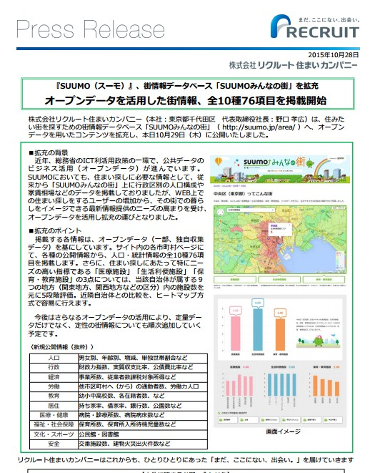
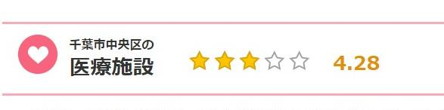
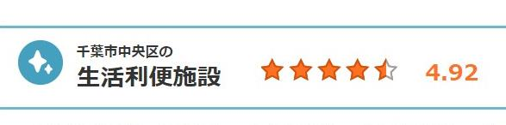
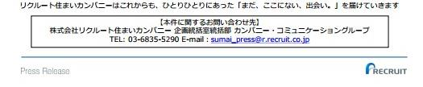
Supplementary information: SUUMO’s “Minna-no Machi”
◆Outline
SUUMO’s “Minna-no Machi” is a Web page, carrying information about the life in various towns.
◆Features
MIC’s statistical data are mainly utilized.
10 categories and 76 items are covered.
Such facilities as “medical facilities”, “life-convenience facilities”, ”child-rearing and educational facilities” are ranked based on a five-grade evaluation method.
↓
We plan to further expand the contents of information on towns towards the future.

Slide 37
To conclude
We consider that our Project is a valuable initiative to lead to a resolution of problems held by municipalities that are suffering from the outflow of population due to the demographic concentration into metropolitan areas, as well as to the revitalization of regional economies.
We plan to further expand the areas to cover by our Project. We are presently examining the feasibility of making “data on vacant houses” a database in order to enhance the portfolio of our data in possession.
To conclude our presentation, we ask all participants from MIC, municipalities and VLED to join forces and continue challenges together with us, using the method we are still working out through public-private collaboration, and we sincerely wish you to continue supporting our activities towards the future.

Slide 38
We accept any questions and enquiries at any time.
Thank you very much for your kind attention to our presentation.
Contact: Junko ENOMOTO
junko@r.recruit.co.jp/ Tel: 03-6835-9873
Recruit Communications

