Slide 1
Local Government Publicity Support Platform
Open Data Symposium 2015
Introduction of “My Koho-shi” or “My Publicity Paper”
November 25, 2015
Tomihiko Azuma
Publica Co., Ltd.
tomi@publica.co.jp

Slide 2
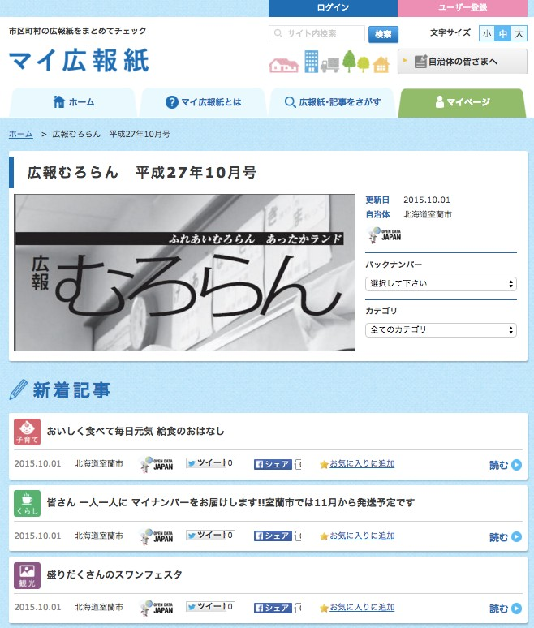
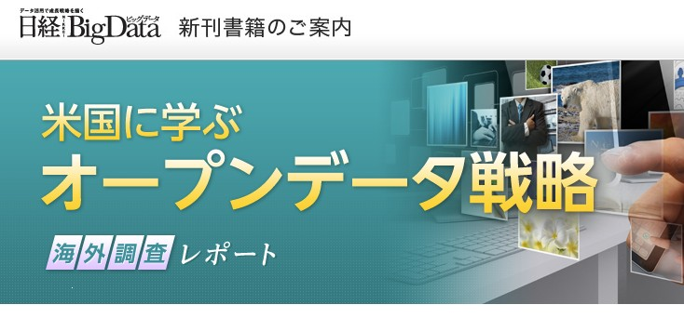






Self-Introduction: Tomihiko AZUMA
https://mykoho.jp/

Slide 3
What is Open Data?
Let’s make data owned by public organizations open to the public for use by the public sector.
But, it seems rather bothersome…

Slide 4
Objectives are not quite clear, and we can’t feel they are close to us.
Transparency of the Government?
Improvement of public services?
Economic revitalization?

Slide 5
There seem to be a lot of difficulties, and it seems difficult to abide by the rules.
Are they machine-readable?
Are they good for secondary use?
Do they require license?
Do they use a common language?
Do they have 5 stars?

Slide 6
We are already quite busy. We want to avoid doing that if possible.
We have no time!
We have no money!
We have no experts!
We can’t take responsibility!
That’s not my job!

Slide 7
Issues at the level of local governments in dealing with open data.
No human resources are available to promote open data. Costs will increase. We have no time to spare.
For data release, we can’t get the understanding from the sections in charge. We are not certain what positive effects we can get.
(Opinions from local governments)
It may be easy to use publicity papers as the source of information for open data, as they are already created in a form of PDF and made open to the public through Web-sites, etc. Let’s start with what we can do now!

Slide 8
“My Publicity Paper” that started utilizing open data from what we can do.

Slide 9
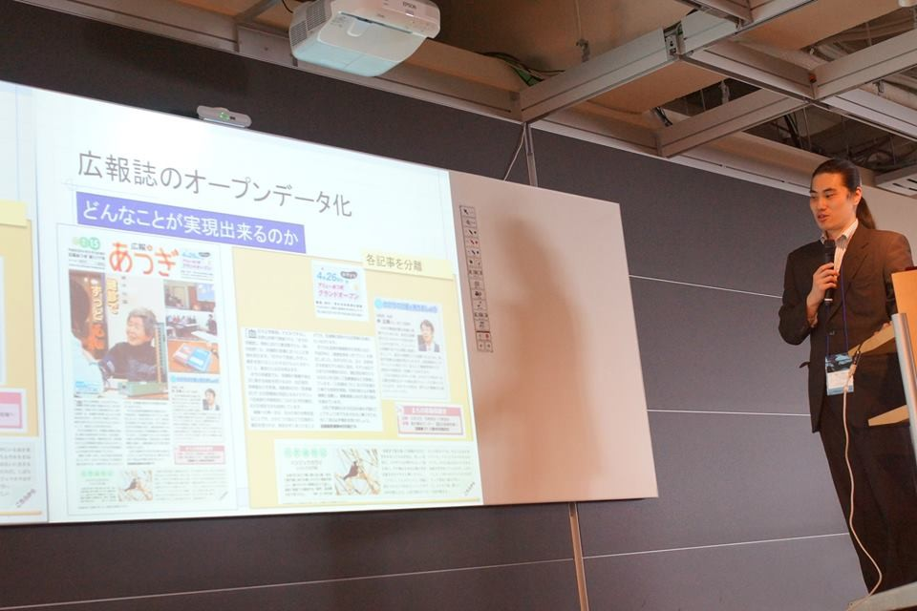

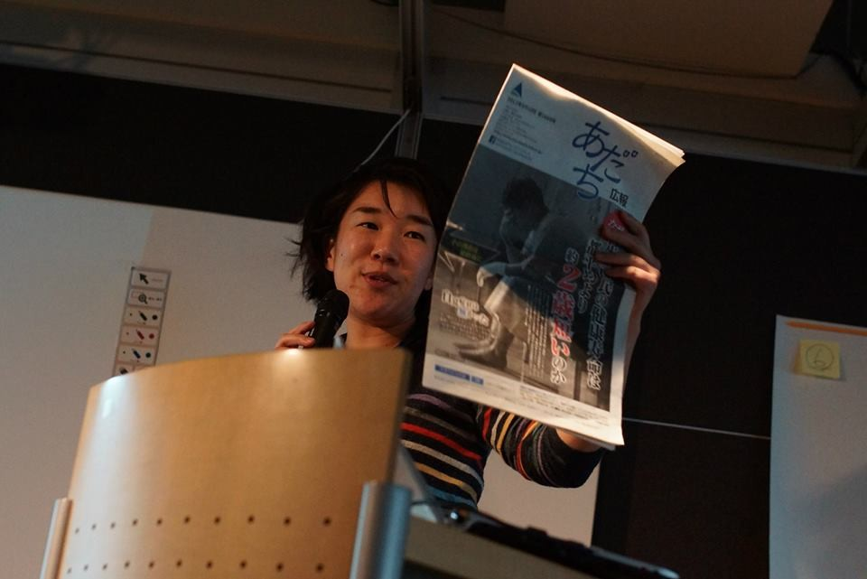
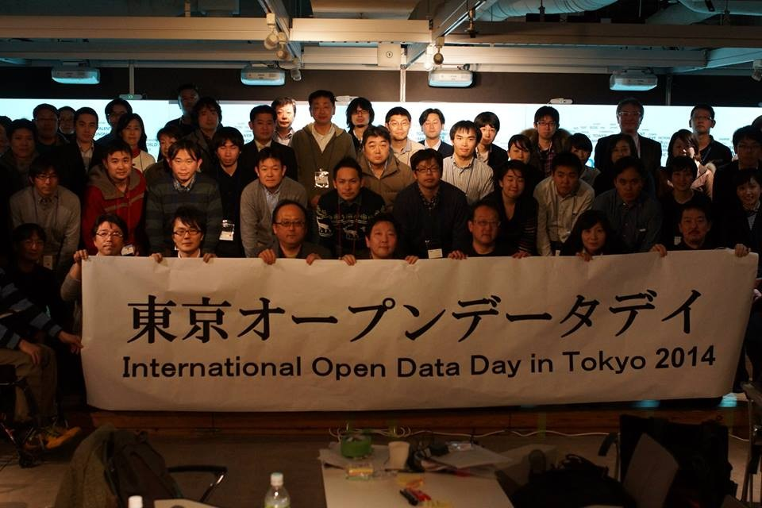
(Reference) Opening of “International Open Data Day in Tokyo”, an “ideathon” utilizing data from publicity papers (held on February 22 and 23, 2014).

Slide 10
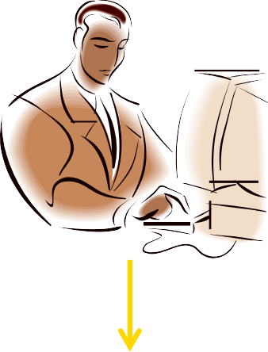
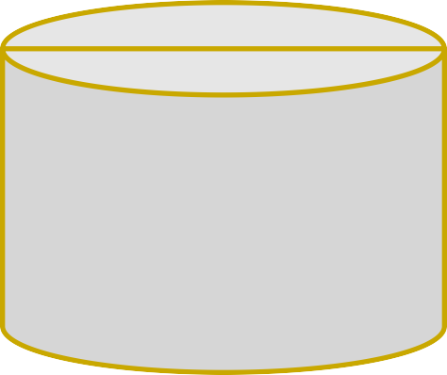
Different patterns of open data utilization from publicity papers
 | Personalized open data (My Publicity Paper, etc.)
Compilation of publicity papers into a form of open data
 | Multi-channelized open data (Collaborative distribution among media companies)
Publicity Papers
Open Data
 | Value added/ functionality-increased open data (Data provision by multi-languages/ linkage to application software)
 | New-types of services (Cross-municipality services, etc.)

Slide 11
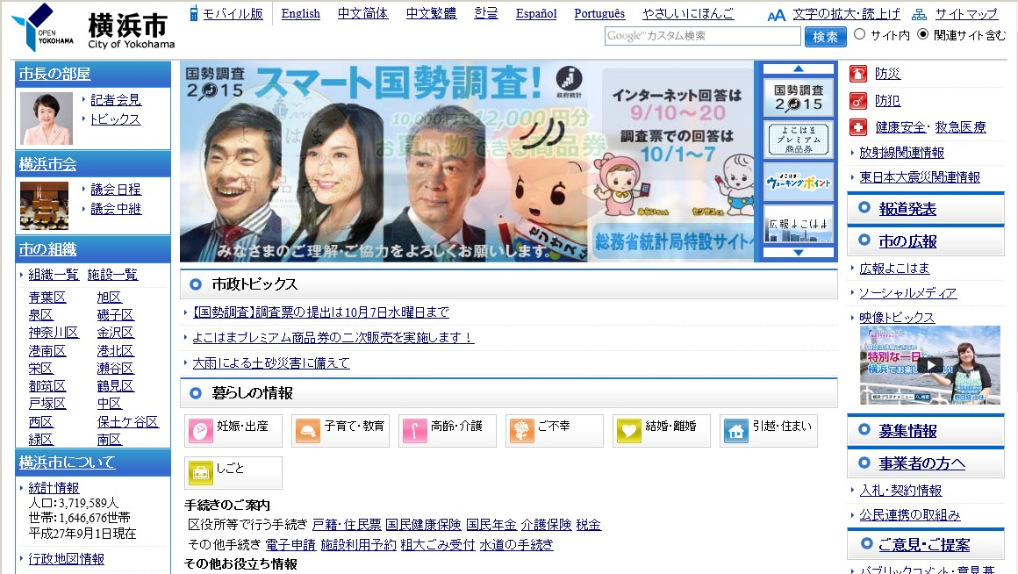
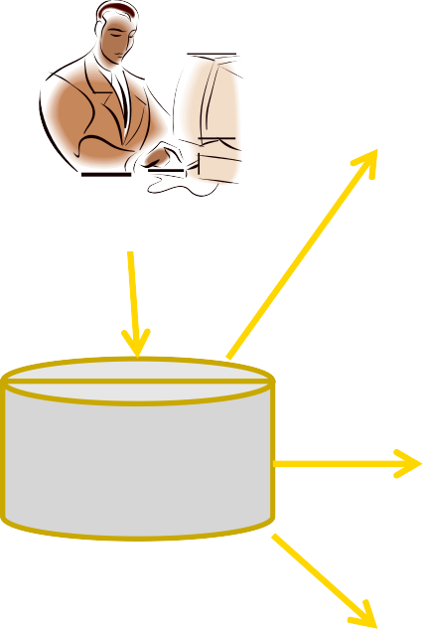


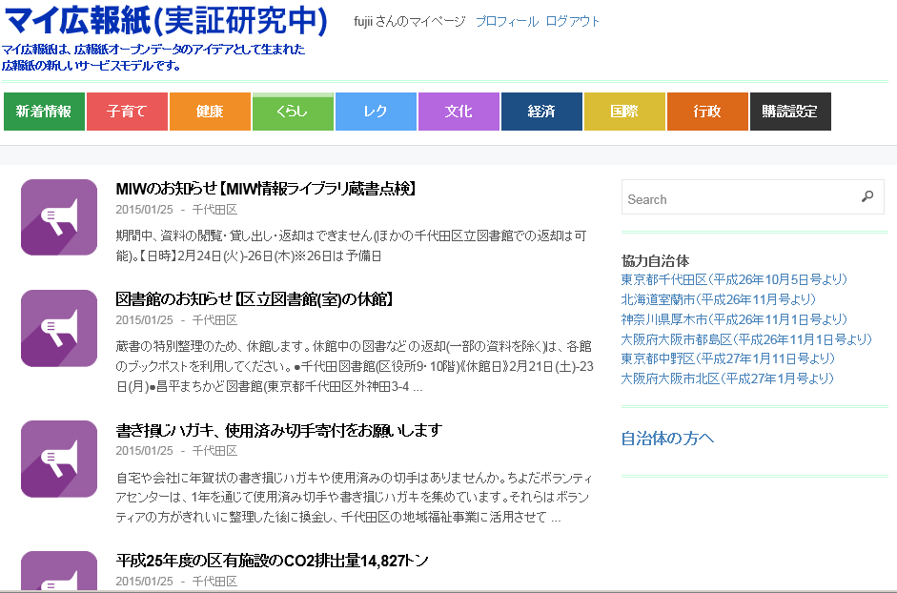
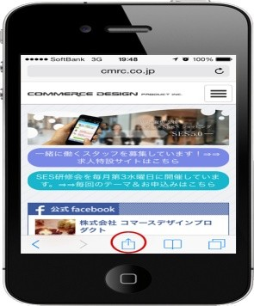
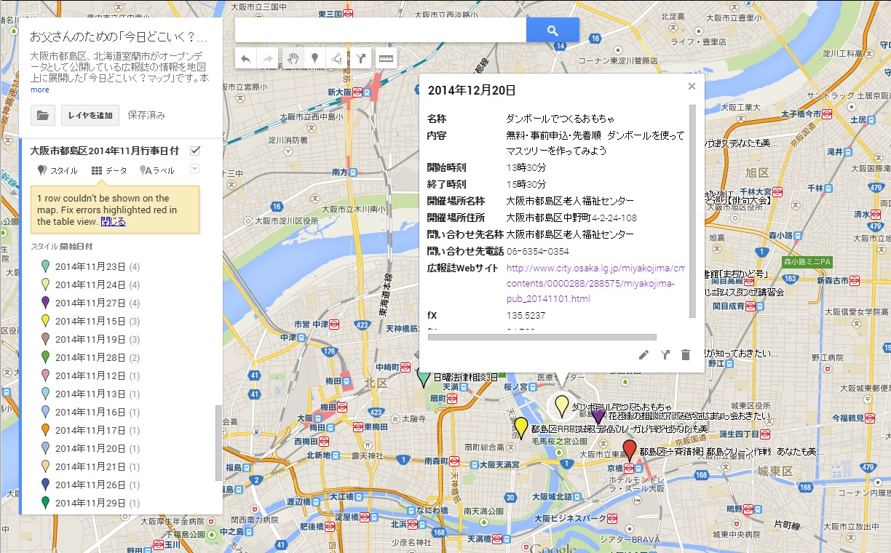


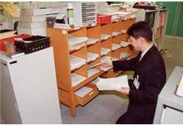
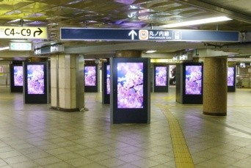
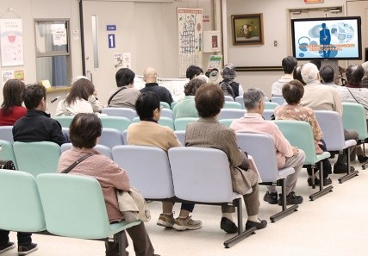
Effects of open data from the standpoint of the publicity activities
Present publicity activities
Production of articles for the Web site
Future vision of open data through publicity paper
<Production of articles for Web site and publicity paper>
Production of articles for the publicity paper
Person in charge of publicity
<Various types of information-providing application software>
Person in charge of publicity
Utilization of Publicity Paper as Open Data
….
Each distribution channel comes to pick up the data.
<Various types of distribution channels>
Information is compiled and distributed to a variety of publicity channels, individually.
↓
It is difficult to smoothly correspond to a large number of channels and to the required speed for information distribution.

Slide 12
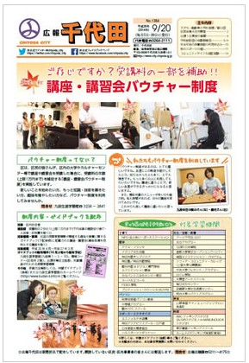
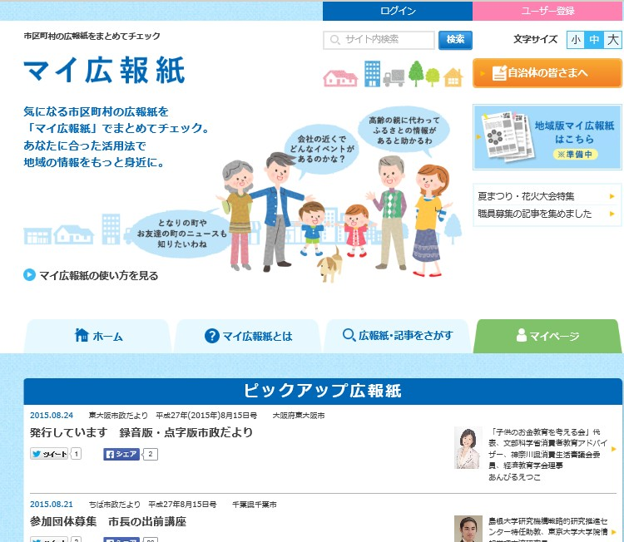

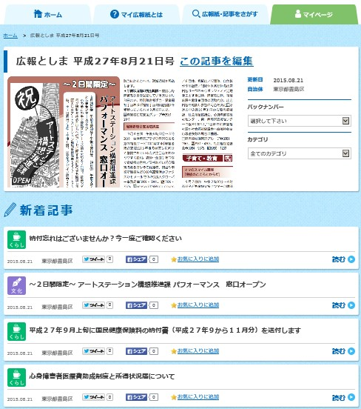
What is “My Publicity Paper? http://mykoho.jp/
We collect data from publicity papers issued by municipalities throughout Japan, and distribute information/data through the Internet, after sorting them out into different types of articles. We carry out personal distribution corresponding to the needs of readers, push-type distribution to smartphones, etc. (real-time distribution), and multi-channel distribution such as digital signage distribution and digital broadcasting. We also collaborate with other information-providing services.
We started our experimental distribution of “My Publicity Paper” on October 22, 2014, and currently, the Paper carries articles from publicity papers issued by as many as 107 municipalities, as well as those issued by the Ministry of Internal Affairs and Communications.

Slide 13
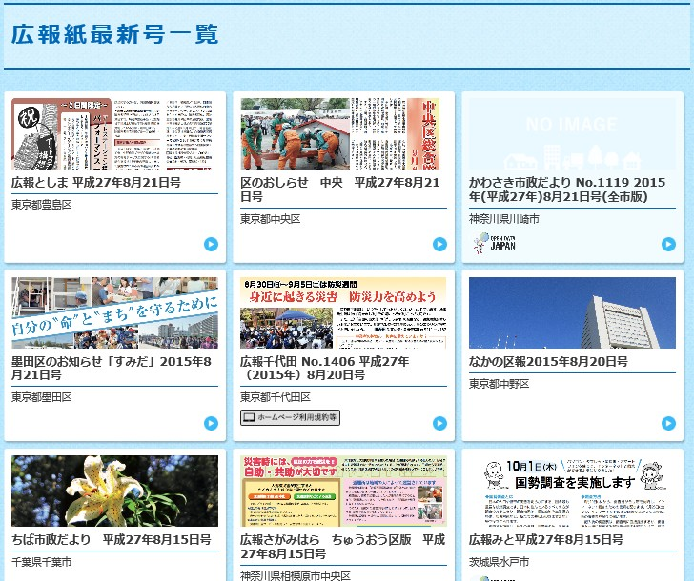
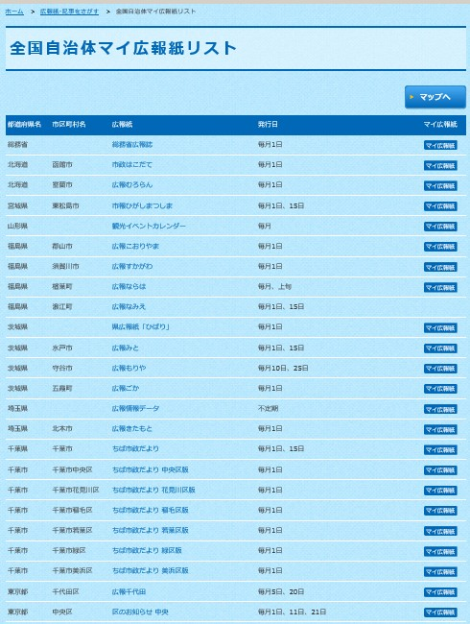
Effects of “My Publicity Paper” (1) Because publicity papers throughout Japan are compiled,
You can get information/data on other regions (in which you work, travel, or your parents live, etc.) than your own living place.

Slide 14
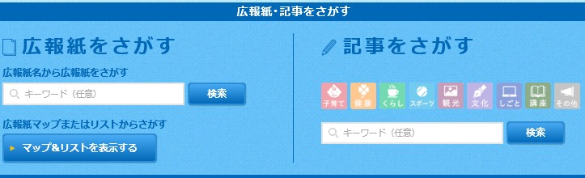
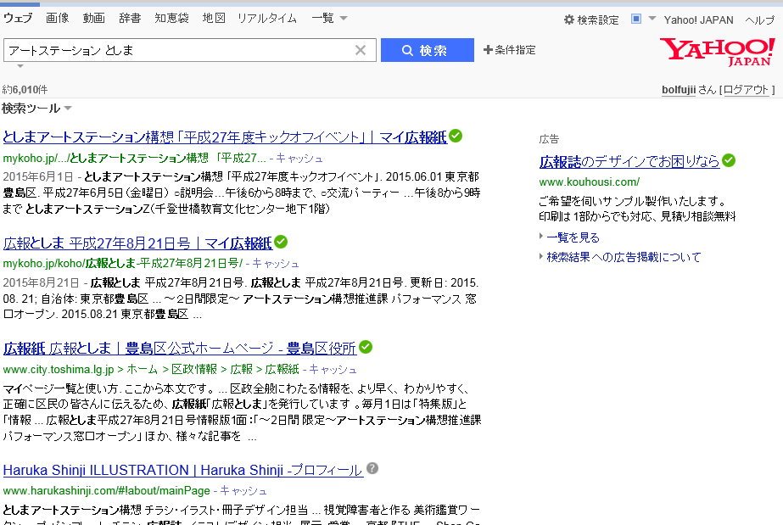
Effects of “My Publicity Paper” (2) Because articles are sorted out and they are distributed for each type of articles separately,
You can search your interested articles easily based on the classification of categories and/or by using key works.
Titles of articles can also be used as the Internet search engine.

Slide 15
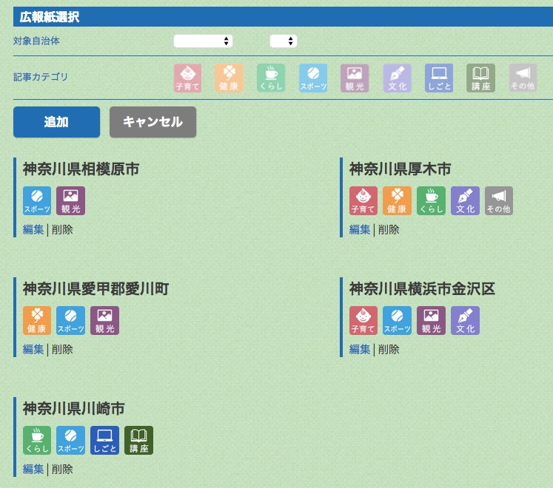
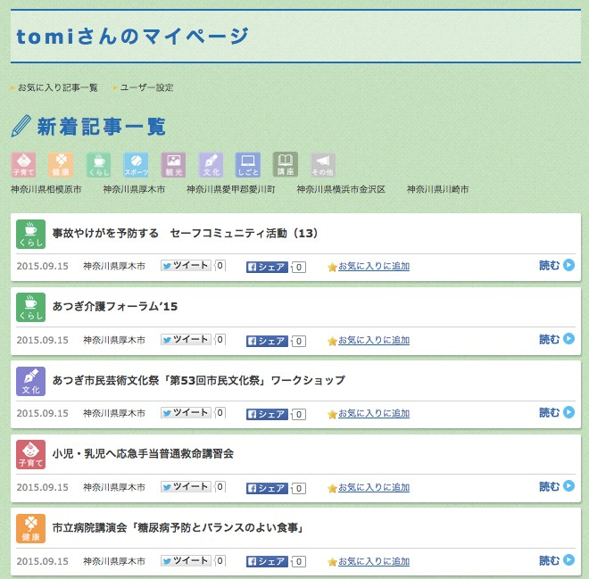
Effects of “My Publicity Paper” (3) Subscription conditions can be arranged through the Web site.
Depending on the selected subscription conditions (types of publicity papers, categories of articles, etc.), you can find all articles of papers nationwide in one place, for each category of articles.

Slide 16

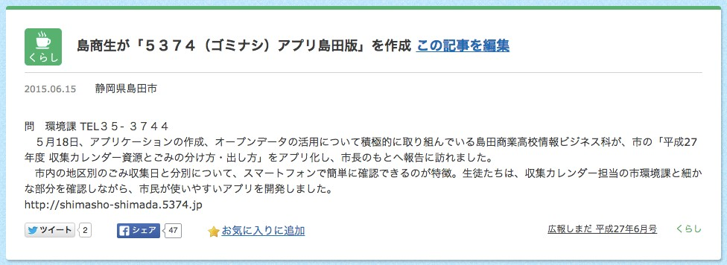

Effects of “My Publicity Paper” (4) Articles can be shared with your friends through SNS (dissemination effect)
⾃自治体担当者による記事の 編集機能は将来的に提供予定
Interesting articles is disseminated through Twitter and Facebook.

Slide 17
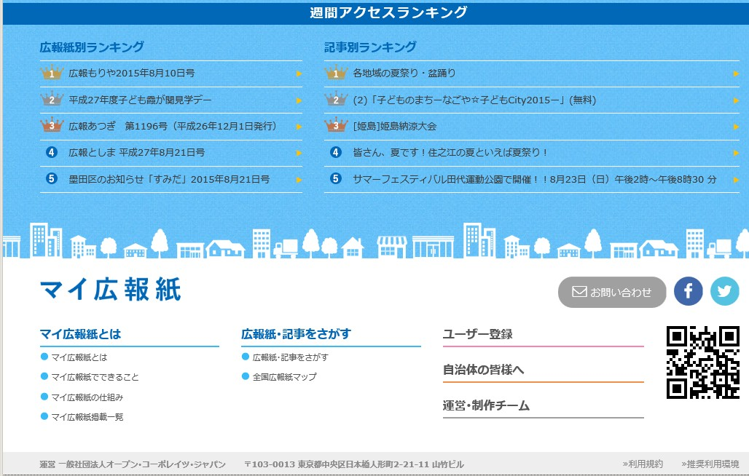

Effects of “My Publicity Paper” (5) Status of access (subscription) can be grasped at a glance.
Weekly access ranking
Access ranking by publicity paper, type of article, etc.
You can grasp the effects of publicity on a real-time basis as to which articles are read by what types of people and how often, through the analysis of access (the result of the analysis has not been released yet).

Slide 18
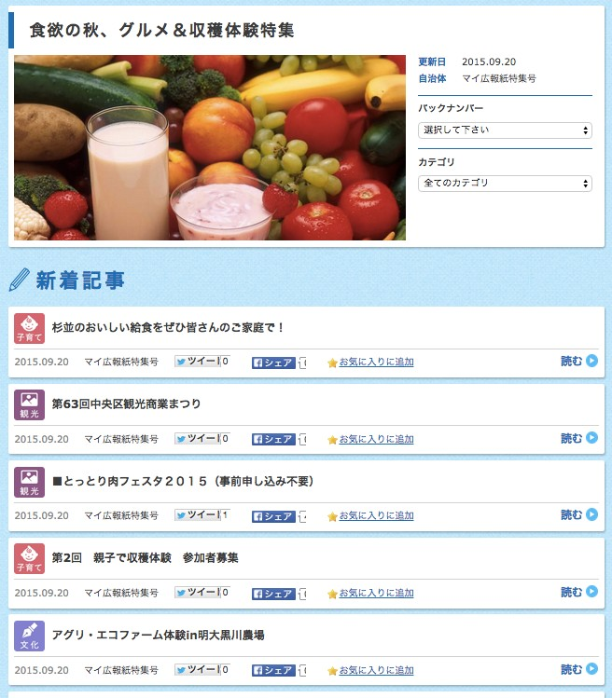
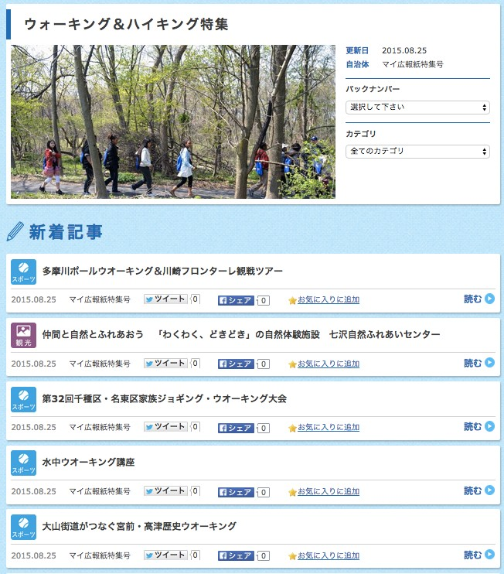
Effects of “My Publicity Paper” (6) Cross-sectional grasping of the situation
Concerning the same article themes, the situation can be grasped cross-sectionally.

Slide 19






Open data utilized by “My Publicity Paper”
+
Data released with a license attached to the files of an arbitrary format, indicating that the contents are recommended by the Government.

Slide 20
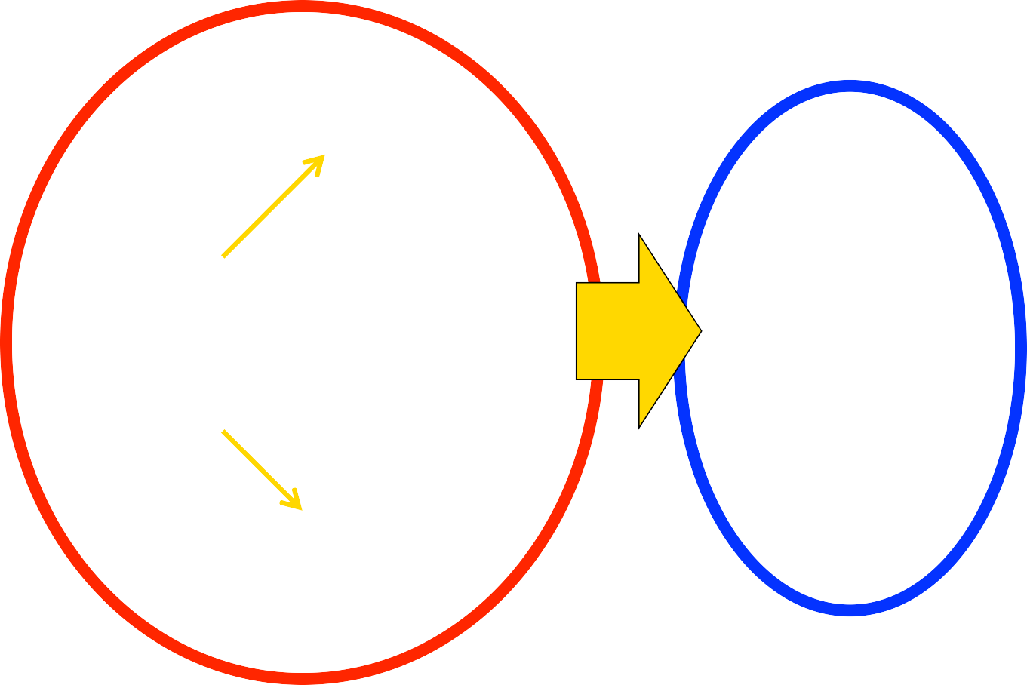
Effects of open data from the standpoint of persons in charge of publicity
Present publicity activities
Production of articles for the Web site
Future vision of open data through publicity paper
<Production of articles for Web site and publicity paper>
Production of articles for the publicity paper
Person in charge of publicity
<Various types of information-providing application software>
Person in charge of publicity
Utilization of Publicity Paper as Open Data
….
Each distribution channel comes to pick up the data.
<Various types of distribution channels>
Information is compiled and distributed to a variety of publicity channels, individually.
↓
It is difficult to smoothly correspond to a large number of channels and to the required speed for information distribution.

Slide 21
Summary and Conclusion
The most important thing is to support publicity activities of municipalities
and
to effectively utilize open data there

Slide 22
Publica
http://www.publica.co.jp/ info@publica.co.jp

