Slide 1

GEEO.OTANI.CO
About GEEO
Otani&Co., Inc. Yuichiro Otani

Slide 2
Yuichiro Otani
Self-introduction
Otani & Co., Inc.
Data Analysis (an article on our activities was carried by a magazine “Nikkei Big Data”)
R Package (govStatJPN)
Qualified Real Estate Transaction Specialist (involved also in sales and purchase of real estate)
GEEE (Real-estate prices estimation services)

Slide 3

Contents of Today’s Presentation
What is GEEE?
Image of users
Core set
Otani&Co., Inc. All Rights Reserved.
GEEO.OTANI.CO

Slide 4
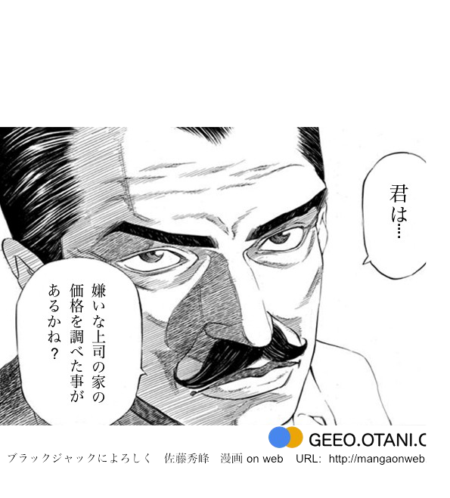
What is GEEO?
Have you…
ever checked the value of the house of your obnoxious boss?
Otani&Co., Inc. All Rights Reserved.
GEEO.OTANI.CO

Slide 5
History of GEEE
2015.09.29
Good Design Award
2015.05.25
2015.09.11
Encouragement Award from the Minister of Internal Affairs and Communications
ProReleased
2014.11.06
MA10
20141006…..
FreeReleased
2014.4.1
Otani&Co., Inc
2012-2013
CTC JGN-X
Otani&Co., Inc. All Rights Reserved.
GEEO.OTANI.CO

Slide 6
About Business
API
Account
Analytics

Slide 7
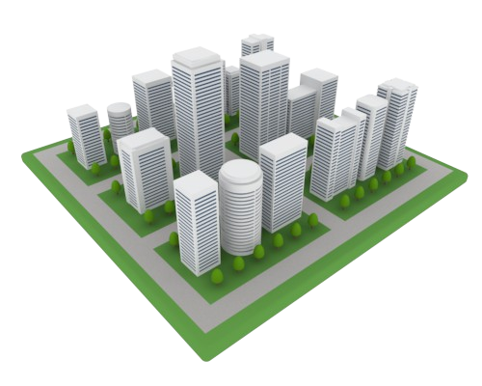
¥25,800,000
Demonstration

Slide 8


Image of Users
VS
Unpaid Users
Paid Users

Slide 9
Unpaid Users
Bad accuracy
Bad accuracy
Bad accuracy
The meaning of prices of real estate is not clear.
You can’t get a good price you are looking for.
There exists a big price difference compared with other surrounding land/buildings.
You are looking for an outlier.
Oh, no.
The definition of accuracy is ambiguous or subjective.

Slide 10
Paid Users
Clear-cut reason for the purchase
Attaching weight to the abundance of the volume of information
Attaching weight to the speed to arrive at your judgment
Small defects to be tolerated
Profit is the difference between the theoretical price and the realized sales price.
Sales price
Profit
Theoretical price
Loss
Sales price
There exists no equivalent real estate.
When you find a good property, you must buy it.
Otherwise, you never gain profit.

Slide 11

Core Set
API
Account
Analytics

Slide 12
Statistical Algorithms
Max. 97 % of accuracy (GEEE)
* Freedom-adjusted R-squared value
Not depending on data
No existence of borderline
Wide range of applications
∏ f ( x , θ)

Slide 13
Examples of Application ranges
Prediction of occurrences
Prediction of possible places of events/accidents to occur.
Prediction of the occurrence of vacant houses
Prediction of damage
Prediction of garbage problems caused by crows
Prediction of damage caused by rats, hornets, etc.
Prediction of the market
Prediction of sales, etc. due to the opening of new eating places
Indexing of potential customers by the number of residences

Slide 14
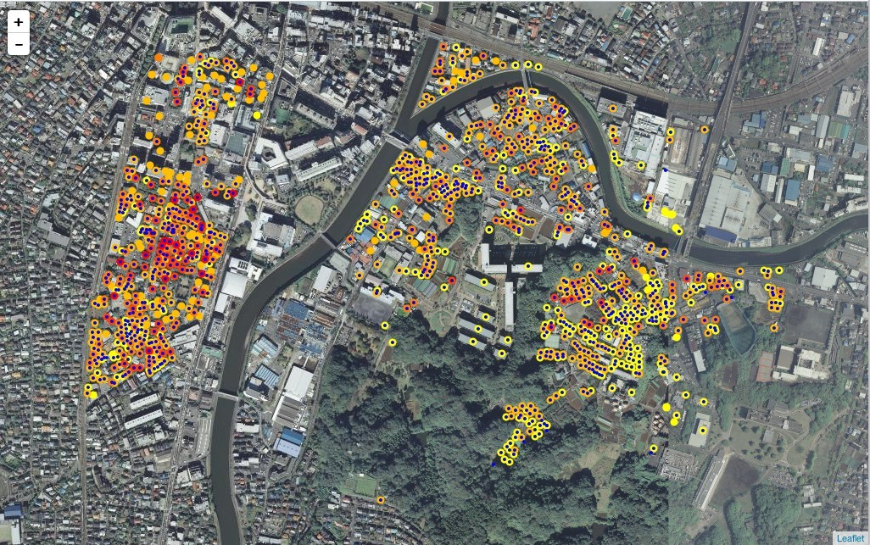
Estimation of Household Income
High
Low

Slide 15
Additional Information
Opening of e-STAT API Seminar
December 4 (basic matters) and December 12 (applied matters)
About the usage of E-Stat API
Distribution by way of “Usteam” is expected
Thank you very much for your kind attention to my presentation.

