Slide 1
Open Data Symposium 2015
Open Data Summit
Association for Open Data of Public Transport
Noboru Koezuka
Professor of University of Tokyo, Vice-President of YRP Ubiquitous Networking Laboratory, Director of General Incorporated Association "Vitalizing Local Economy Organization by Open Data & Big Data”, Association for Open Data of Public Transportation

Slide 2
Agendas for Public Transportation of Japan: The Most Developed and the Most Complex System in the World

Slide 3
Railway System in Tokyo:
A Total Length of 1,052km、760 Stations
14,500 Vehicles

Slide 4
Bus Service
2,545 Routes（Number of Bus Routes）
Approx.7,023km（Service Distance)
Approx.9,000 Vehicles（Route Buses ）
Approx.4,000 Vehicles (Chartered Buses)

Slide 5
Number of Taxies in Tokyo
52,000 Vehicles

Slide 6
Characteristics of Public Transport Infrastructure Management: Privatization with Many Private Entities

Slide 7
Operation of Public Transport in Tokyo
14 Railways Companies, 38 Omnibus Companies, 1,100 Taxi Companies (Excluding Owner Driver Taxies)
)

Slide 8
Difficult especially for Tourists to Get hold of the Entire Picture of Transport Network in Tokyo

Slide 9
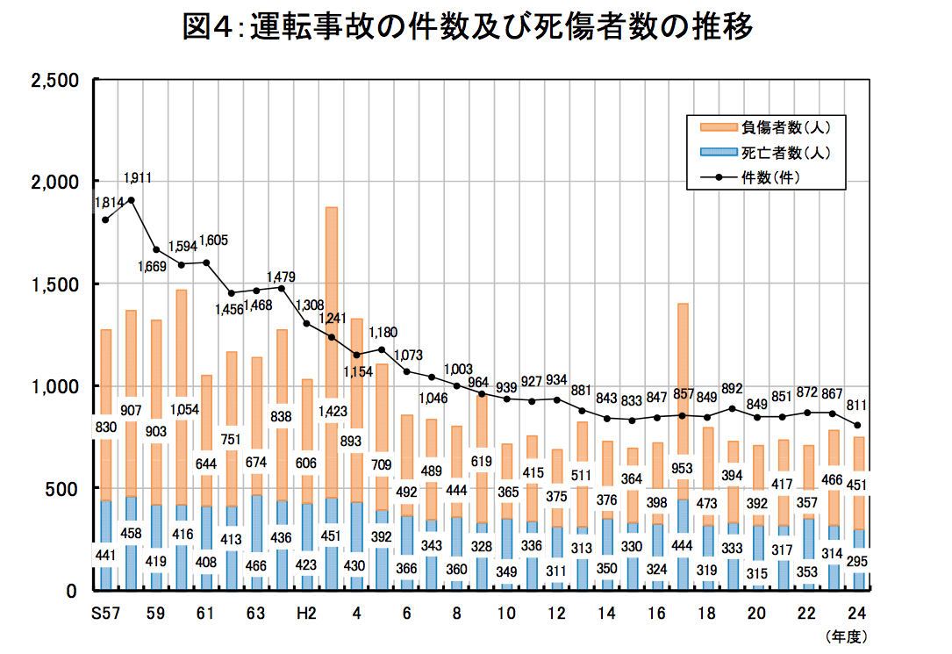
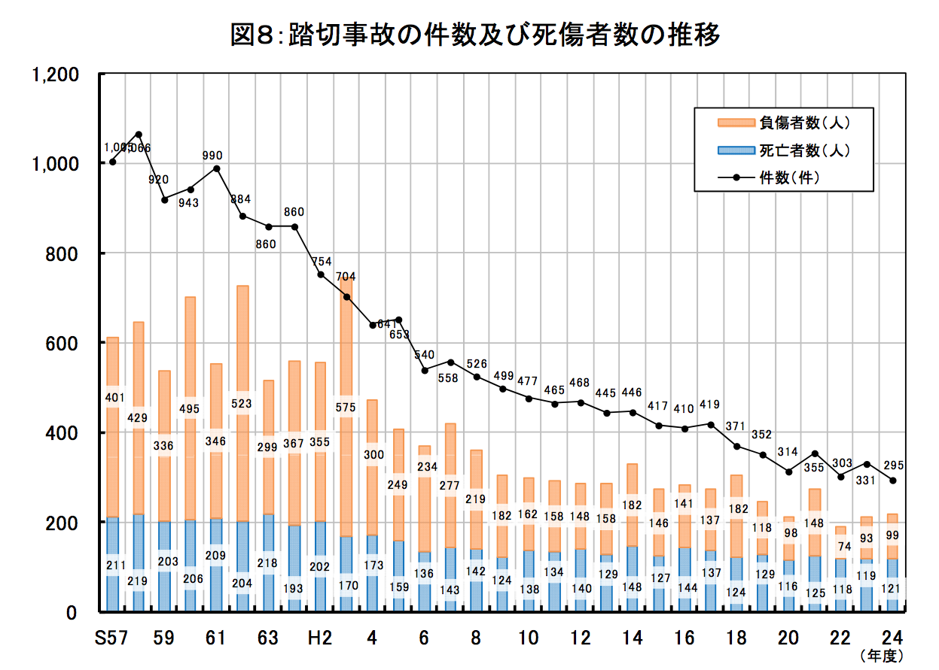
Proud of the Most Punctual Service in the World but not Without Many Obstacles
Ministry of Land , Infrastructure,
Transport and Tourism：From “Information
on the Safety of Railway Transport(2012)”

Slide 10
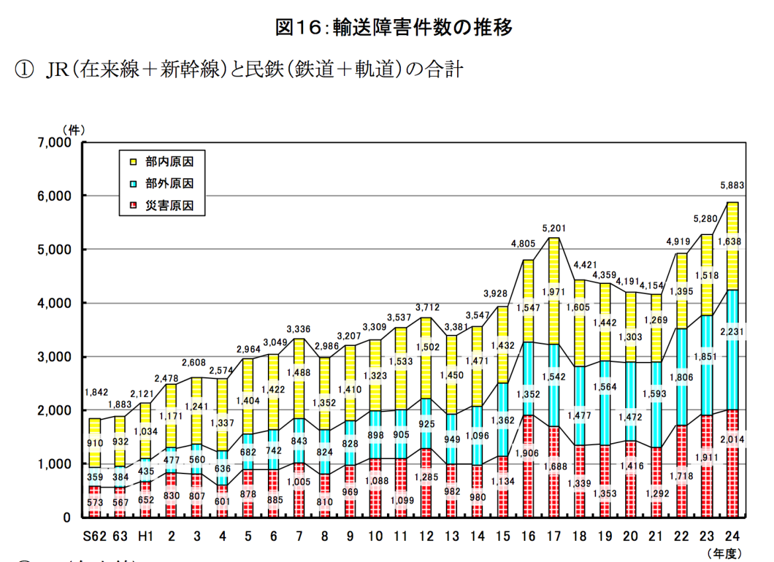
Transport Disruption（Trains Canceled 、Passenger Train Delays of more than 30 Minutes, etc. ）
Transport Disruption (2012) 5,883 Cases
  Transport Disruption Originating from Railroad workers, Vehicles or Railway Facilities(Internal Causes) =1,638 cases(27.8%)
  Transport Disruption Originating from Natural Disaster such as Storm & Flood, Snow Damage and Earthquakes(Natural Disaster) =2,014 cases(34.2%)
  Transport Disruption Originating from Break- into- Rail, etc.(External Causes) =2,231cases(37.9%)

Slide 11
Public Transportation Open Data Association

Slide 12
History of Activities Involving Public Transportation Open Data Association
February-March 2013
  The First Application Contest
2013年 3月March 2013
  The First Train-On-Rail Data using Dokosil provided
August 2013
  Public Transportation Open Data Association Inaugurated
January-February 2014
  The Second Application Contest (In Co-sponsorship with Open Data Promotion Association)
September-November 2014
  Tokyo Metro Open Data Contest
September 2015
  Public Transportation Open Data Association Inaugurated

Slide 13
Membership
President
  Ken Itamura（Professor of University off Tokyo、President of YRP Ubiquitous Networking Laboratoy)
Directors
  Tokyo Metro Co., Ltd （Director: Kouichi Murao, Managing Director）
  NEC Corporation （Director：Hiroshi Hashimoto, Senior Executive Manager of Transport & Logistics Solutions）
  East Japan Railway Company（Director：Atsushi Ouchi, General Manager of Information Systems Planning Department, Corporate Planning Headquarters ）
  Fujitsu Co.Ltd （Director：Mitsutoshi Hirono Managing Executive Officer）
Leading ICT Partner
  Japan Microsoft Co.Ltd
Observer
  Promotion for Content Distribution Division, Information and Communications bureau, Ministry of Internal Affairs and Communications
  Regional Communications Development Division, -do- ,-do-
  Information Policy Division, Policy Bureau, Ministry of Land, Infrastructure,Transport and Tourism
  Public Transport Policy Department, -do- ,-do-
  Planning Officer(in charge of Overall Transport Systems)（Concurrently attached to the Office of Director General Policy Planning) , General Affairs Division, -do- ,-do-
  Office of Railway Service Policy, Railway Bureau, -do-
  City Railway Policy Division, -do-, -do-
  Civil Aviation Network Planning Division, Civil Aviation Network Department, Civil Aviation Bureau, -do-
  Bureau of Urban Development ,Tokyo Metropolitan Government

Slide 14
Member (As of November 2015)
WingArc1st Co. ,Ltd.
Val Laboratory Corporation
Odakyu Electric Railway
Kanto Bus Co., Ltd.
Google Inc.
Keio Corporation
Keisei Electric Railway Co., Ltd.
Keihin Electric Railway Co., Ltd.
Jorudan Co.,Ltd.
SEIBU RAILWAY Co.,Ltd.
Seibu Bus Co., Ltd.
All Nippon Airways Co., Ltd.
Sony Corporation
Dai Nippon Printing Co.,Ltd.
Tokyu Corporation
Tokyo International Air Terminal Corporation
University of Tokyo Interfaculty Initiative in Information Studies, Graduate School of Interdisciplinary Studies
Bureau of Transportation Tokyo Metropolitan Government
Tokyo Metropolitan Television Broadcasting Corp.
Tokyo Waterfront Area Rapid Transit ,Inc.
TOBU Railway CO., LTD.
TOBU BUS CO., LTD
Narita International Airport Corporation
Tokyo Airport Building Co., Ltd.
Japan Airlines Co., Ltd.
Nippon Telegraph and Telephone Corporation
PASCO Corporation
㈱Panasonic System Networks Co. ,Ltd.
Hitachi,Ltd.
National Defense Academy of Japan
Tokyo Waterfront New Transit YURIKAMOME
YRP Ubiquitous Networking Laboratory

Slide 15
Major Activities

Slide 16
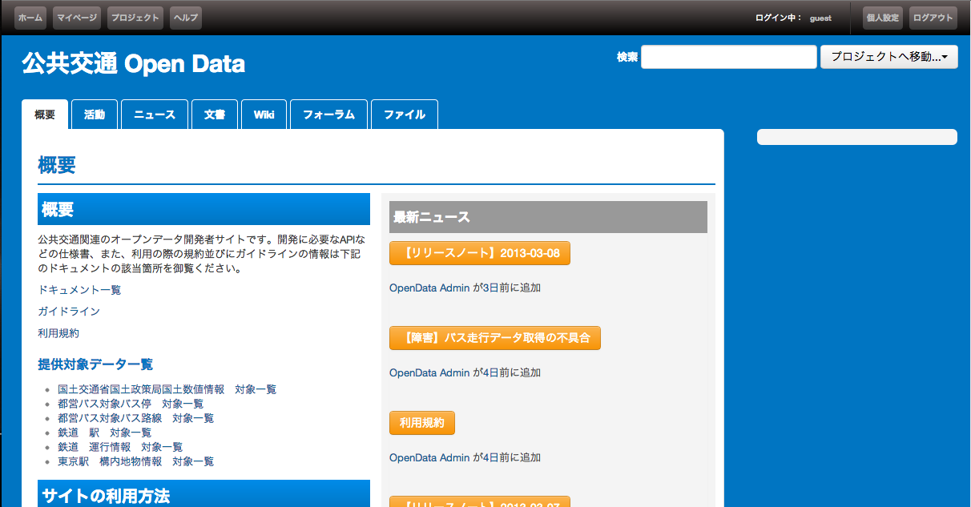
Open Data Developer Site

Slide 17
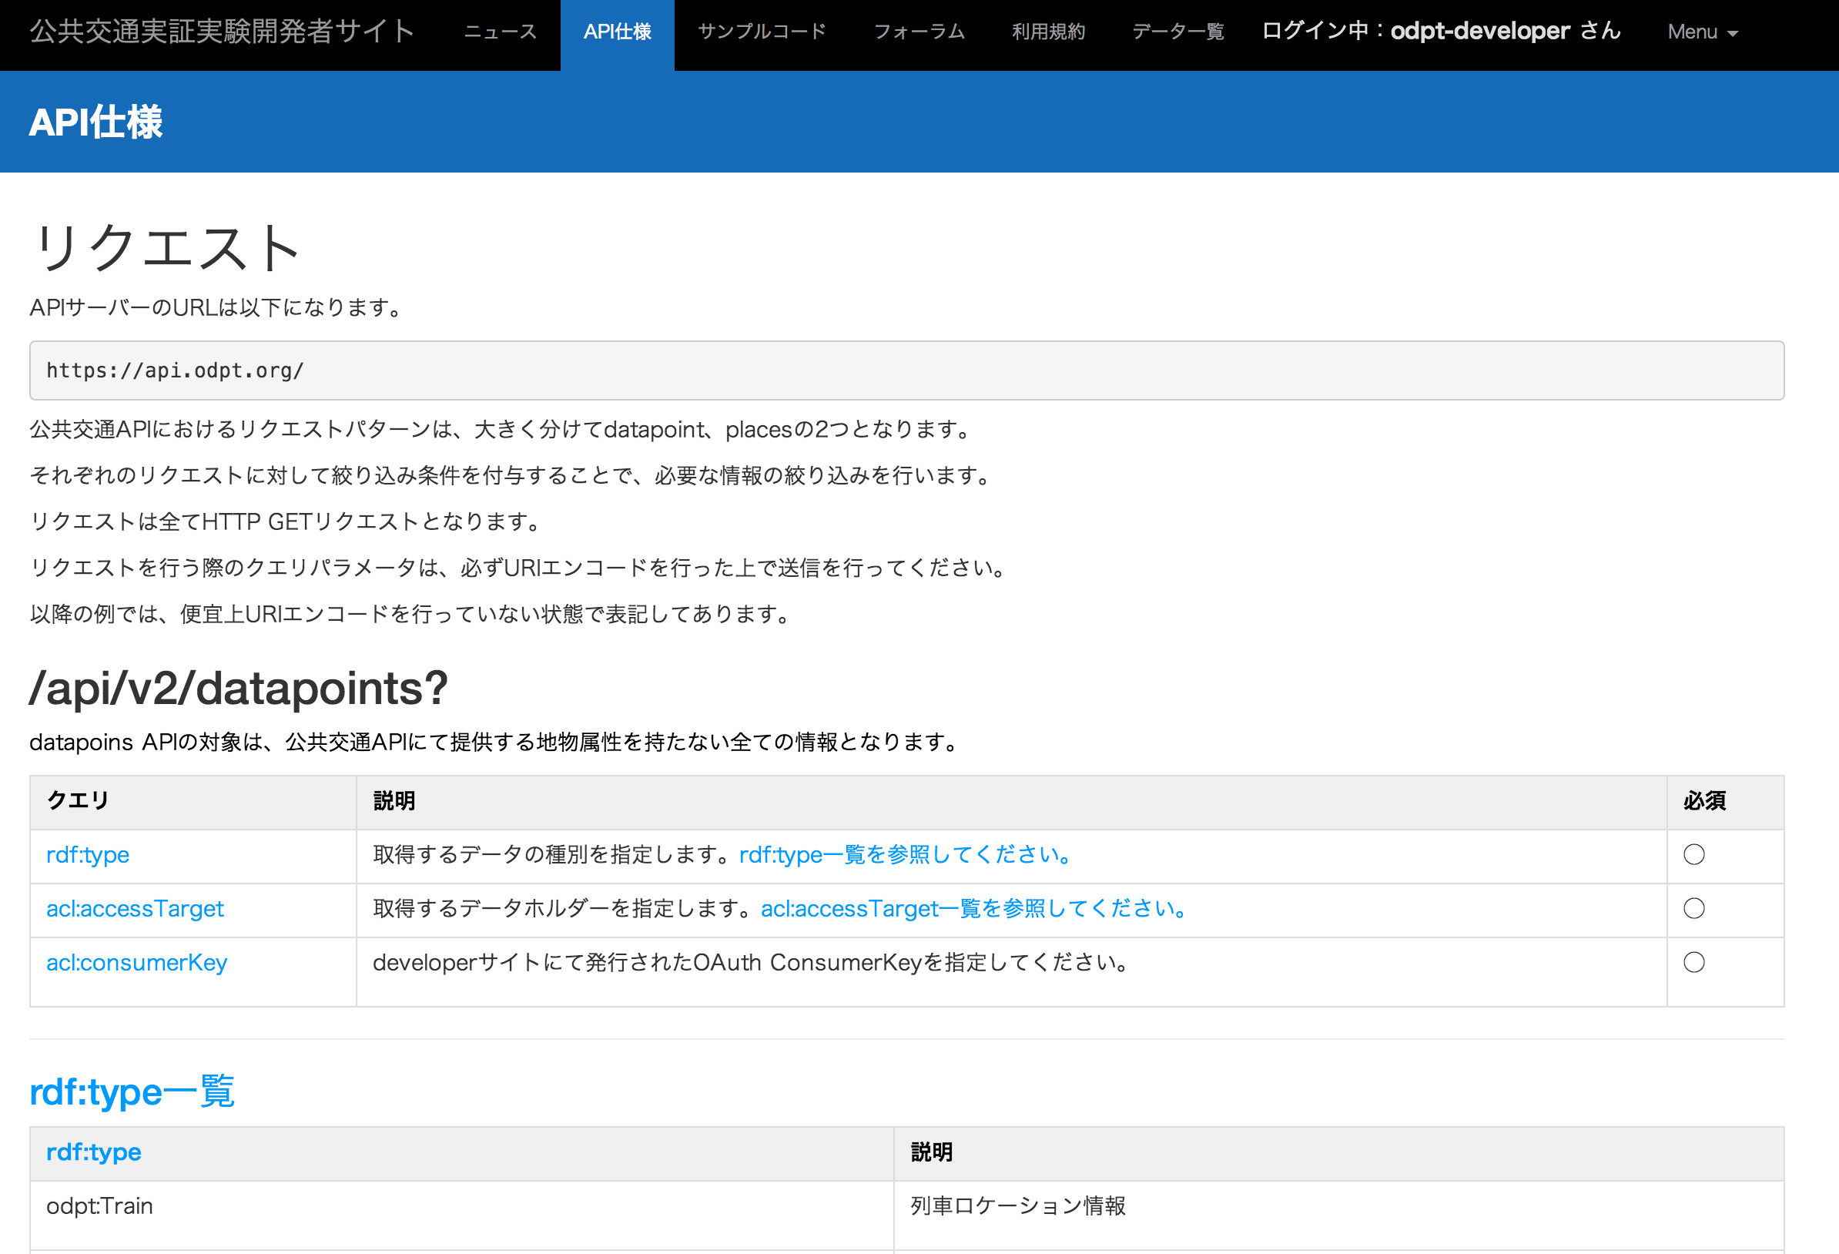
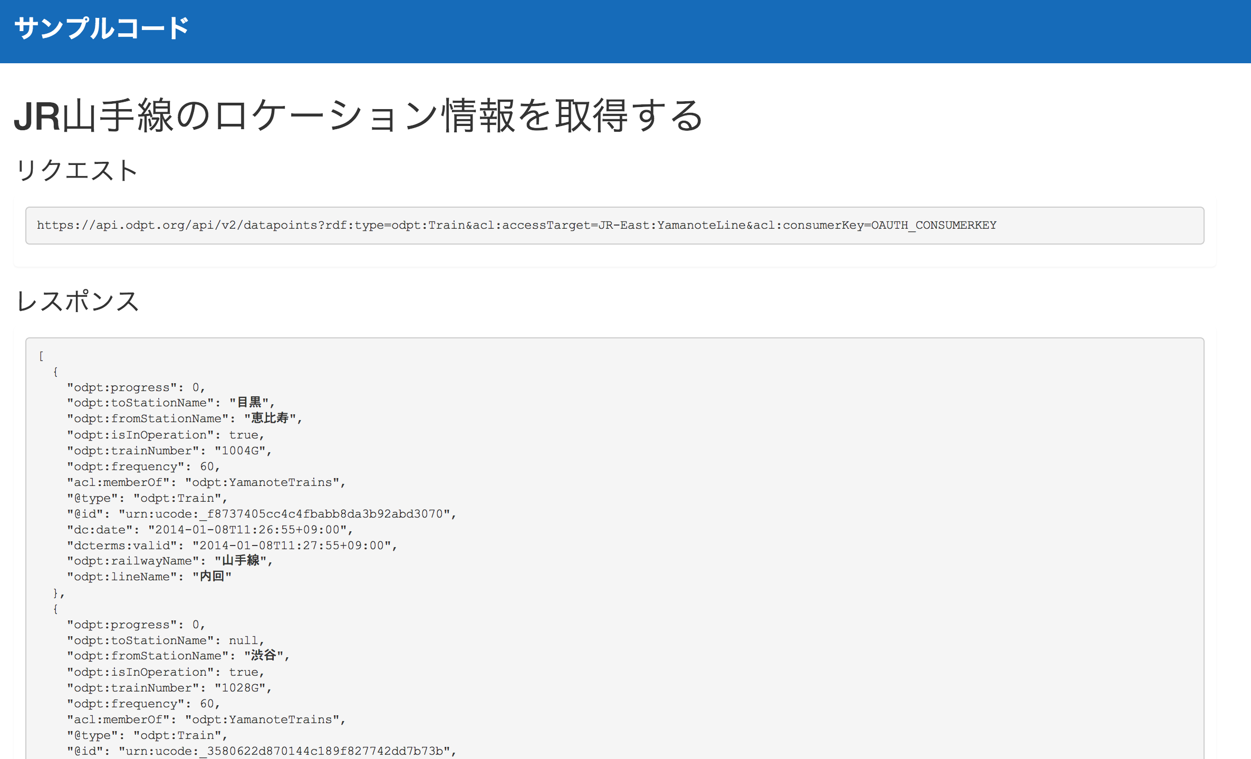
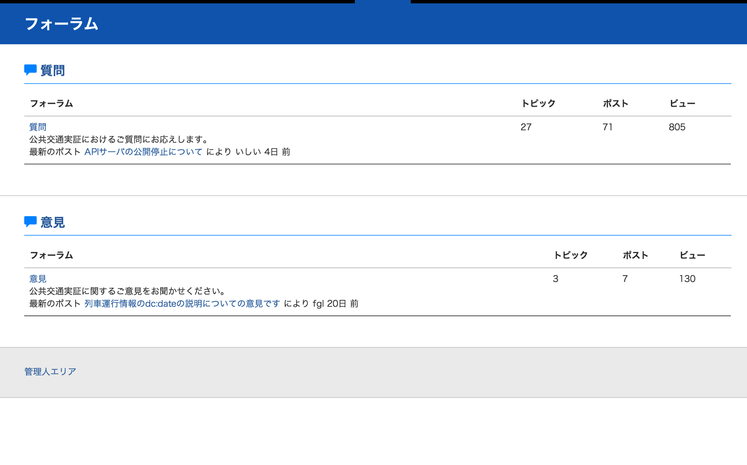
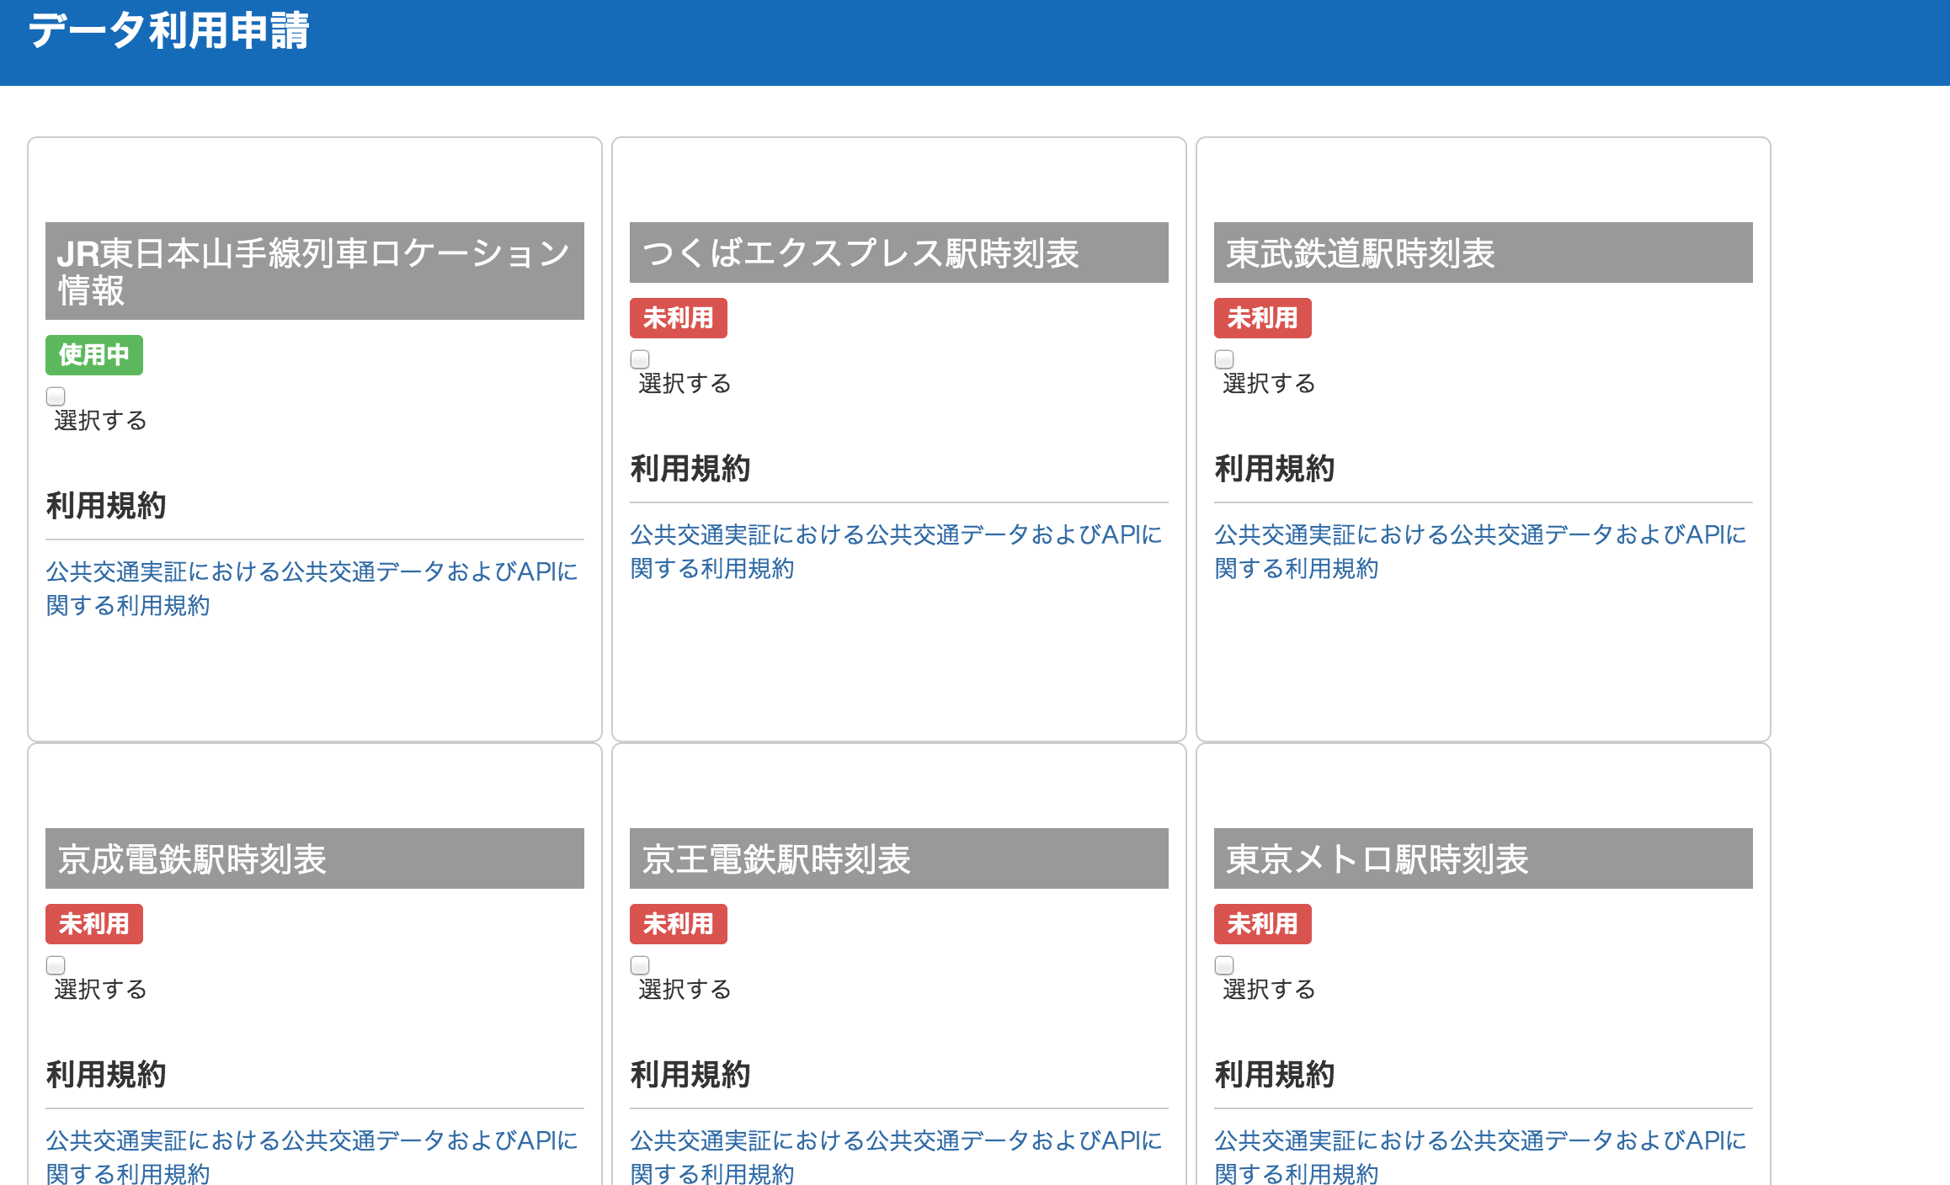
Information Supplied from Developer Site
API仕様
サンプルコード
フォーラム（開発者間の情報交換）
データカタログ

Slide 18
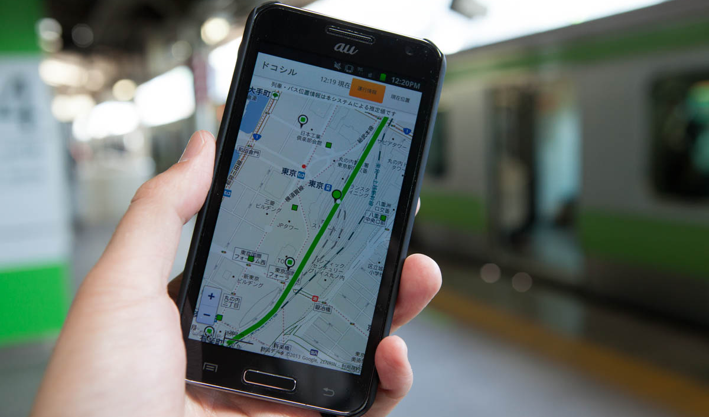
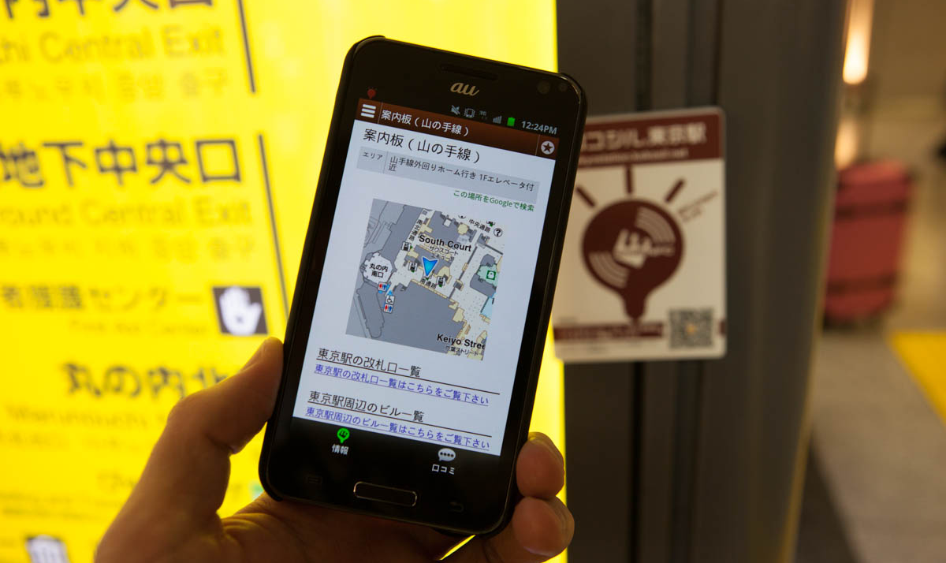
Information Supply Service for Passengers(Dokosil, Kokosil)
Information Service (dokosil) for Real-Time Train & Bus Service
  Supply of Information on Real-Time Train & Bus Service and on Timetable
  Supply of Information on Real-Time On-Rail Train and On-Route Bus, Service and Timetable
Smart Terminal Service “Kokosil Terminal”
  Supply of Information on Public transport Facilities Such as Stations & Airports
  Supply of Information on Real-Time Conditions of Facilities such as Congestion
  Supply of Location Information Based Services on Premises by way of Position Information
  For Location Guidance on Premises, Kokosil Markers using Bluetooth LE have been installed at Stations and Airports for Information supply experiments

Slide 19
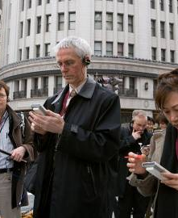
Multi-Lingual Supply of Public Transport Information
Multilingual Information Supply Method based on Machine Translation
Information in Dictionary or Corpus Necessary for Public Transport Information Supply have been organized
Proper Nouns such as Station Names written in Roman or Kana Letters, etc. Streamlined

Slide 20
Information Supply Method at Time of Transport Disruptions
Supply Method of Information on Alternative Transport Means
  In the case of disruptions in railway transport, transfer to other railways as well as transfers to buses and taxies, etc. should be facilitated
  Supply method of information on alternative transport means in cases of flight cancellation
  Transfers should be facilitated by supplying real-time information on bus location and train
Exchange of Information among Business Entities concerned

Slide 21
Tokyo Metro Open Data Contest

Slide 22
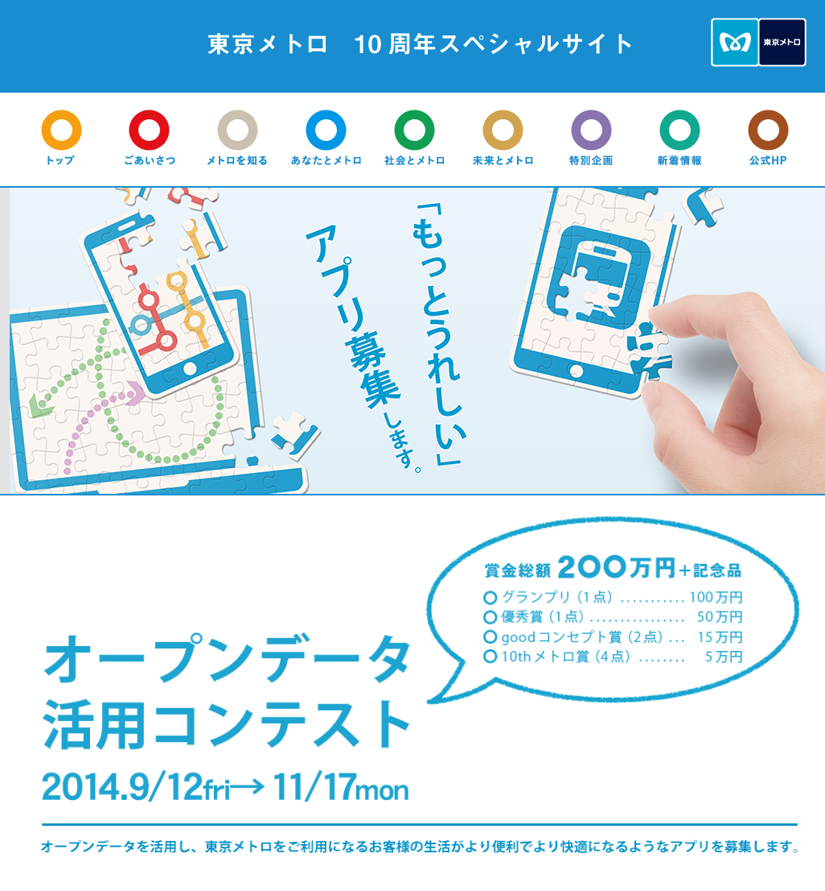
Tokyo Metro Co. Ltd., Open Data Contest Now
Notes:
Now, we are collaborating with Tokyo Metro Corporation
to provide open data of live status of the Tokyo Metro Lines.
This is very big project.
Open data consists of all tokyo metro lines (9 lines),
179 stations, more than 300 train services at the same time.
This project has a very big impact.
Now, more than 1,700 groups are registered
as developers of this open data.

Slide 23
Open Data Offered in the contest
Data offered related to train location and time of delay, etc. on all the Routes of Tokyo Metro
※Data Distributed at one minute intervals
  Direction (Destined for what direction)
  Train number
  Train Classification(Local, Limited Express, Express, Rapid ,Special Train ※Information on Non-commercial trains(train on trial run and train out of service)supplied
  Starting Station & Destination Station
  Operating Company (Company to which Train belongs)
  Train Position (2 Sections: Station Platform and Section between two Stations
  Time of Delay( Delay of more than 5 minutes indicated as Delayed
In addition, a variety of data on trains and facilities supplied
    Station Timetable, Fare Table, Required Time of Run between Stations、Number of Passengers getting on and off at Each Station, Trains Reserved for Women
  Information on Facilities
    Information on Impediment Removal, Gateway, Nearest Facilities for Each Train Car, Signs Showing Each Gateway

Slide 24
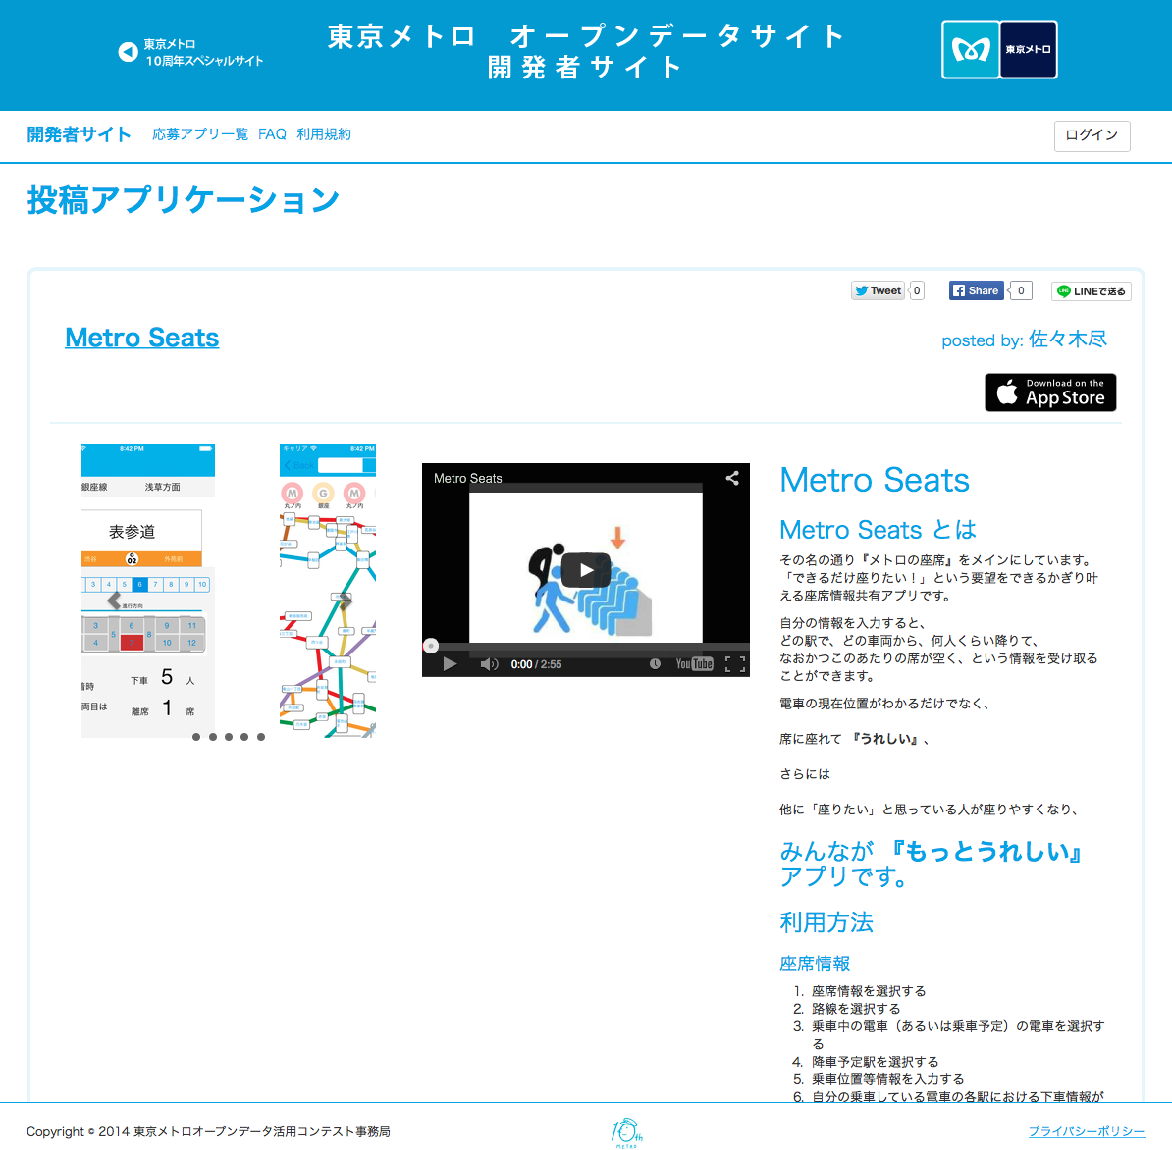
Number of applications for Appli Contest＝281

Slide 25
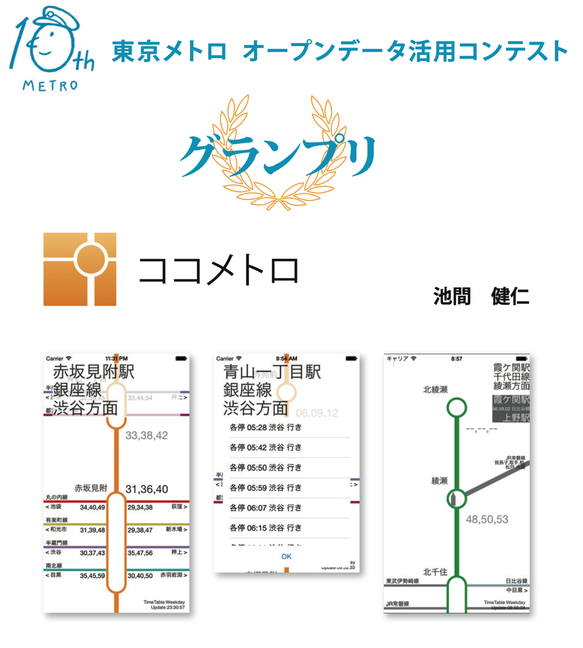
Grand Prix
Grand Prix Awarded to Timetable Appli
  Appreciated was the Conceptual Idea to Redesign from Zero Base Timetable and Route Map for A Paperless New Age of Interactive Touch Panel

Slide 26
Tokyo Metro Appli Contest Alone
ROI = Approximately 1 Billion Yen
（Initial Development Effect Alone）
Approximately 300 Appli with a Value of approximately 3 million Yen
Moreover, the Value of Data of Other Companies and Entities is far greater.

Slide 27
Future Activities

Slide 28
Target of Activities for Fiscal 2015

Slide 29
Agendas

Slide 30
Agendas
Expanding Activities to Regions outside Tokyo
How to involve Private Businesses?
  Public Service Privatized
  Why Private Businesses’ Data is to be offered?
What is at Stake is not only Legal Liability but also the Quality of Service as Customer Service
  How handled if Data is Mistaken?
  スIncreased Awareness on “Best Effort “ in Data, and National Consensus
Point of Demarcation of Responsibility among Multi-Stakeholders
  Transport Business Operators, Open Data Business Entities, Information Providing Business Entities

Slide 31

The End

