Slide 1


VLED2015福岡
Open Data:International Cooperation
and Support
for Innovative Creation
ODI Osaka
Osaka Innovation Hub

Slide 2



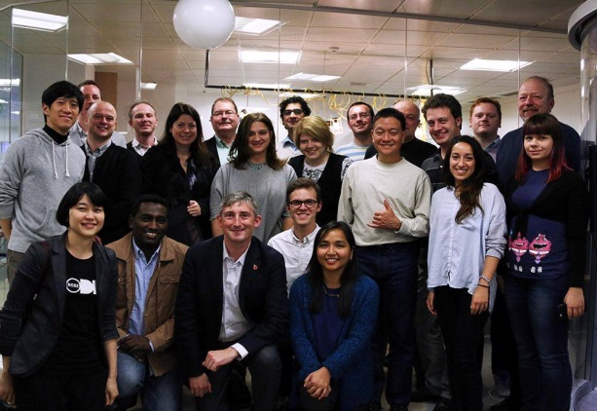


Profile
Shimachi Takahashi
攻Majored Fine Arts Histoy in US University
Machi Takahashi
Worked in a Venture Business
President
Museum Guide博物館ガイ
Open Data Event Planning& Management
Representative of ODI Osaka

Slide 3

Osaka Innovation Hub
Grand Front Osaka Directly Connected Osaka

Slide 4
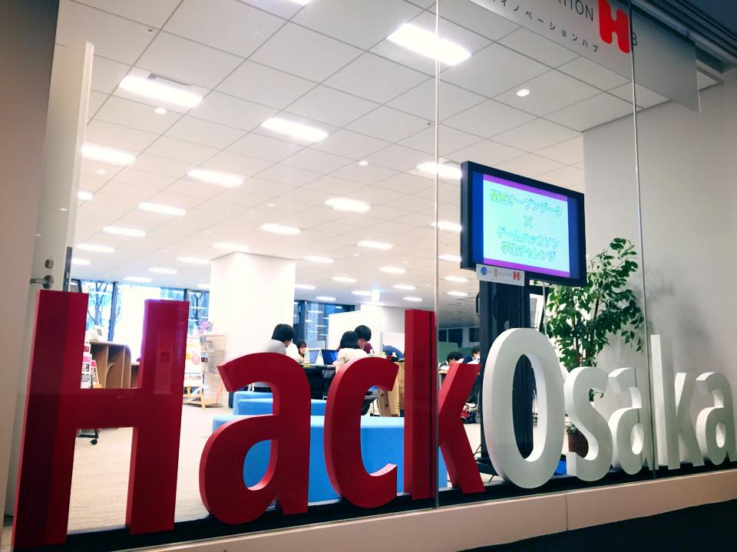
Osaka Innovation Hub

Slide 5
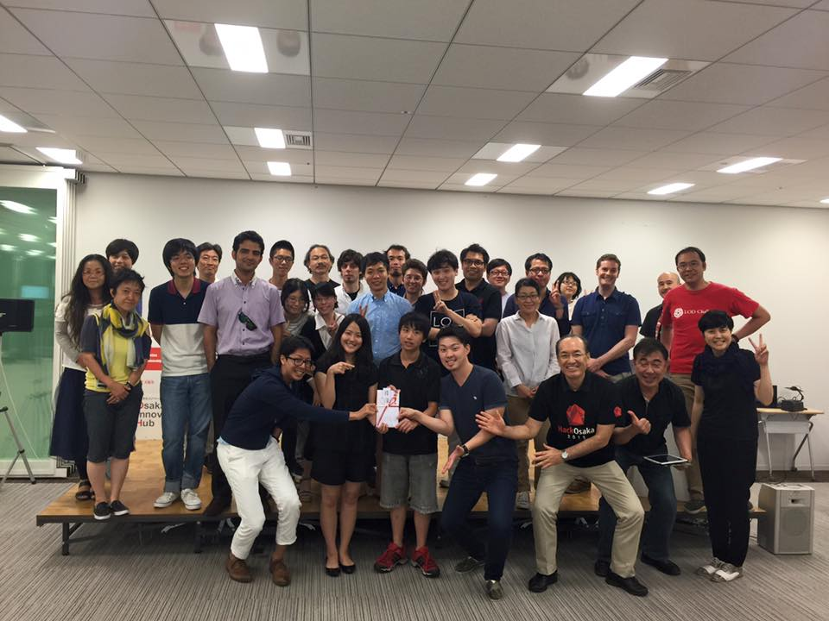
Osaka Innovation Hub
MashApp!Kansai Hackathon Problem Solution for Foreigners English Only Hackathon

Slide 6
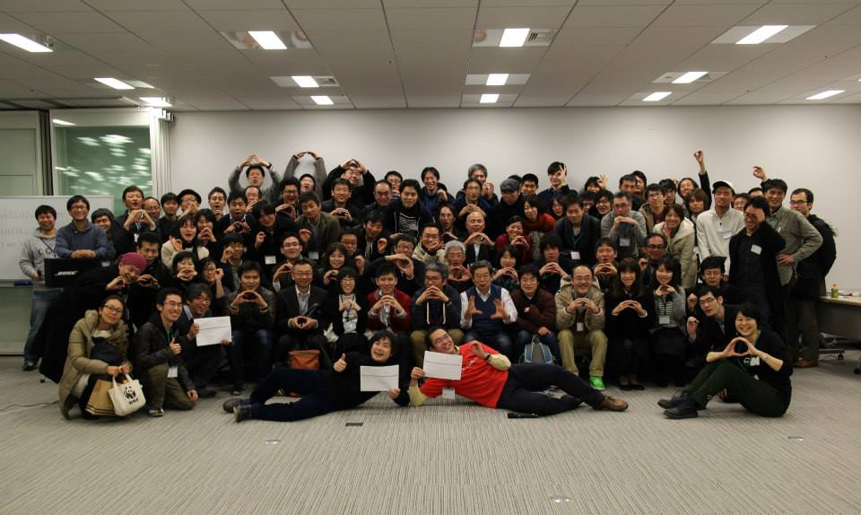
Osaka Innovation Hub
Kansai Open Data Expo ‘15
All Kansai！

Slide 7
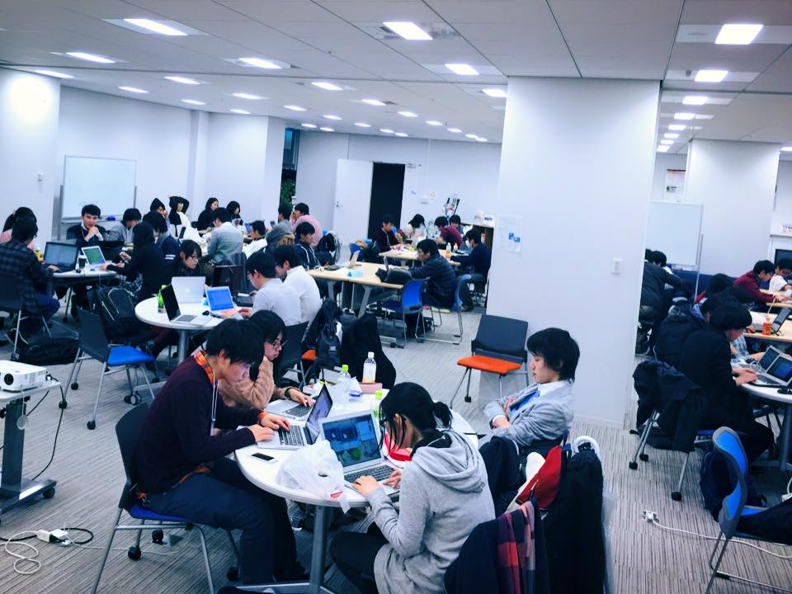
Osaka Innovation Hub
Open Data ×Game Hackathon

Slide 8

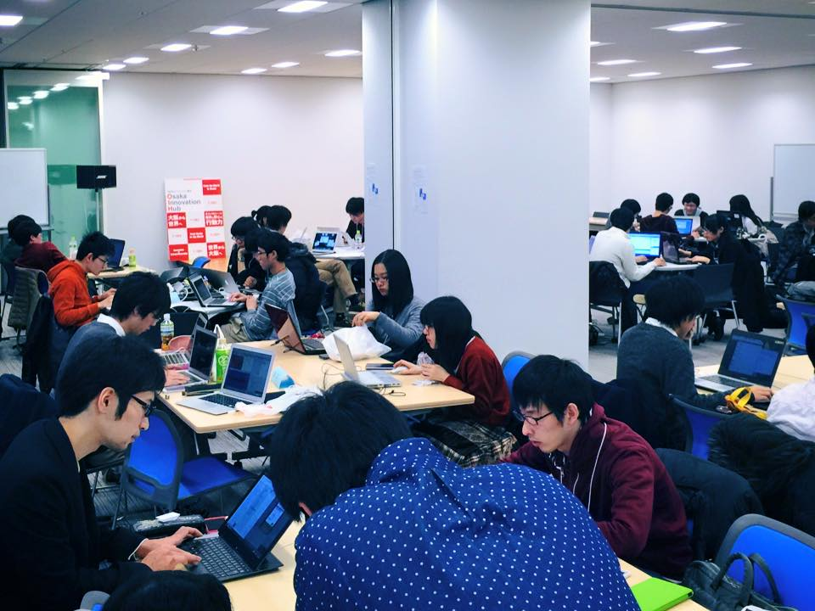
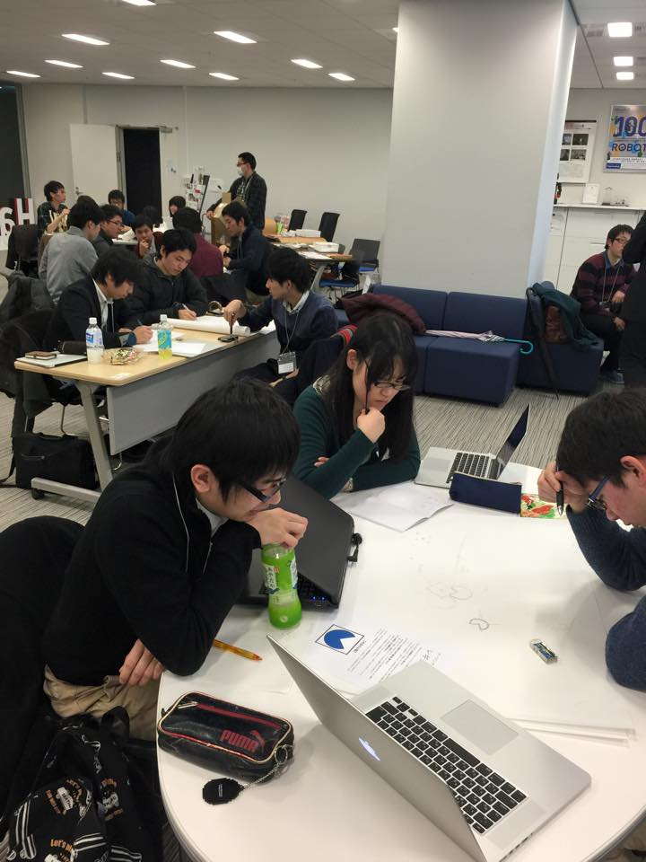
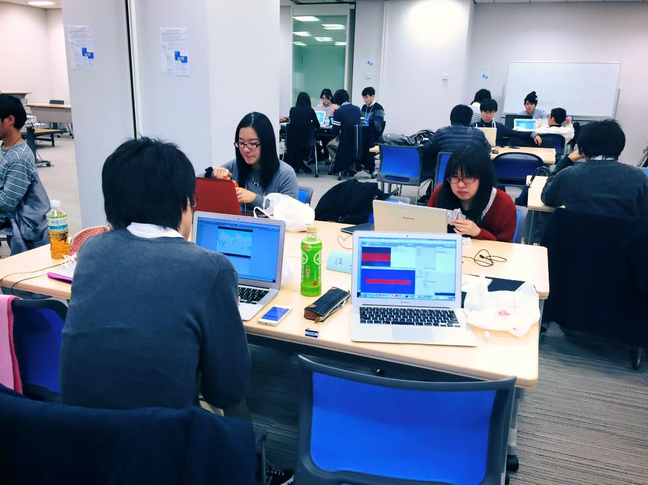
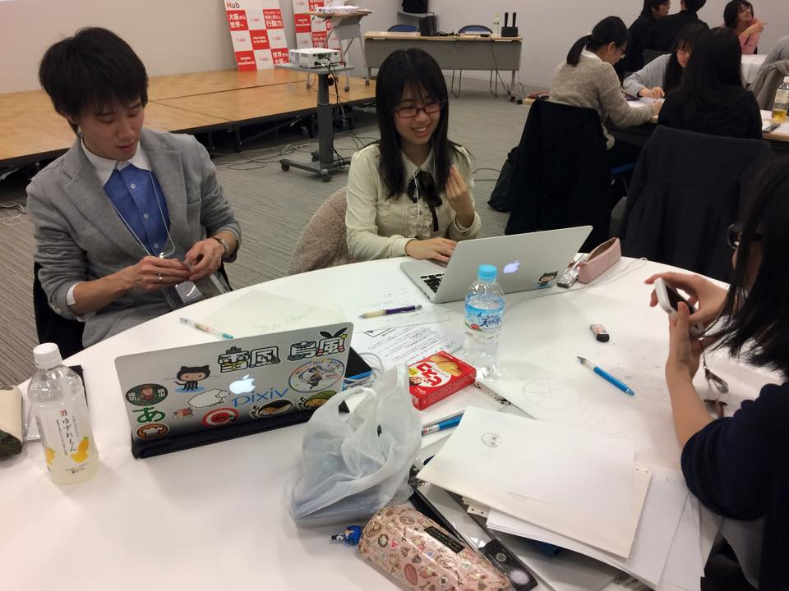
Osaka Innovation Hub
Open Data ×Game Hackathon

Slide 9
Osaka Innovation Hub(OIH) is the base for innovation inaugurated in May 2015.Based on the Osaka Innovation Declaration, we challenge innovation creation activity. We praise those who solve social problems, change the era, innovate things. We assist those who continue to challenge without being afraid of failures. We support those in finding partners and in creatingprojectr projects by organizing various events such as hackathons, workshops, and Sillicon Valley tours. We create Osaka full of people who plan, act themselves and organize themselves in networks, and open to the rest of the world.
Open Data is one of the areas of our challenging efforts . Innovate ! Osaka running OIH was inaugurated in February 2014 and started activities as ODI Osaka actively to cope with Open Data.
Notes:
9

Slide 10
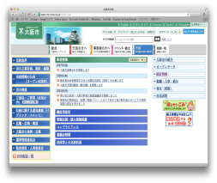

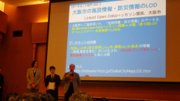
OIH’s Open Data related Initiatives in fiscal 2013
From Technology Workshops on linked Open Data to Game Hackathon, tourism, Public Relations and Civic Hack
○Study Meeting on Open Data and Social Design
Date：July3, 2013
The venue is always Osaka Innovation Hub, Grand Front Osaka
○ The First Linked Open Data Hackathon Kansai
Cosponsored by LOD Challenge Day Executive Committee/NPO LODI
Date:October 19,2013
○ The Second Linked Open Data Hackathon Kansai
Date: December 6,2013
◯The Third Linked Open Data Hackathon Kansai
International Open Data Day Kansai Pre-event
Date: February 11(Tuesday),2014 11:00～19:30
Outlines：Introduction of Open Data Activities of Various Regions of Kansai, Speech on Technological Aspects, Ideathon
◯The Third Linked Open Data Hackathon Kansai
International Open Data Day Osaka
Date：February 22(Saturday)2013 11:00〜19:00
Outlines ：Hackathon and Datathon based on the result of Ideathon of February 11
Presentation on UK ODI City Node
Osaka City Data Transformed into Open Data
January 2014
Osaka Certified as Asia’s First City Node
February 2014
LOD Challenge Japan 2013
Osaka City Team received “Challenge Day Prize”
LOD of Facilities Information & Disaster Prevention Information of Osaka City
（LOD Hackathon Kansai, Osaka City）

Slide 11

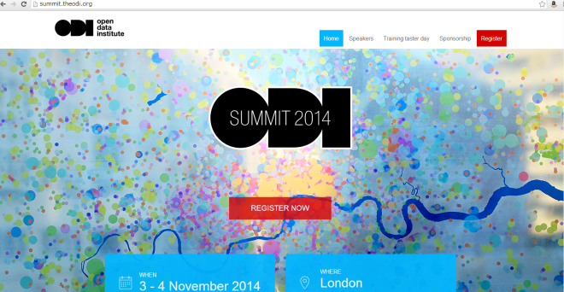

Open Data Related Initiatives of OIH in Fiscal 2014
○ The First Mozilla x HTML5 x LODI Web Innovation Hackathon, Date:June 28,29, 2014
○ The Second Mozilla x HTML5 x LODI Web Innovation Hackathon, Date:July 19,2014
○ The Third Mozilla x HTML5 x LODI Web Innovation Hackathon,Date: September 14,15,2014
◯ The Fourth Linked Open Data Hackathon Kansai, Date: December 2014
◯ ODI Summit
Date: November 3,4,2014 (UK)
ODI Date:November 5,2014日International City Node Meet-up Participation & Presentation Date: November 5,6,2014(UK)
◯ International Open Data Day Pre-Event
EXPO’15Kansai Open Data Expo’15
Date: February 21,2014
◯ International Open Data Day
The FIfth Linked Open Data Hackathon Kansai, Date:
Date:February21, 2014
○ Open Data ×Game Hackathon
Date: February 22,28 and March 1,2015

Slide 12

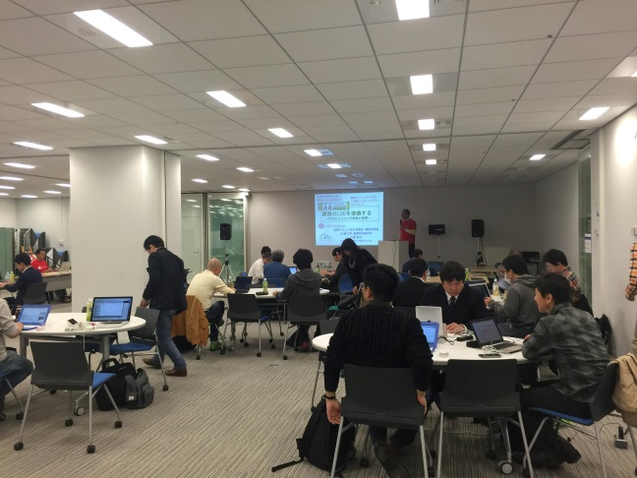
Open Data Related Initiatives of OIH in Fiscal 2015
○ The Sixth Linked Open Data Hackathon Kansai
Date: July 8,12,2015
Tourism& Tourism Events ×Open Data Hackathon
○The Second Kansai Mash App!Vol.2
Date: August 2,7,9, 2015
Inbound Appli Developed to support “Enjoy Oneself, Spend Time &Live in Kansai” by Combining Various Open Data and API
○ CitizenLab Meetup Organized
Meetup with Belgium Originating Open Data Startup
◯ ODI Summit
Date:November 3, 2014(UK)
ODI International City Node Meet-up Participation & Presentation
Date: October 29,30, 2014(UK, ODI Headquarters)
○ Kansai Open Data Day –Oshitan Day for Searching Open Data on the Internet （翻訳者注） ？？？
Date:November 23,2015
SPARQL Internet Search Hands-On and Workshop
○ Osaka × GitHub Meetup
Date: December 15,2015
○ International Open Data Day
Expected Date: March5,2016

Slide 13

Open Data Institute
ODI：Open Data Institute (London, UK)
Non-Profit Organization Established By the UK Government in 2012、with Tim Berners-Lee as the Co-founder
Implement New Initiatives for Open Data Utilization
Promote the Opening of Data（Training, Issuance of Certificate）
Scout for Innovation (Organizing Contests)
Incubation (Incubation of ODI Start-UP)
International Cooperation （Establishment of ODI Node（Training, Issuance of Certificate））

Slide 14

ODI Node International Network
Osaka becoming a Member of International Network in February and participating as Network Node
20 Countries in the World ･･･As Compared with 13 Countries last Year27 Locations in the World･･Compared with 21 Location Last Year
Other Locations in Asia: Seoul(Korea), Queensland(Australia)
（Depending upon Regions, participated as Training Node for Organizing Seminars）

Slide 15
Open Data
Transparency
Efficiency
Innovation

Slide 16
What is ODI Osaka?
MISSION
・Organization Promoting Innovation through Open Data
・Support Business Start-Up Focused on Business Incubation
・Role of Hub Linking Japan with the World
・Support Open Data Business Originating from Osaka！！
ORGANIZATION
・Leadership Team Formed by Innovate Osaka, Umbrella Organization of Osaka Innovation Hub and NPO Linked Open Data Initiative
・Osaka City Government Administrative Department General Affairs Division ICT Strategy Group acting as Advisory Board
http://www.innovation-osaka.jp/ja/projects/5216

Slide 17

ODI Summit
Organized on November 3,2015
The Second
Innovation,
Data Visualization,
Best Practice,
ODI Startup Pitch,etc.

Slide 18

ODI Summit
20
Organized on November 3, 2015
Node Network Booth

Slide 19

ODI Summit
Organized on November 3, 2015 ,Participated by Approximately 700 People with Tickets Sold out

Slide 20
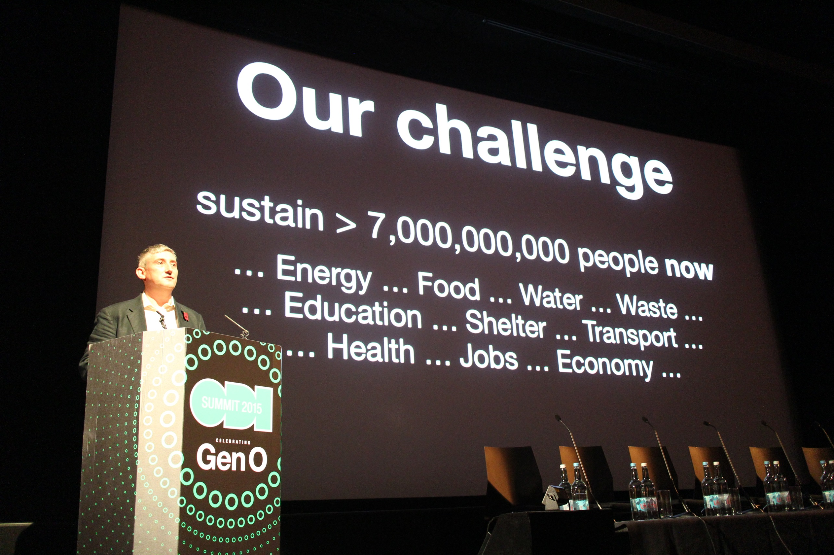
ODI Summit
Domains For Challenges in Open Data

Slide 21
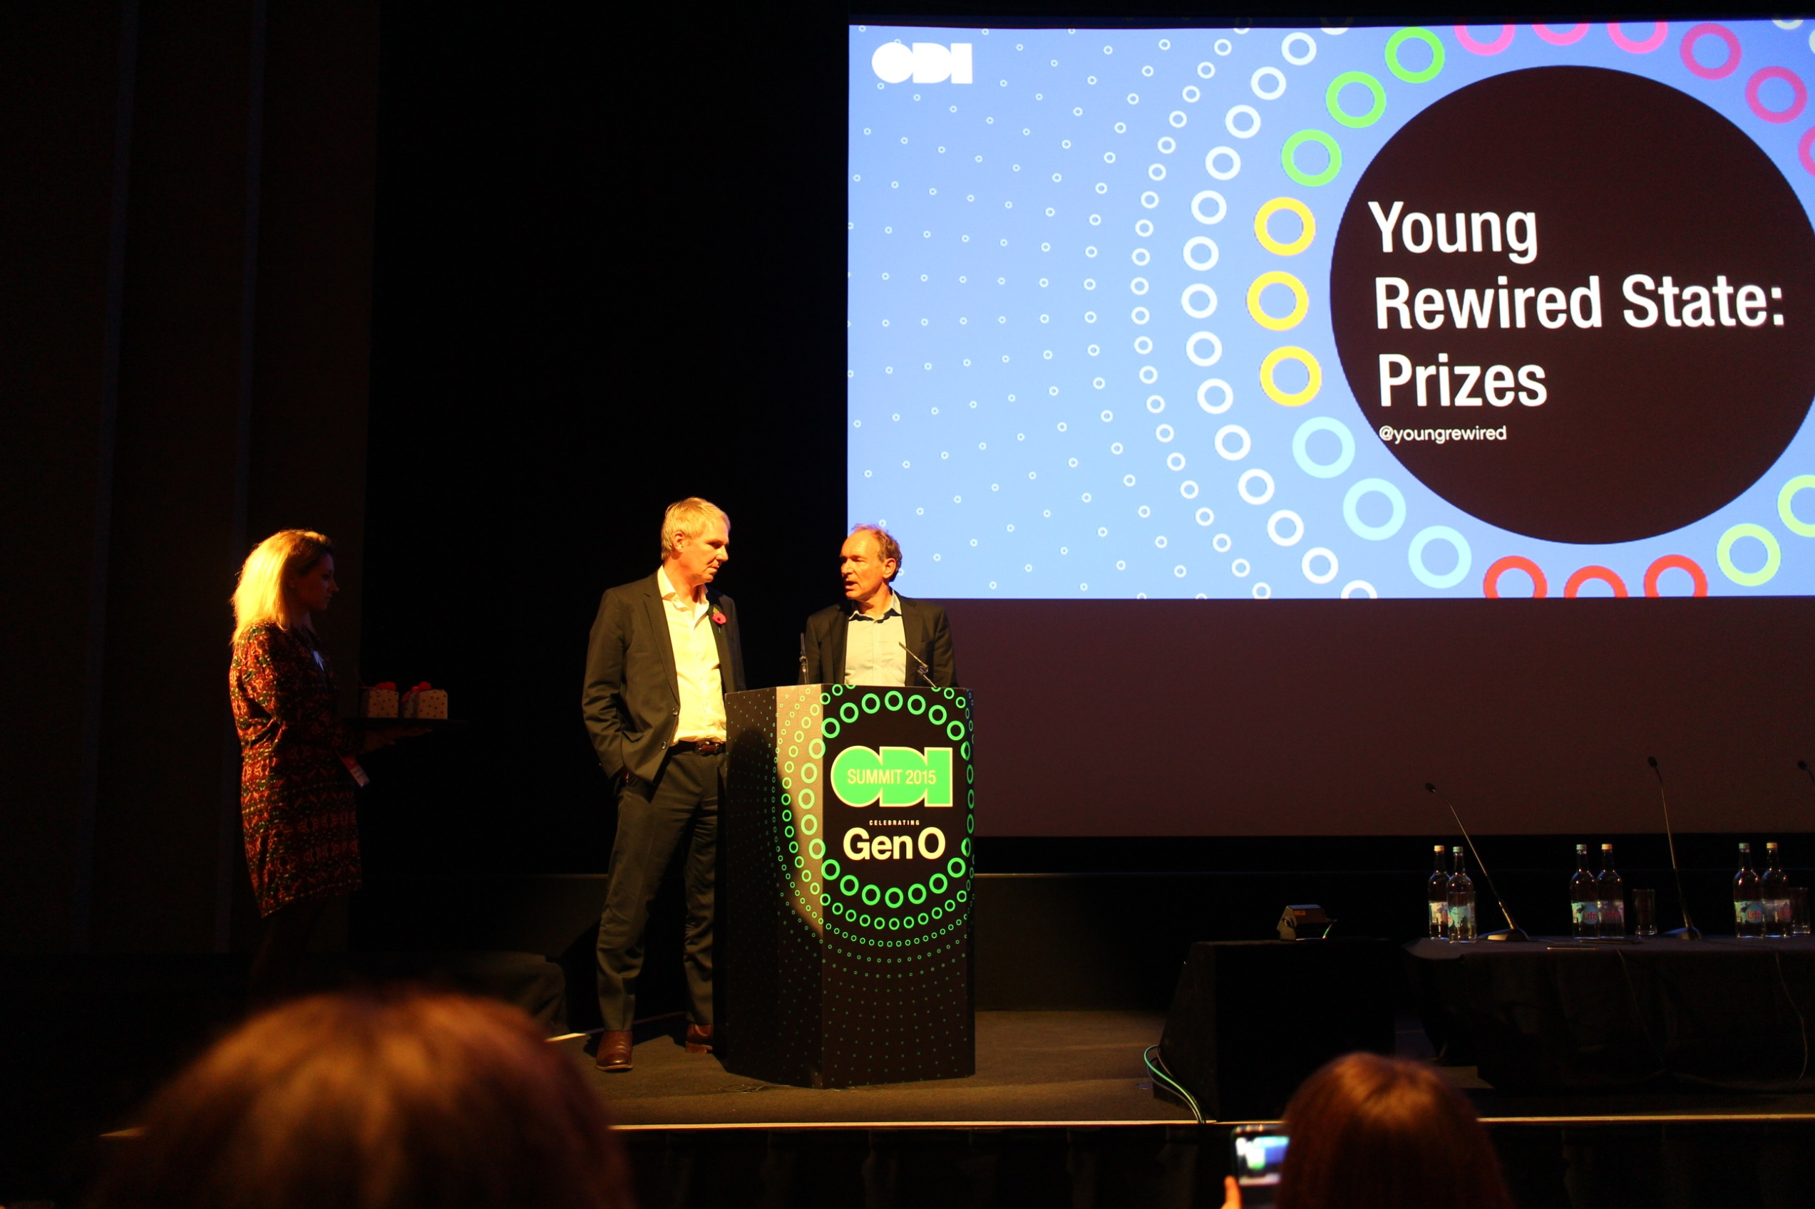
ODI Summit
Sir Nigel Shadbolt
Tim Berners-Lee

Slide 22
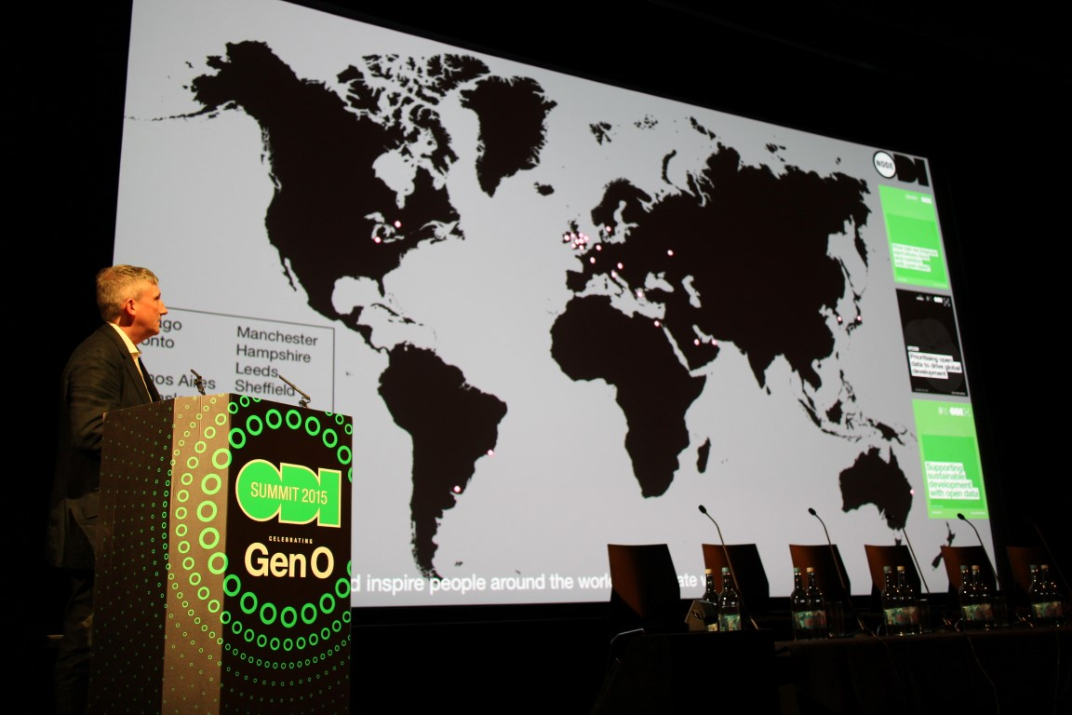
ODI Summit
ODI Nodeが紹介
20国27拠点

Slide 23
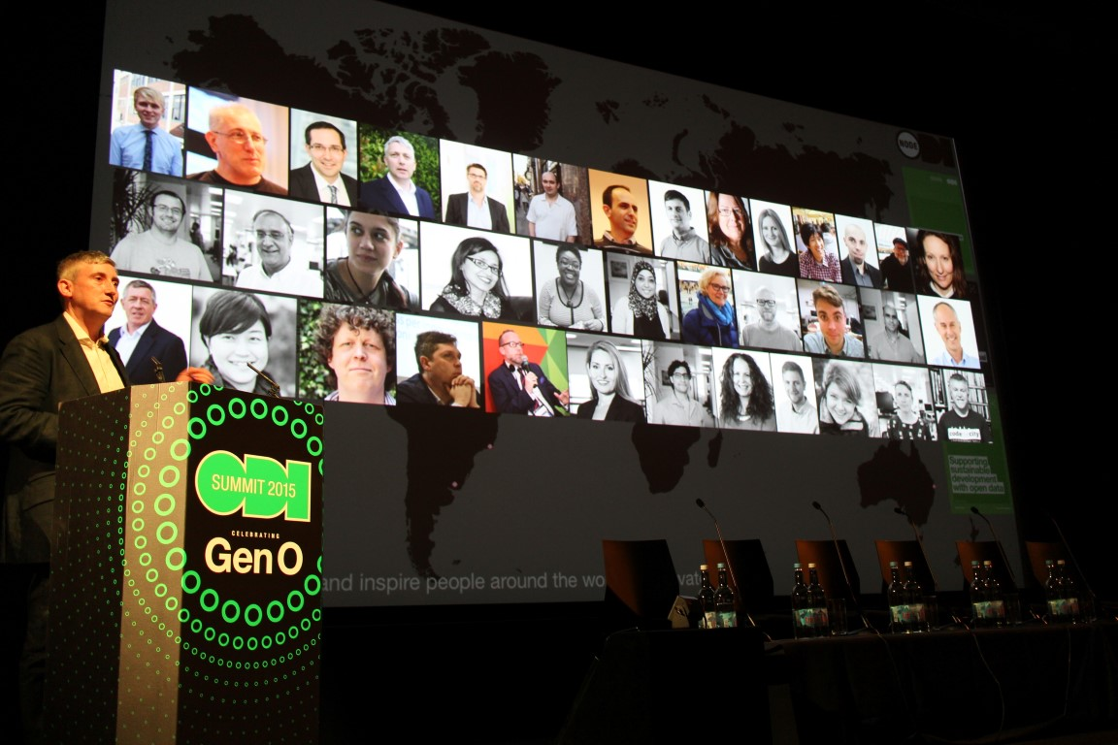
ODI Summit
Introduction at ODI Node: Facial Photographs of Delegates from Participating Countries

Slide 24
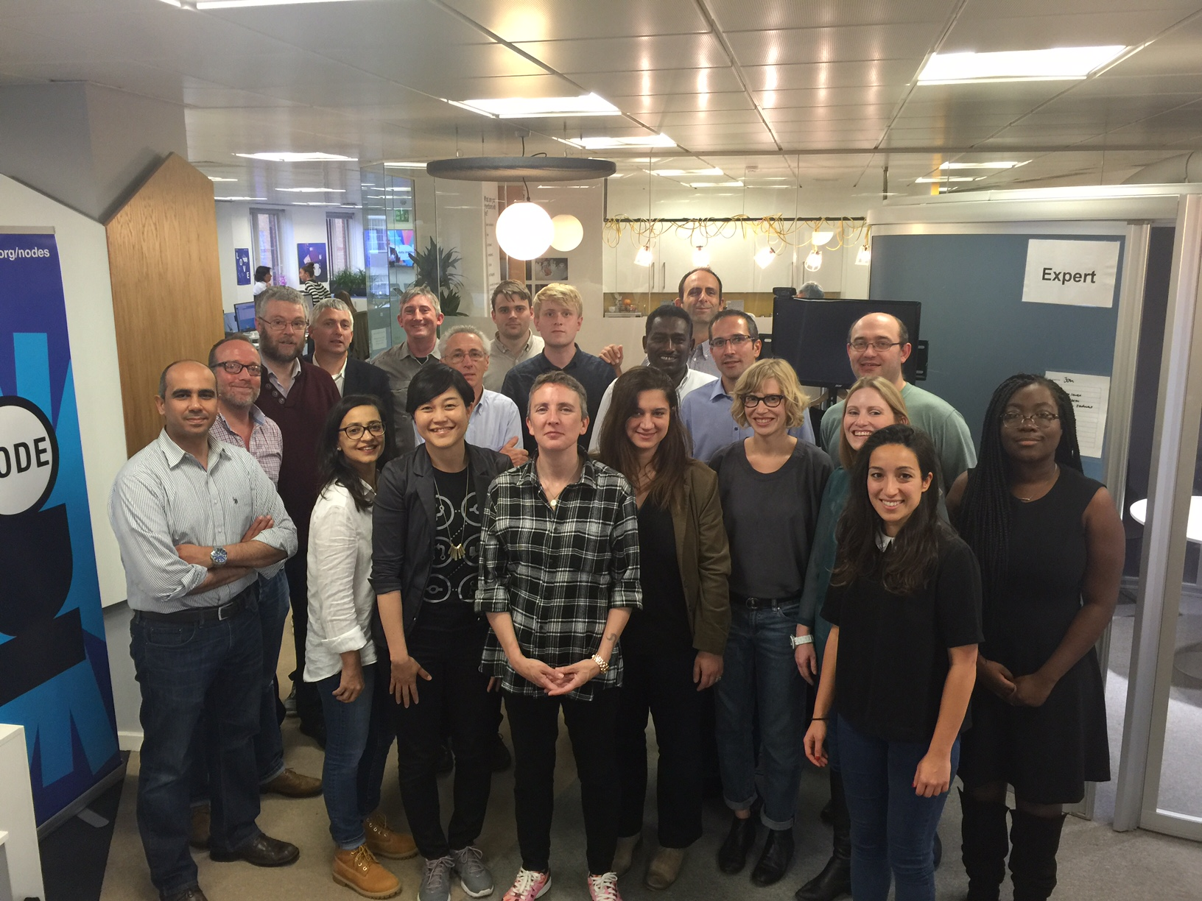
ODI Node International Strategy Day
Meet-up of ODI Node Organized Every Half a Year(ODI Headquarters in London

Slide 25

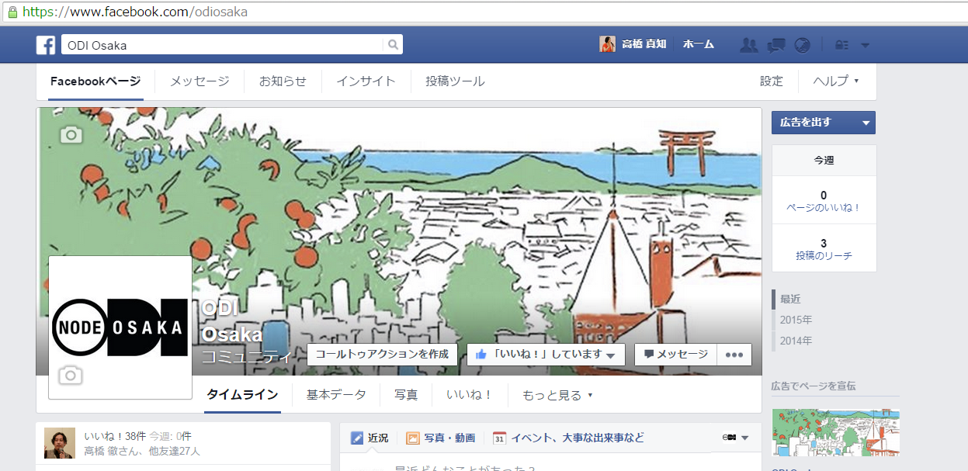
Osaka Innovation Hub 3-1Ohukachou, Kitaku Osaka City 530-0011 Grand Front Osaka Knowledge
Capital Power C 7 th Floor Tel:06-6359-3004(Monday-Friday 10:00-18:00 ecept Year End & New Year

