Slide 1

Utilization of Open & Big Data
for Regional Vitalization in Japan
Toshiyuki Minami
Director-General for Policy Planning (ICT), Ministry of Internal Affairs and Communications
November 2015

Slide 2
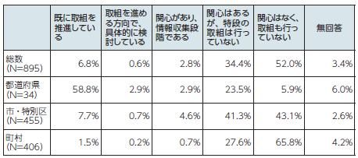
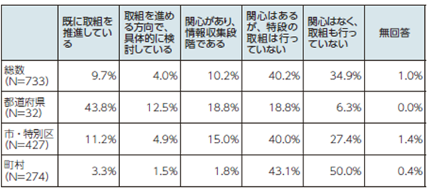
Approach to Open Data in the Government and Local Authorities in Japan
1
1. Government’s Approach
○ In June 2014, the concrete targets regarding open data, namely “Realization of the World’s Top Level Contents of Open Public Data (more than 10, 000 data sets) within the Fiscal 2015” and “Inauguration of Full-Scale Operation of a Data Catalogue Site in the Fiscal 2014” were proclaimed in the “Declaration of Creation of the World’s Cutting-Edge Information Technology State (Rev.)” in the “Japan Revitalization Strategy (Rev. 2014)”.
○ Hence, the full-scale operation of the government’s data catalogue site “DATA.GO.JP” started in October 2014, and the data set volume has already reached 14,731 sets in September 2015.
2. Local Authorities’ Approach
○ Local authorities enthusiastic about open data have been on the rise, and as many as some 180 authorities are currently working for the promotion of open data.
○ A number of local authorities including cities of Yokohama, Chiba, and Sabae have already set up their own data portal sites for making their data open to citizens.
Situation of Open Data Activities of Local Authorities
＊Excerpt from “Research on ICT Utilization in Regions in Japan” MOIAC, 2014

