Slide 1
1
The forerunner in open data
“Weather Information”
2
Our service
-- Challenges for HALEX--
3
Three examples of practical use

Slide 2





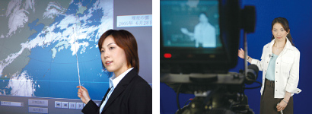
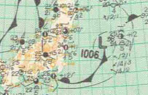
In 1993, the weather business was first opened to the private sector
1940
1960
1980
2000
2010
Changes in ICT
Telegraphs and telephone
＞＞
Radio
＞＞＞
TV
＞＞＞＞
ＰＣ/cell phone・
＞＞
Mobile terminal
Individuals
Users
Personal use skyrocketing!
Governments and organizations
Weather information is required to match changes in ICT and social needs
Delivery of information
Meteorological Agency の天気forecasts
Observation/weather chart
HALEX’s proprietary weather system
Confidential information
Same everywhere
Individual needs
Dedicated information
Closed
＞＞＞
General information
＞＞＞＞＞＞＞＞

Slide 3
Section in charge
Information Promotion Office!
Meteorological Agency
Meteorological Agency wants
as many industries as possible to use its information!

Slide 4
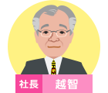
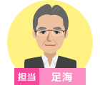
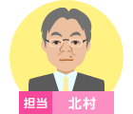


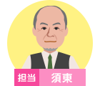

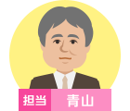











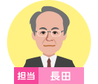
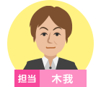





The forerunner in open data
Do open data ever have a future when we are unable to do business based on weather information?
We aggressively engage in daily activities with “guts and pride”!

Slide 5
1
１
Top forerunner in open data
“Weather Information”
２
Our service
--Challenges for HALEX--
3
Three examples of practical use

Slide 6
￥
Open
Carry out business by taking advantage of open data
Data
This means
Aggressively
Compete against Free Services!

Slide 7
付
加
価
値
Added Values
No clients will be interested in us if we do not offer added values!
Then…
What added values can we offer?

Slide 8

Previously
“General forecasts” released to mass media by Meteorological Agency
1
to
N
B to C
Base
weather data
Private
weather company
Meteorological Agency
Clients
Distributed without charge
Information
‘
Primary processing
Secondary processing
Information
TV
Radio
HP
Ready-made information
Fine processing
Only “free” information is provided

Slide 9
Originally
Only a private weather information company can do this!
“Forecasts for you”
1
to
1
B to B/B to G
Meteorological Agency
Base weather data
HALEX
System company
Clients
Cooperation
Processing on demand
Primary processing
Raw materials
S
Issues
Provides solutions

Slide 10
By introducing weather information into the business of clients, we deliver “Effects”!
These are
the added values we can offer

Slide 11



Business of clients
Effects
Business know-how
Function
Our service
×
Weather information
＝
Efficacy
Performance
Analytics
(Power to make assumptions)
Protect
firmly
Earn more
Big Data
Save more
To meet different customer needs, how should we loot at open data?

Slide 12
1
１
The forerunner in open data “weather information”
２
２
Our service
--Challenge for HALEX--
３
Three examples of practical use

Slide 13
1. Business with Keikyu Corporation

Slide 14
Protect firmly!
Fully use precipitation data
to prevent missing information!

Slide 15
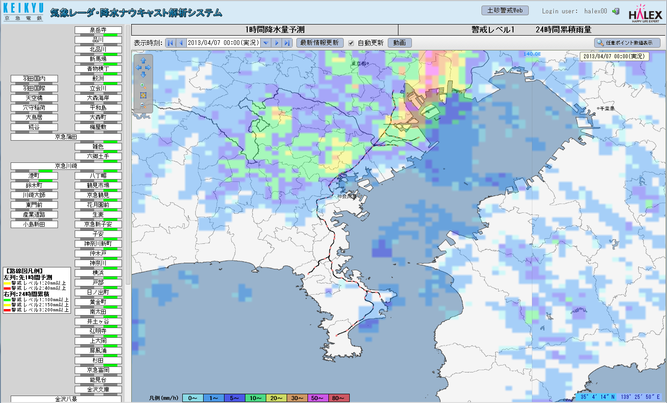
Click
Rain clouds are shown in tiles
1km×1km

Slide 16
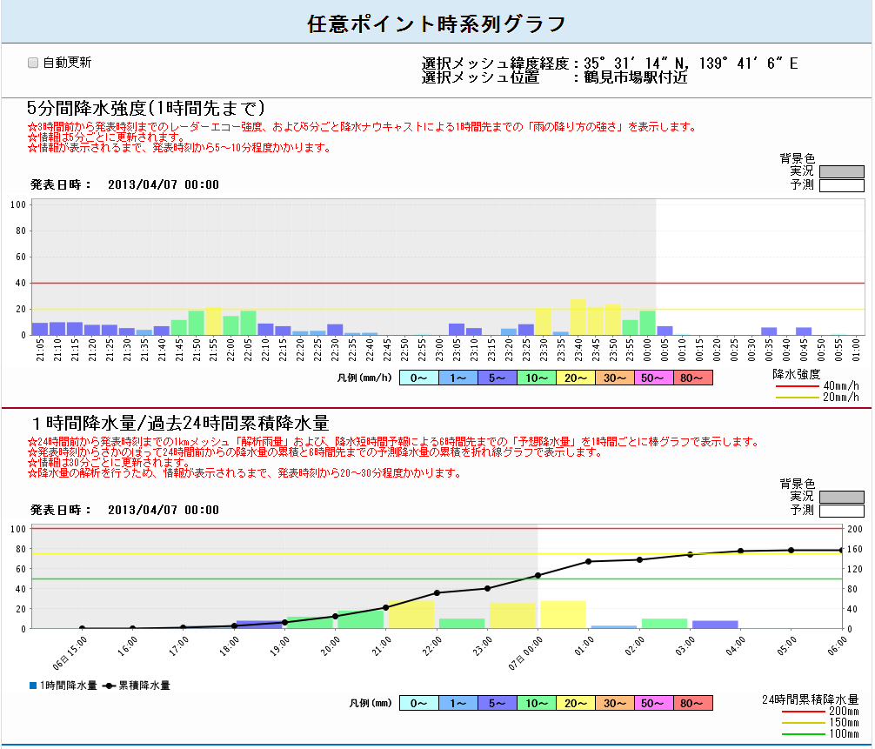
“Rainfall intensity change” for up to 1 hour
Accumulated amount of rainfall for the past 24 hours + the future 6 hours
You can see by mesh hole how the rain may fall

Slide 17
At these stations
When you detect an excessive amount of rainfall on any line

Slide 18
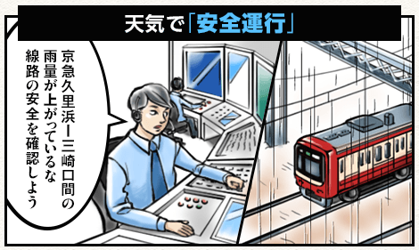
新大津
北久里浜
路線図上
危険箇所に
アラームが現れ
京急久里浜
YRP野比
京急長沢
雨量自動監視と危険の見える化
Visualize the automatic monitoring of rainfalls for the amount

Slide 19
2. Business with an agricultural corporation

Slide 20
Protect firmly!
Save more!
Earn more!
From now on,
weather information is ”the strongest weapon” for agriculture

Slide 21

Natural environments surrounding agriculture
Soil
Biological environment
（pests, weeds, etc.）
Weather
地形･地理
weather
Topology/ geography
Pay attention!

Slide 22
In agriculture, what is affected by weather?
Selection of varieties of plants
Growth diagnosis
Regional differentiation
Growth prediction
Protection against diseases and pests
Adjustment of planting/shipping time
Protection against abnormal weather
Fertility management
Strategy
Tactics

Slide 23
Utilization of weather information
Quantitative management of agriculture
Strategy
Tactics
Planning of an agricultural management strategy
Daily management
(Quantitative management)
Understanding the trends
Monitoring the conditions
Long- and mid-term forecasts （1 month, 3 months, warm/cold seasons）
Instantaneous forecasts （6 hours, 1 hour）
Past weather observation data
Short-term forecasts （weekly, 72 hours, 24 hours)
Regional characteristics
Recorded data (e.g., temperature change, accumulated temperature, sunlight hours)

Slide 24
Added values we must create
Strategy
Tactics
Earn more!
Protect firmly!
Save more!
可能性のコンサルティング
weather 予測→気候予測
想定リスクの提示
代替手段の推奨
Consulting on possibilities
Weather prediction→climate prediction
Presenting potential risks
Recommending alternative measures

Slide 25


We have information long required by farms
The future of agriculture is changing
Currently under demonstration testing in Ehime Prefecture
Ehime Prefecture delivers
The world’s first “Weather Forecasting System for Agriculture”

Slide 26
3. Business with a leading advertising agent

Slide 27
Earn
More!
Use of seasonal forecasts
Launching advertisements in a timely manner!

Slide 28
An example of a leading maker of men’s clothing

Slide 29
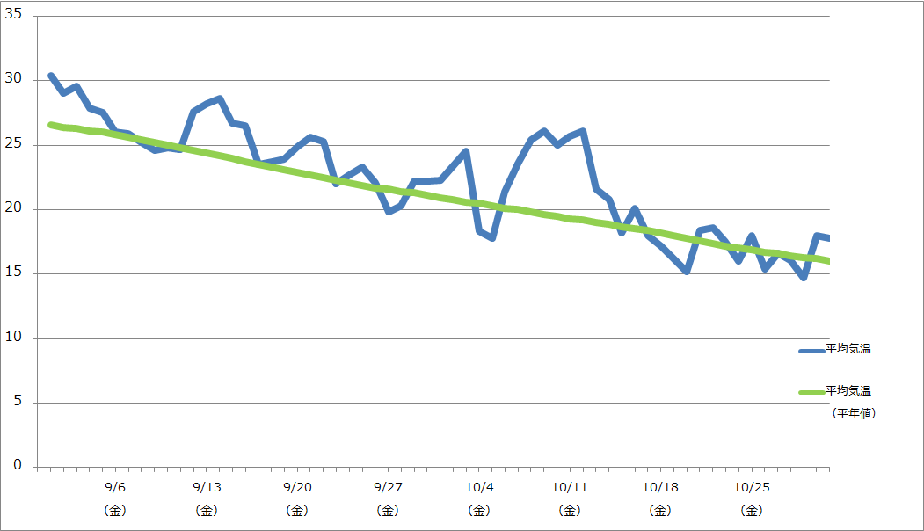
Launching TV commercials as usual for fall/winter campaigns
平気気温
25度以上
The highest temperature exceeding 30°C
Temperature changes from end of September to October, last year
Best timing for TV commercials
Timing mismatch in advertisement!

Slide 30
A decision on launch of commercials made
３ weeks before
Little known
Monthly Forecasts used

Slide 31
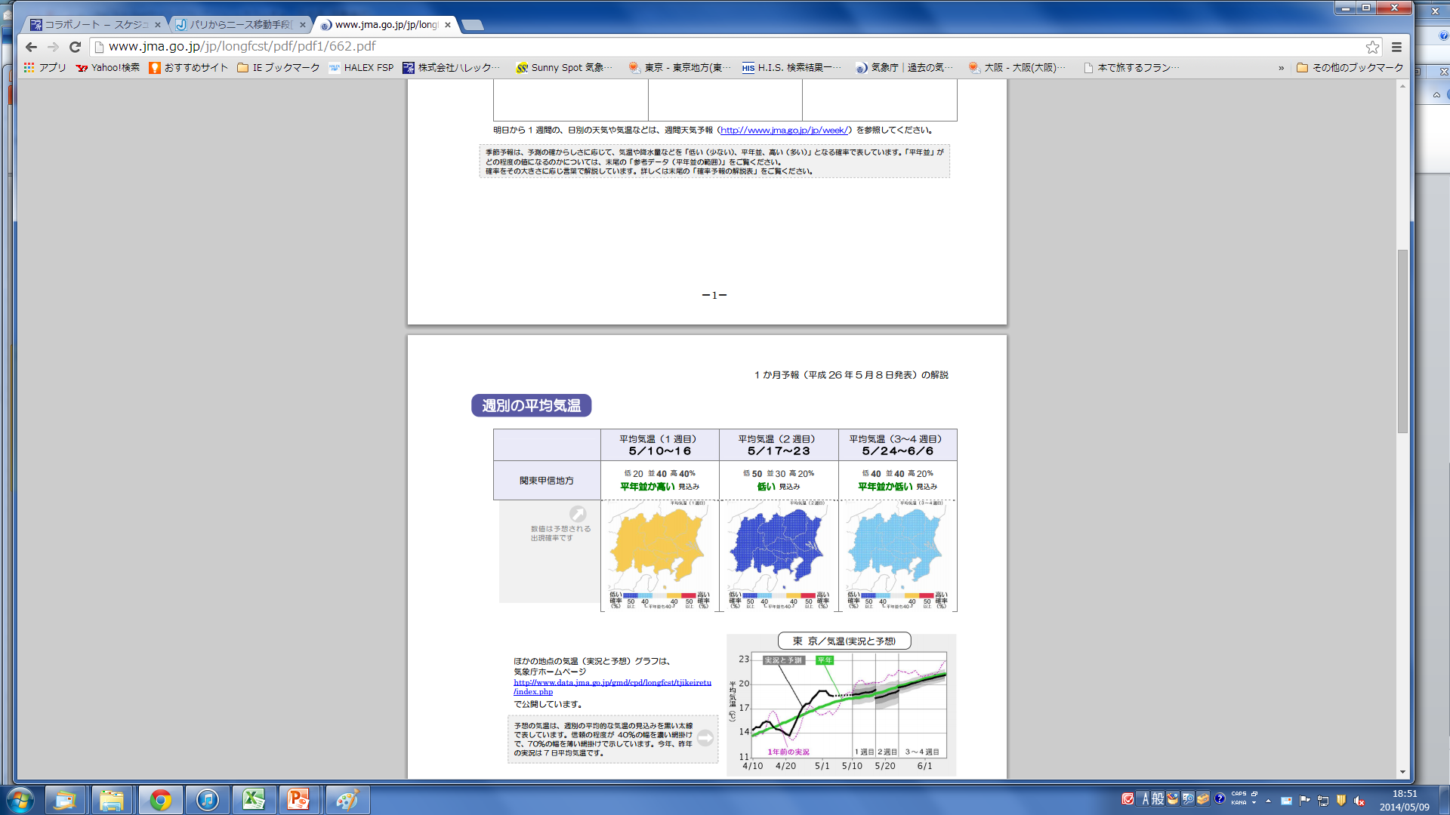
“Monthly forecasts” posted on the Meteorological Agency homepage
Unusable!

Slide 32
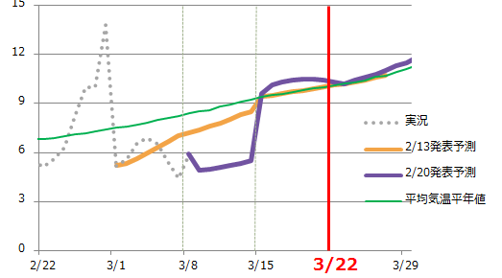
Verification materials
Sales personnel are also weather foprecasters
Meteorological Agency’s “forecasting trend” analyzed and explained with the skill of a weather forecaster
Our services are based on our
“ability to analyze and understand data”

Slide 33
Finally

Slide 34


Techniques for using information＝Intelligence
IT
Intelligence
Technology
＝
Information
Technology
Amalgamate into

Slide 35
Open data are useless when they are simply looked at
clients の目的･要望に応じて
データを読み解けるかが
最大の鍵！
The greatest key is whether data can be analyzed to meet the purpose and needs of individual clients

Slide 36

Thank You

