Slide 1
Our first in Japan
Create common sense of near future
Saga prefecture
December 3, 2014 Open Data Symposium
Toshio Morimoto
Chief Information Officer, Saga Prefecture

Slide 2
Saga is the first in Japan!

Slide 3
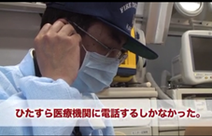

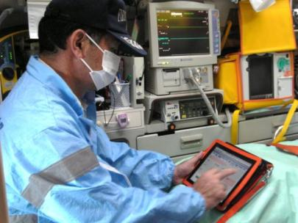
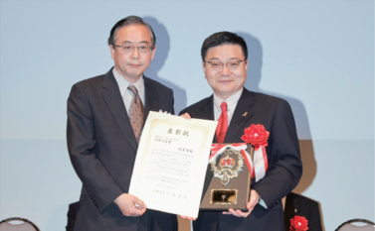
救急搬送の情報革命 ～iPadが命を救う～
Information revolution of emergency transportation
iPad saves life
Shorten the emergency transport time for 1 minute by ICT technology utilization!（34.3min→33.3min)
BEFORE
Keep calling the emergency hospital
AFTER
Confirm the information immediately with iPad.

Slide 4


Hokkaido
８
installed
27
Under
consideration
Aomori
Akita
Iwate
Ishikawa
Yamagata
Miyagi
Niigata
Gunma
Fukushima
Yamaguchi
Shimane
Tottori
Hyogo
Kyoto
Toyama
Tochigi
Ibaragi
Hiroshima
Okayama
Fukui
Gifu
Nagano
Saitama
Nagasaki
Saga
Fukuoka
Osaka
Shiga
Chiba
Yamanashi
Tokyo
Kumamoto
Oita
Ehime
Kagawa
Wakayama
Nara
Mie
Aichi
Shizuoka
Kanagawa
Kochi
Tokushima
Miyazaki
Kagoshima
Okinawa

Slide 5
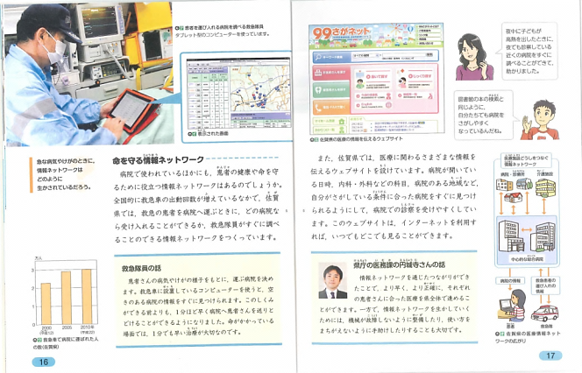

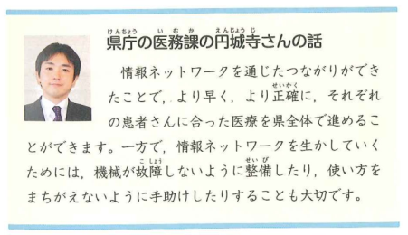
Work of 99 Saga Net was published to text books
Mr. Enjoji, Medical affairs section,
Saga Prefectural Government
Advance medical treatment for patients can be applied through the prefecture, even faster and more effectively as a result of creation of the information network. On the other hand, it is important to maintain a machine to avoid failure and to help utilization to prevent from a wrong operation.
KYOIKU-SHUPPAN
FY 2015
5th grade, Elementary school,
Social studies, Volume II

Slide 6
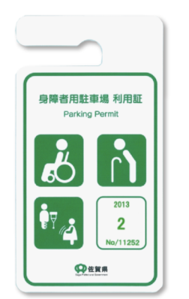


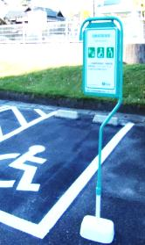
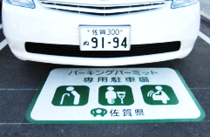

佐賀県発、全国に広がる ～パーキングパーミット～
From Saga, spread throughout the country
Parking Permit
Disabled Parking
Parking Permit
Disabled Parking Sign
Cooperative facility
1767
（within the prefecture）
Disabled Parking
Parking Permit
相互利用
31自治体
Interoperable utilization 31 local governments
Use of this disabled parking is only permitted to the person who has the parking permit issued by Saga Prefectural Government.
Facility is managed by

Slide 7

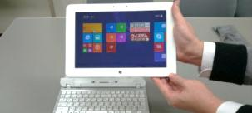



Introduction of ICT utilization into education at public schools
Electronic blackboard
Tablet
Introduced in all classrooms from last year
Introduced into all students from this year
(From freshman in high school)
Systematization of management for the learning, teaching materials and school affairs
Registration
Leaning & teaching materials
Management system
Link
School affairs
management system
Distribute
exam and homework
Submit exam and homework
Deliver the learning result
Learning result
processing
Statistical
processing
Preparation of
teaching materials
Learning history
reference of learning level
conduct the exam and homework
Preparation of academic report
Preparation of
materials
Support teachers to prepare teaching materials and handouts

Slide 8
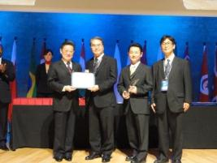
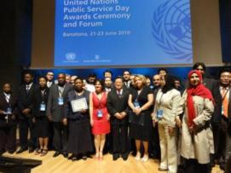
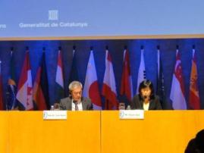
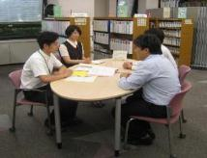
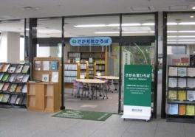
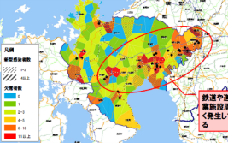
新しい行政のカタチ、世界へ ～日本初、国連公共サービス賞受賞～
Introducing new work styles of public administration to the world
Saga prefecture was the first in Japan to receive the United Nations Public Service Awards
Collaboration testing
Collaboration research
Consignment of general service management for residents
Mapping the infection status of influenza
50% increase in visitors ↑
80% increase consultation↑

Slide 9
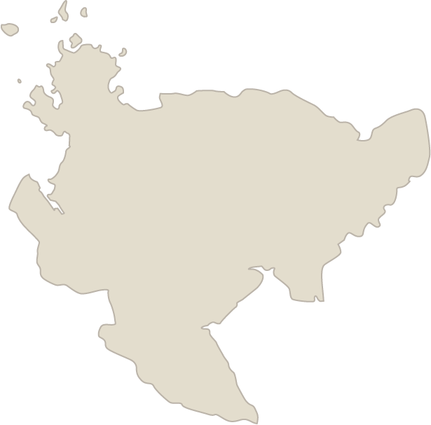
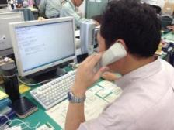
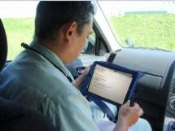

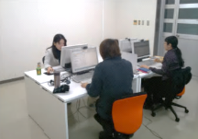
佐賀県庁「どこでもオフィス」の実現 Setting up “mobile office” of Saga prefecture
Office
Outside office
ＩＣＴ infrastructure development
Access to prefectural office
Communication tool
One ＰＣ per stuff
Mobile terminal device
Transmission & sharing of
pictures and video
Home
Satellite office
Presentation application
WEB meeting system
Remote access
13 offices
in and out of Saga prefecture
Telework is operational from this October for all officials (3000 officials) in prefectural office.

Slide 10

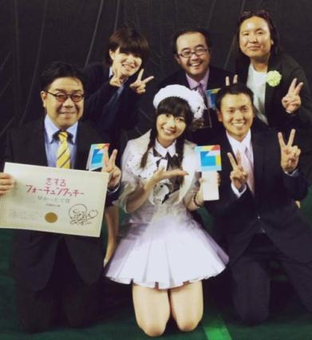
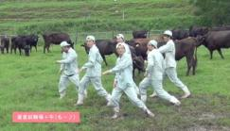
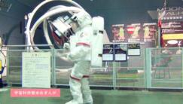
動画で情報発信
Information transmission by video
①Fortune Cookie in Love（AKB48）
First local government to released the video.
It became popular in internet and was even introduced on TV and in newspaper.
Play count
Over ２２０
Million times

Slide 11

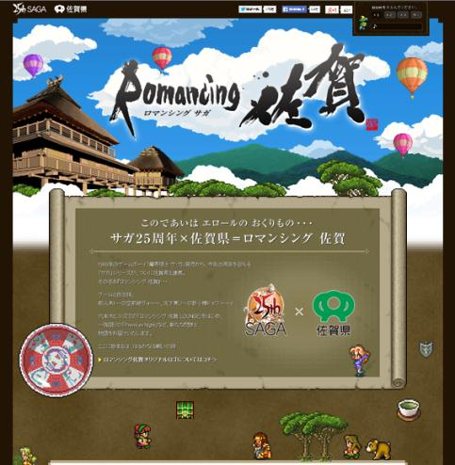
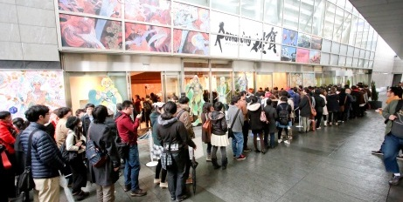
コラボによる情報発信
Information transmission by collaboration
①Romancing Saga
http://romasaga.jp/

Slide 12
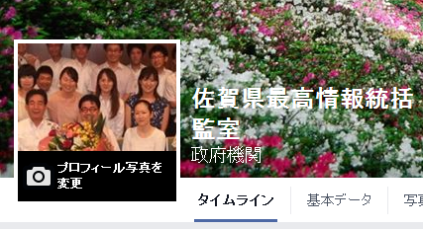
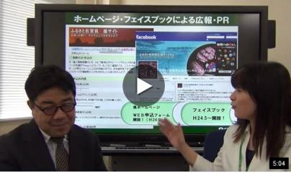


Facebook Chief Information Officer (CIO) in Saga prefecture
” Chief Information Officer (CIO) in Saga prefecture” was established on Facebook, June 6, 2014, to deliver the information of ICT implementation of Saga prefecture to nationwide
Introduction of the video
-ICT utilization promotion project.
Our implementation information such as “maintenance of free Wi-Fi environment maintenance” and “Telework promotion” is on the page. Please visit our website.
https://www.facebook.com/saga.cio.team
いいね総数 約8,000件
リーチ総数 約90,000件
投稿
10月末現在

Slide 13
Big data
Open data

Slide 14
Do-iT! Progress Situation of project
7/8
Press conference
11/8
Final Presentation of Dig
11/17
Interim report
Director General Group
Construction method of KPI
Making a book for analysis know-how
Base development
statistical analysis
division
Data utilization training
Examination of the training plan for human resource development
Dig
Open data
information &
work restructuring
division
Nagoya Castle Ideathon
Analysis of the preceding theme
Medical care
Medical economic division
Fire defense & disaster prevention division
Analysis of the data of 99 Saga net
Pottery
festival
Sightseeing commerce and industry
Arita CCI
Tourism association
Town hall
Planing to attract more people to Arita city
Data collection
Supporting the questionnaire plan
Discussion of data utilization
Airport Division
Sight seeing
Analysis of the preceding theme
Refer to the next page

Slide 15
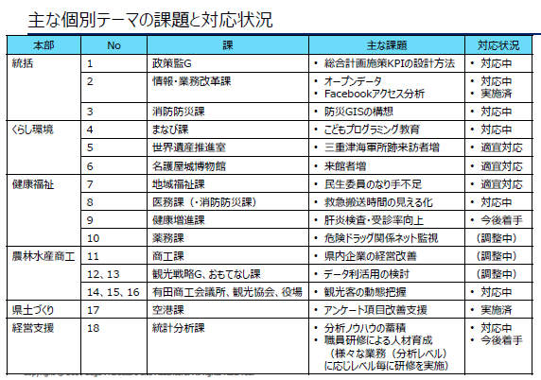
Considerations and correspondences of major individual subject

Slide 16
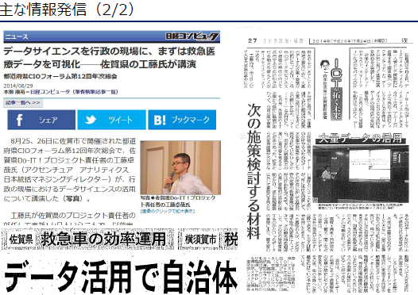
Transmission of main information

Slide 17
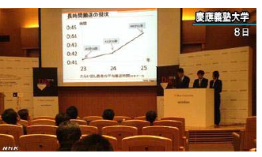
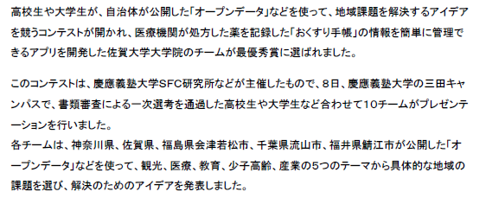
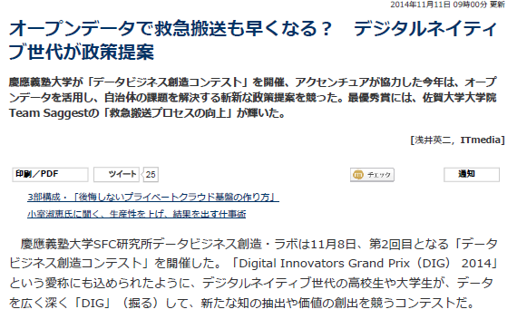
Digital Innovators Grand Prix (DIG)

Slide 18
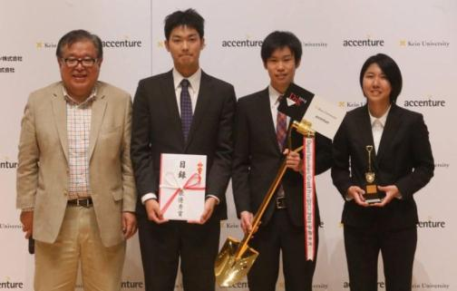
Graduate school of Saga University was awarded the highest award among 47 teams applied nationwide.
○The examination result of three teams which proposed a policy to Saga prefecture.
・Highest award: Improvement of the emergency transportation process by the open data analysis (Graduate school of Saga University team)
・Special judge award: Efficient placement of ambulances to shorten the time of urgent transportation (Graduate school of Tokyo University team)
・Award winning team:Youth on average age of 19 years challenge for Arita ware which is in business for 400 years. (Collaboration team of Keio University, Kyoto University of art & design, and Arita technical high school)
3

Slide 19
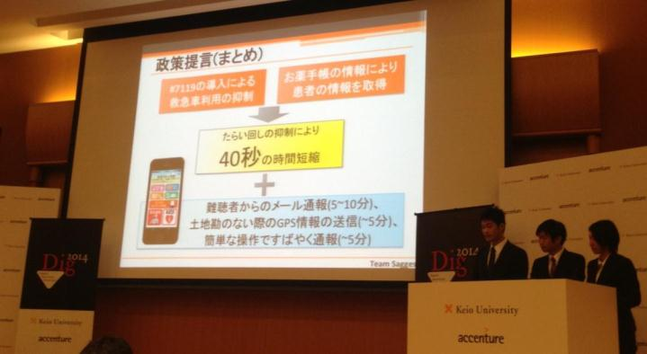
Saga prefecture was the first to apply utilization of iPad in ambulance, and the reduction of transportation time was proposed based on its detail data which exceeded 100,000.
Policy proposal based on “hands-on approach”, which included site visit of emergency operation room by courtesy of Fire Department of Karatsu, was highly evaluated.
4

Slide 20

Virtual Nagoya Castle Project
Nagoya Castle 2014
Ideathon

Slide 21
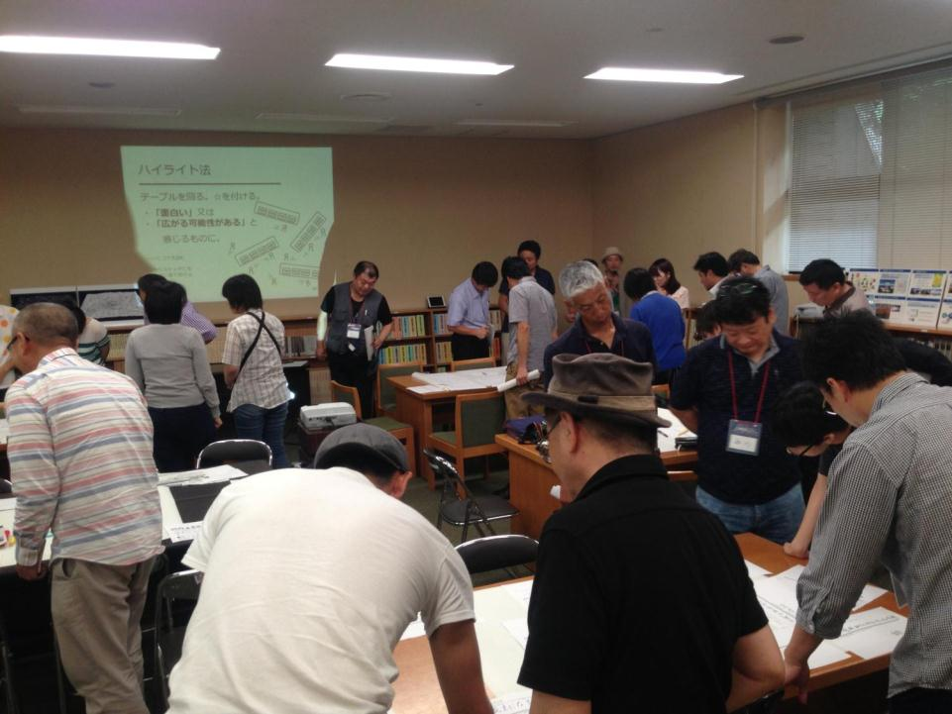
Ideathon was hold with open data of stored item and topography!

Slide 22
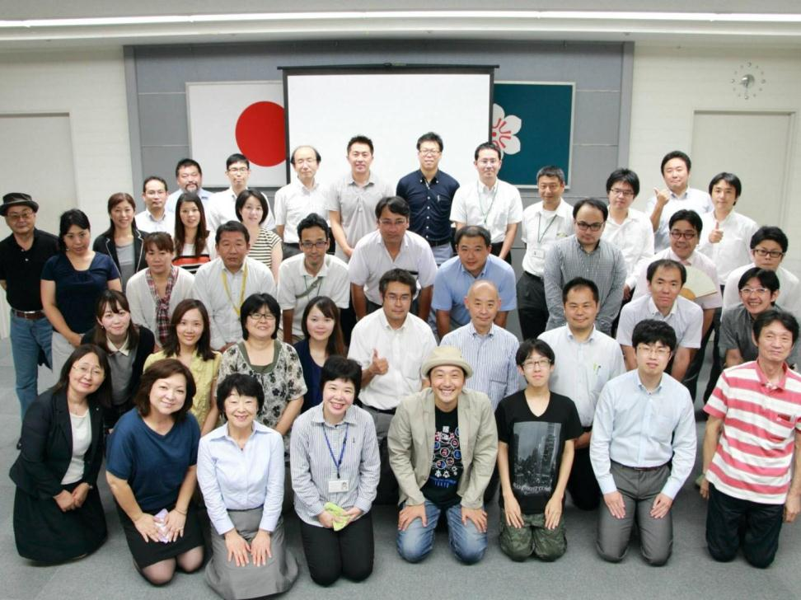
Small success first!! Enhance opportunity of data utilization

Slide 23
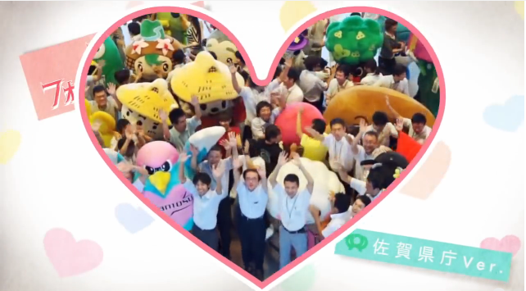
Society changes into a better direction by producing a new thing. want to be such a community
Culture to produce something new
新しいものを生み出す風土

Slide 24
Thank you

