Slide 1


Private Utilization Promotion of Public Data (Open Data) in Fukui Prefecture
General Policy Department of Saga prefecture, Policy, statistics and information division
December 2014

Slide 2
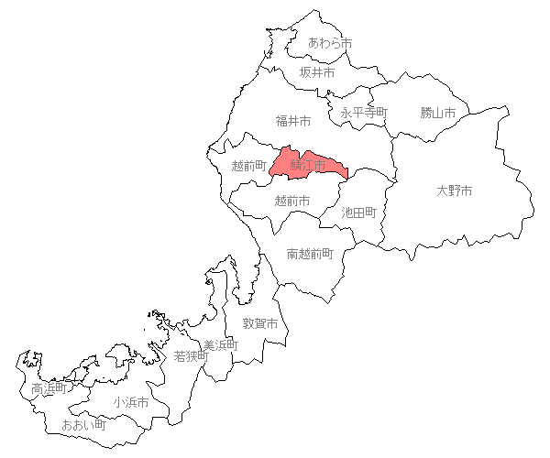
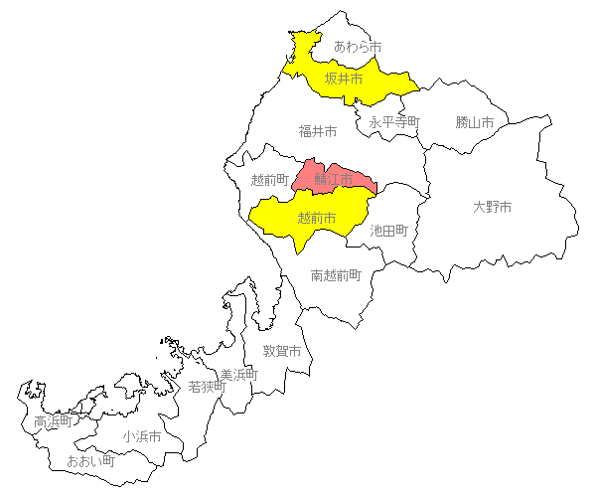
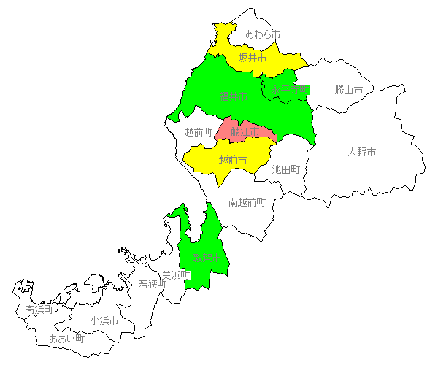
１ The background why Fukui begins open data
Eiheiji City, 6th
March 12, 2014
Sakai city, 2nd
May 8, 2013
Fukui city, 5th
February 1, 2014
Tsuruga city, 4th
November 29, 2013
Sabae city, 1st
January 30, 2012
Echizen city, 3rd
June 24, 2013
－１－

Slide 3
２ Outline of open data promotion in Fukui prefecture
Launching the open data by establishing "Fukui open data library" in the prefecture homepage on December 26, 2013.
○ List of public data (released in CSV excepting map & images)
・Prefectural original data 94 data (759 files)
・Joined published data of prefecture and all cities 4data (40 files)
(“Public facility information” owned by prefecture and cities, a list of garbage collection, a list of waste classification and a list of evacuation area)
○List of applications which utilize the data of the library
・"Fukui opening event navigator ", the application offered by the prefecture.
→ Developed by outsourcing to show “ability “of open data concretely.
(The application is released as open source to promote application development.)
・ Introduction of application for the public data utilization 6 applications
○Entries of the Fukui Web Application Contest
・A result of application contest that utilized the public data of the library and the introduction of the applications entered.(Application reception: By the end of February, 2014. The number of entiries: 21 works (12 within the prefecture, 9 outside of the prefecture)
Main contents of “Fukui open data library”
－２－

Slide 4
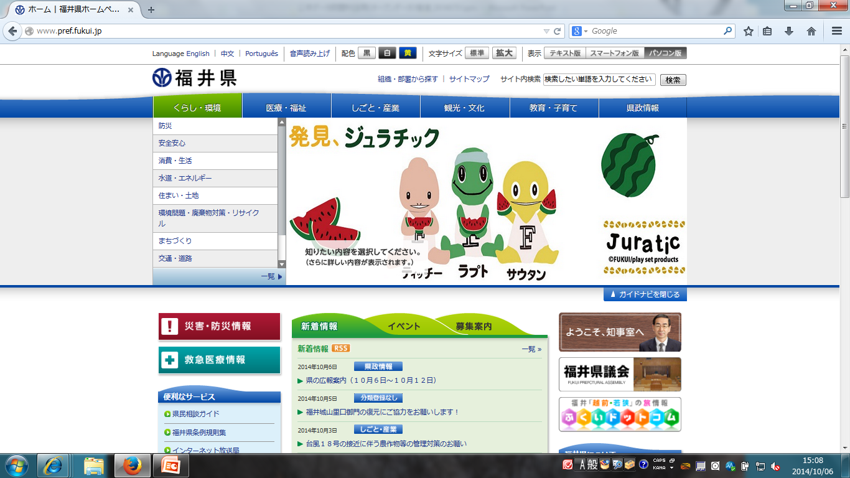
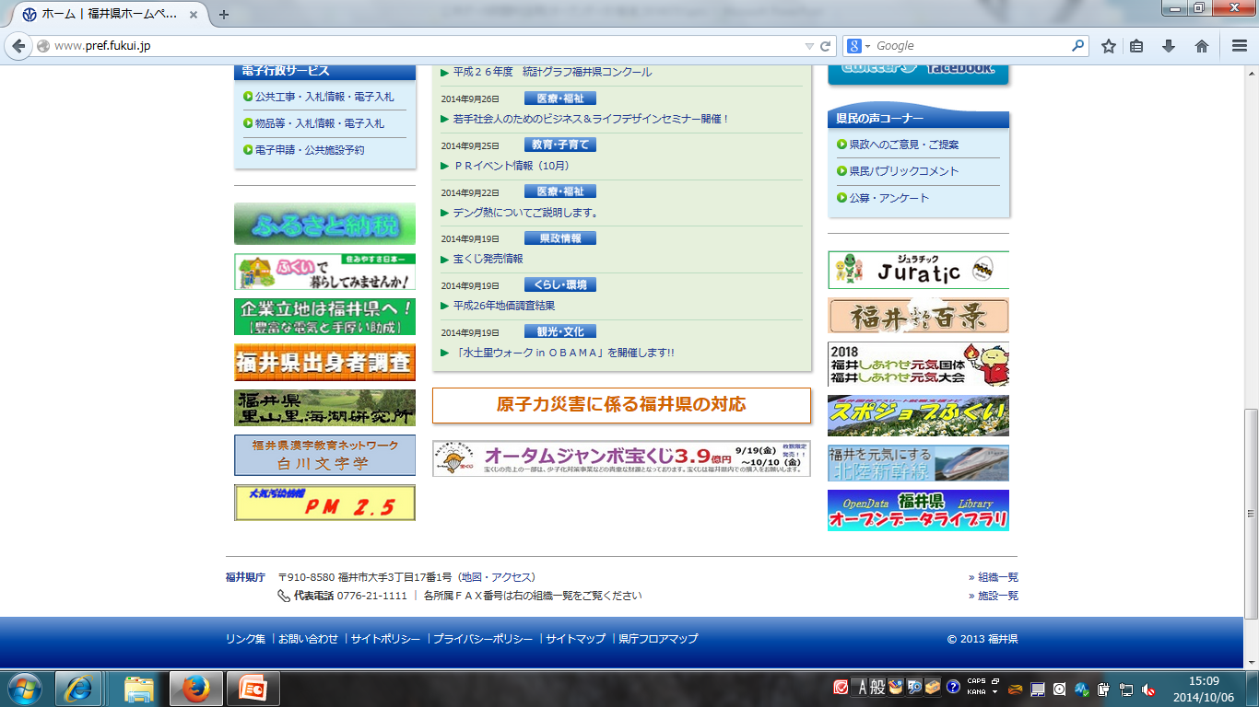

２ Outline of open data promotion in Fukui prefecture
The banner is installed in the lower right of the prefecture top page.
－３－

Slide 5
３ Features of the open data in Fukui prefecture
①Promotion within the prefectural government (small start)
【Organization】 Starting from the study meeting consisted of the young people of each department.
⇒ Study about “open data” which is unfamiliar to them and increase understanding.
⇒ Implement into all offices in 2014 FY.
【Objective Data】Starting from the light work for the offices without making rules.
⇒ The data already released on the homepage will not be the problem if it is released as the open data….
⇒ Judgment of open data release is responsible for the section who owns data.
[Work] Starting to open to the public with minimum task of the section who owns data.
⇒ Only submit the electronic data in format of Excel, Word, PDF to the Policy, Statistics and Information section
⇒ Conversion to the CSV format and publication to the open data library are done by the Policy, Statistics and Information section.
－４－

Slide 6
３ Features of the open data promotion in Fukui
②Cooperation with cities.
Situation in the city
3 groups were already in a stage of work for the open data including Sabae city. 2 groups were in a stage of planning.
Impression was inconvenient after using the Web application because the data could be used only within the city
It is inconvenient and ineffective for users if the data has different contents and is in different format.
Role of prefecture
Create a standard of contents and format of the open data for each municipality and make it easier for the users to use.
Promote the open data as a whole prefecture by making it easier for municipalities who do not handle the open data yet to deliver the data easily.
Development of the application which can be used in a wide area becomes possible by releasing the data in standard contents and format of all municipalities.
Organization
Establishment of “Working group for private utilization promotion of public data” in the Fukui e-municipality promotion consultation consisted of senior directors(主管課長)who are in charge of information of the prefecture and all 17 municipalities.
Release of the agreed data discussed in the working group by collecting and setting them into the standard contents and format by the prefecture.
Release of the 1st version of public facility information owned by the prefecture and municipalities.
－５－

Slide 7


４ Considerations for the future
◆No expansion of open data utilization, no application development.
◆No effective business model utilizing the open data.
◆No response to the publication of open data.
■ Cooperation of the open data beyond a border in prefectural and city government (standardization of the data format)
■Mashup of the public data and the private data.
■ Continual dialogue with the open data users (IT business operators).
－６－

Slide 8
Local industry and local specialty in Fukui
General Policy Department of Saga prefecture, Policy, statistics and information division
December 2014

Slide 9

１ Local industry in Fukui
Fiber sector and the eyeglass sector have the largest market share nationwide.
There are many highest shipment values in local and traditional industry field such as in fiber, eyeglass frame, Japanese paper and lacquer ware.
The prefecture accounts for 95.9% of national shipment value of the eyeglass frame.
・The technique of Fukui is utilized into resistors of cellular phones, condensers, coating of electronic components and body painting, and furthermore contributes to a reduction in size and weight, development of high function, creation of high added value and implementation of higher service.
Search for
“Actually, the technique of Fukui!”
－７－

Slide 10

２ Special product of Fukui
Flame of glasses
Wakasa fugu
Echizen Oroshi-soba
Echizen crab
Koshihikari (rice)
Koshino Ruby
(Midi-tomato)
Fukui ume
－８－

Slide 11
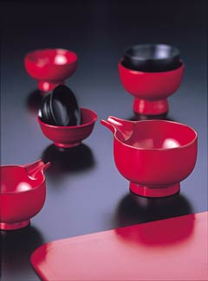
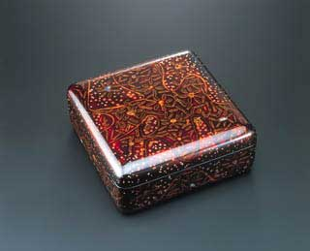
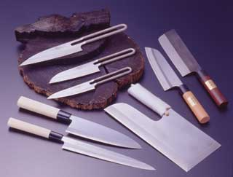
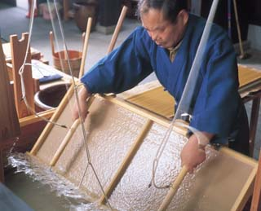
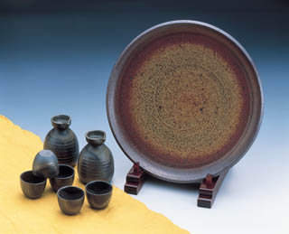
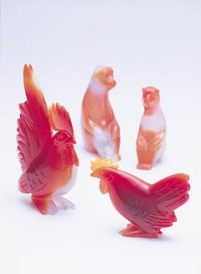
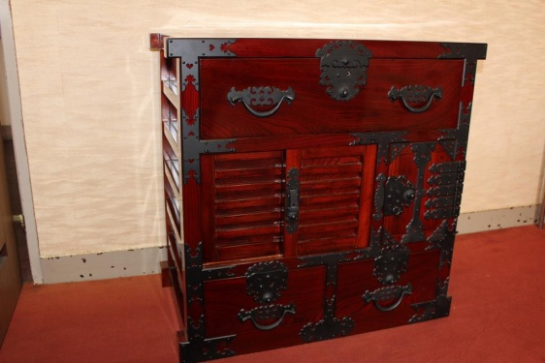
３ Fukui Traditional Crafts
Echizen shikki
(Mainly manufactured in Sabae city)
Wakasa-nuri
(Mainly manufactured in Obama city)
Echizen Uchihamon
(Mainly manufactured in Echizen city)
Echizen washi
(mainly manufactured in Echizen)
Echihizen-yaki
(Mainly manufactured in Echizen city)
Wakasa meno-zaiku
(mainly manufactured in Obama city
Echizen Tansu
(Mainly manufactured in Echizen)
－９－

Slide 12
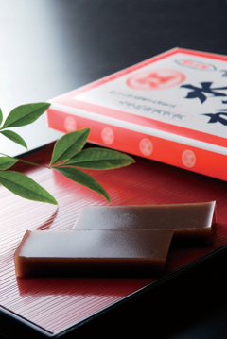

Thank you
Please come to visit Fukui prefecture, “the happiest in Japan”
The one we have enjoyed in a winter in particular as the taste of the home in snowy district Fukui from the prewar days is the soft adzuki-bean jelly originated from Fukui. It is made with a good mixture of adzuki, agar, coarse sugar and brown sugar, in particular the flavors of the brown sugar is fragrant slightly. People tend to think that the soft adzuki-bean jelly is eaten in summer, but in Fukui, we cool it and eat them warming ourselves in Kotatsu of a warm room.

