Slide 1



Open Data Activities of the Ministry of Economy, Trade and Industry
December, 2013
Ministry of Economy, Trade and Industry
For copying, distributing, displaying and performing a part of this file, you are requested to describe the name of the copy right holder (METI).
However, in case of photos and figures with the description of the source, CC-BY is not applicable to them.
(Copyright) Ministry of Economy,Trade and Industry

Slide 2
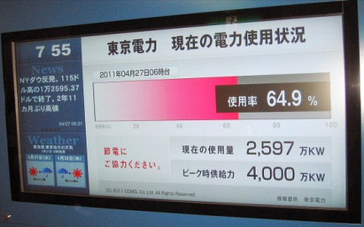
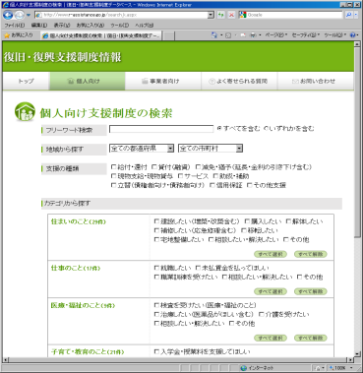
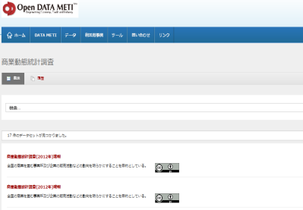
Chronology of Activities of METI
2008
2008.10 Started consideration in the government CIO forum.
2009
2009.3 Announced“E-Government One Point Focus Project”
2009.10 Implemented “Idea Box”
Development
Example
2010
2010.7 Installation of “Open Government Laboratory” ★
2011.7 Inaugurated “setsuden.go.jp” ★ Upon making the power demand / supply data open, an application suited to users’ needs was voluntarily developed.
2011
2011.10 Making “Character Information Base” Open ★
  Free release of character information base which enabled external character entry with which PCs so far could not deal.
2012.1 Making “Disaster Reconstruction Support Measures Database” Open ★
  One-Stop DB which enables retrieval of disaster-hit area assistance measures after the Great East Japan Earthquake that have been separately undertaken by the government and local authorities.
2012
2012.7 Announcement and Implementation of DATA METI Concept
Environment consolidation for opening data owned by METI as well as revitalization of economy by open data.
Reconstruction Support
Measures Database
2012.8 Installation of Government Data Working Group
Installation of Government Data working Group consisted of private sector experts, and consideration of rule setting.
2013
2013.1 Installation of “Open DATA METI” (β version)
The data catalogue site that was the first ever such site created by government offices. It targets METI’s data.
2013.3 Proposed the measures to be taken as the next step in the E-Government Open Data Working Level Meeting
Open DATA METI
2013.10 Organizing Government Data Working Group
Review of the progress of open data.
Open Government
Open Data
★：Cross-Cutting Matters involving other Ministries

Slide 3
Open DATA METI Concept
Environment consolidation for open data targeting data owned by METI itself followed by actual open data promotion. It also aims at being the model for exemplification to the government as a whole. The development of social infrastructure with which enterprises do their businesses making use of open data of the government will help the revitalization of the Japanes economy.
1. Provision of Data owned by METI
2. Consideration of Technology and System
3. Construction of Data Portal Site
4. Creation and Share of Open Data Utilization Cases
5. Utilization by Residents and Businesses
6. Recognition of Needs and Challenges
Extension to Comprehensive IT Strategy Office and Other Government Offices
Provision of Data from those Ready for Going Public
Improvement of Data Provision System based on the Feedback Earned
Identification of Technical
and Systemic Issues
Reporting Challenges Relevant to the Government as a Whole
Feedback of Needs and Challenges regarding Use of Government Data
Provision of Technology (Machine-Readability, API, LOD Conversion) and System for Promotion of Data Utilization
Implementation of Needs Analysis and Seeking Cooperation from Communities
Provision of User-Friendly Data Supply Environment
Introduction of Data Utilization Cases, and Assistance for Data Use
Feedback of Knowhow and Wisdom
Earned in the Course of the Implementation
Showcasing
Model Cases
2

Slide 4
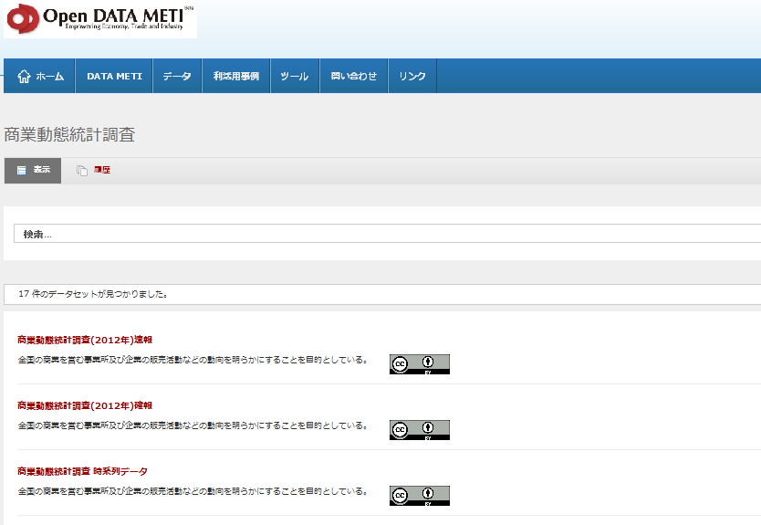

Construction of Open DATA METI Site
The open data catalogue site that deals with METI’s open data, ”Open DATA METI” (http://datameti.go.jp/ ), was released in Jan. 2013 , which was the first ever such open data catalogue site created by the government office.
CC license is clearly posted to each data, which sensibly shows the conditions of data usage.
Current Use Situation (as of Nov. 30, 2013)
No. of Page Views app. 214,000 times
No. of Downloads app. 8,400 times
No. of Posted Data app. 630 datasets
Current Registered Data (as of Nov. 30, 2013)
Data related to Priority Fields (White Papers, Disaster Prevention / Reduction, Geospatial, Human Mobility Info., Budget, Settlement, Procurement）
Major Statistical Info. (Industrial and Commercial Statistical Survey, etc.) , etc.
3

Slide 5
Release of Open DATA METI Application Profile
Release of Description Rules (Application Profile) of Meta Data which Defines Vocabularies for Meta Data, and Description Forms of Vocabularies.
The Purpose is to show clear structure of data catalogue info., and to facilitate the easy data utilization.
It aims at realization of lowest cost compatibility with domestic and global major systems and others.
International Meta Data Systems & Vocabulary Systems
METI
Government
Compatibility
Compatibility
Trial
Data Catalogue Site
DCAT
Open DATA METI
Schema.org
Common Vocabulary Base（IMI）
DC-NDL
＜Examples of Compatibility (Dataset Level)＞
DCAT
Publisher
Contact Point
No Measures
Frequency
Description
Version
Open DATA METI
Publisher | Name of Publisher
Contact Point | Name of Responsible Department
Creator | Name of Creator
Frequency | Frequency of Publication
Notes | Explanation
Version | Version
Trial Data Catalogue Site
owner_org | Name of Organization
Publisher | Name of Publisher (Department)
Author | Name of Author
Frequency of Update | Frequency of Updating
Notes | Explanation
No Measures

Slide 6
Outline of Common Vocabulary Base
（IMI：Infrastructure for Multi-Layer Interoperability)）
Common vocabulary base means reference dictionary of vocabulary which makes the confirmation of identity of various data as well as inter-system linkage and open data use easy.
This sort of device is indispensable for reuse of data among plural institutions.
The importance of the development of common vocabulary base is clearly stressed in the Declaration of the Creation of the Cutting-Edge ICT Nation.
Vocabulary
API
Requirements for Cross-Cutting Information Exchange are :
・Unification of Basic Formats
・Recognition of Same Meanings
among Different Languages
if the Meanings are the Same.
・Clarification of Different
Meanings of the Same Word
Core
Vocabulary
Information Exchange Package（IEP)
Name
Address
Organization
API
Source ：http://goikiban.ipa.go.jp/node/20130925/

Slide 7









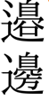






Outline of Character Information Base
Free release of about 60,000 letters required in the public service.
  IPAmj Mincho Font ：Equipped with about 60,000 letters in compliance with the international standard.
  List of Character Information ： Information of relations with characters of other systems is provided.
Character Information Base：IPAmj Mincho Font (58,813 Letters in Chinese Characters)
Standardized Characters for Family Registration (55,250 Letters in Chinese Characters)
Letters Compiled for the Use for Online Family Registration (Compilation based on dictionary)
Standardized Characters for the Basic Resident Register Network System
(19,563 Letters in Chinese Characters)
JIS Chinese Character Code (10,050 Letters)
Compiled Letters being used for Family
Names and Given Names by Many Residents
Chinese Characters Designated for Daily Use (2,136 Letters)
Selected Letters based on the Necessity for Practical Information Exchange and frequency of use.
（JISX2013:2004）
It is the yardstick for use of Chinese characters in writing the modern Japanese language in the social life including legislation, public documents, newspapers, magazines, broadcast, etc.
Source ：http://mojikiban.ipa.go.jp/

Slide 8
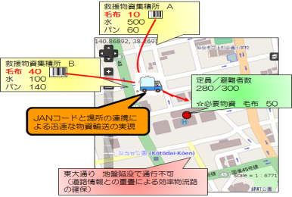



Creation and Share of Open Data Utilization Cases
Activities in the Fiscal 2012
  Created the Data Catalogue, in Collaboration with Local Authorities, with the Themes of Tourism, Disaster Prevention, Area Marketing, and Infrastructure Development.
  Earned the Cost Estimation Work Contents of Open Data based on the Public Data (Tourism and Disaster Prevention) owned by the Kita Ward Office of Tokyo. Implemented the Verification Test from the Viewpoint of Cost Reduction.
Activities in the Fiscal 2013
  Implementation of Verification Test Making Use of Public Data for Examining the Service Models in Collaboration with Private Sector Data Aiming at Creation of New Services.
  Catalogue Preparation of Data of Local Authorities, and Identification of Technical and Systemic Issues that might Affect the Promotion of Open Data Utilization.
  Preparation of Tools Necessary for the Promotion of Utilization of Government and Public Open Data.
  Identification of New Models of Open Data Utilization, through Contests, etc., and Consideration of Necessary Measures.
Model Verification Tests in the Fiscal 2013
● Public / Private Collaboration Model for
Products Information
Public / Private Collaboration Model for Realization of Efficient Storage and Management of Supplies Making Use of Supply Chain Framework.
● Public / Private Collaboration Model for
Public Infrastructure Information Mgt.
Public / Private Collaboration Model for Underground Installation Mgt. and Realization of Disaster Simulation.
● Public / Private Collaboration Model for
Local authorities’ Data Processing
Model for Processing Local Authorities’ Data into Machine-Readable Format, on their behalf, by Incorporated NPOs for Open Data.
Road Info.
通行止め
Water & Sewer Info.
Data Reception
Gas Info.
Electric Power Info.
工事中
Telecom. Info.
Local Authorities
Processing & Provision
NPO

Slide 9
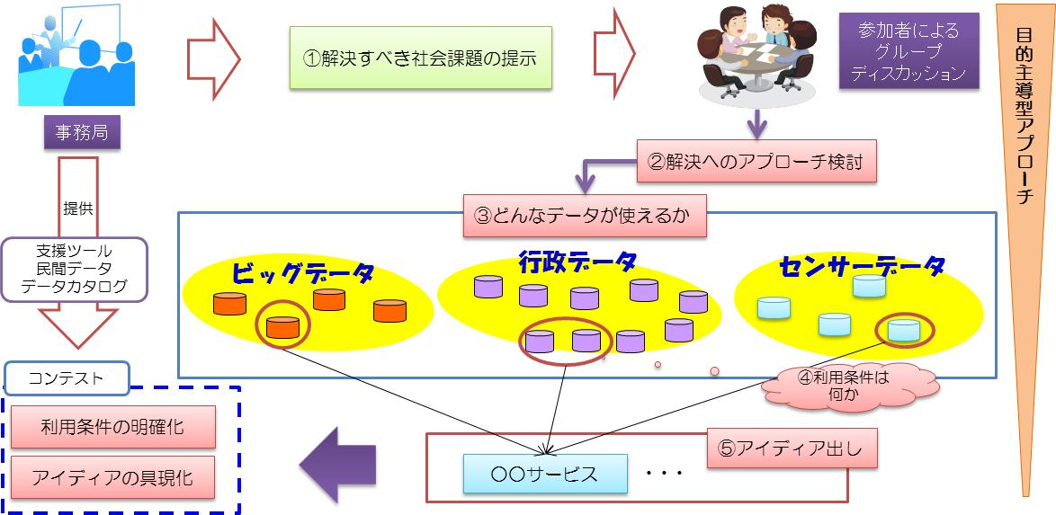
Utilization by Residents and Businesses (Social Issue Solution Type Contest)
For the Promotion of Government and Public Open Data and for the Creation of New Cases of Open Data Use, a Contest in which Making Use of Data and Tools being Developed in the Fiscal 2013 is Required.
Characteristics：Shift from Individual Optimum to Total Optimum
Realization of Purpose-Driven Data Use Cases through a Contest with Themes Set by the Organizer.
Social issues vary from place to place. Only local residents are well versed with the data required for the solution of local issues. From this point of view, plural idea-thons will be organized in cities as well as rural areas.
Participating local authorities are required to clearly notify the rules of open data. Thus it will contribute to the promotion of open data from ministries and local authorities.
Organizing Idea-Thons
Implementation of “Issue Solution Type Idea-Thons”, with the themes of local issues, to identify effective ways of usage of data owned by the government and local authorities.
 | Osaka | Tokyo | Matsue
Sub Title | Creation of New Business by Utilization of Open Data | Can Open Data Change the Rules and Regulations? | Open Data in the Local Perspective
Date | Nov. 9 (Sat) | Nov. 21 (Thu) | Nov. 26 (Tue)
Venue | Grand Front Osaka | Institute of Industrial Science, The University of Tokyo | Matsue Open Source Laboratory
Organizing Open Data Use Case Contests
Organizing contests to invite cases of utilization of open data of government and public sources which materialize the ideas and concepts proposed in idea-thons. Cases may include applications and services, etc.
 | Tokyo | Osaka
Date | February 7 (Fri) Afternoon (TBD)
Venue | Tokyo International Forum | Grand Front Osaka
※ Commendation of excellent products and presentations will be simultaneously held by webcast connecting the two venues.
Notes:
本日は有り難うございました。

Slide 10
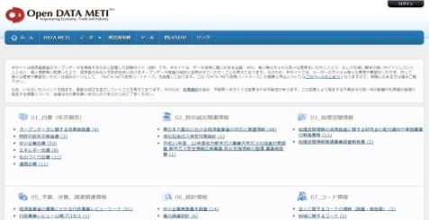
METI’s Future Activities for Open Data
METI
Open DATA METI
Information Sharing Base
・Trial as Japan’s First Ever Data Catalogue Site.
・Installation of the World’s Top Level Meta Data, and
Examination of LOD Utilization.
・Identification of Knowhow, Issues and Improvement
Measures Regarding Operation of Open Data.
・Construction of Data Base of Common Vocabulary
Base
・Verification Test by Local Authorities Making Use
of Common Vocabulary Base
・Dissemination & Promotion of Textual Data Base
Base Development Necessary for the Promotion of Open Data of Japan
Promotion of Information Provision to Government Offices and Local Authorities
・Construction of a Webpage for System Developers in Open DATA METI so that They Get Knowhow (Meta Data, Tools, FAO, etc.) for Developing New Services Making Use of Open Data.
・Proposals to Various Meetings Related to the Comprehensive IT Strategy Office.
・Provision and Promotion of Application Profile and Common Vocabulary Base.

Slide 11
Thank you for your attention.
For queries or comments, please contact
wada-takashi@meti.go.jp

